Slide 1
Summary of Performance (or SOP for TOP)
SETTING THE STAGE FOR HELPING YOUR STUDENTS CONNECT WITH THE REAL WORLD.

Slide 2
Welcome & Purpose
Brief overview and discussion on:
The summary of performance requirement with sample
Preparing supporting documentation for community agencies

Slide 3
What IDEA Says:
The Summary of Performance (SOP) is required under the reauthorization of the Individuals with Disabilities Education Improvement Act of 2004 (IDEA 2004). The language as stated in IDEA 2004 regarding the SOP is as follows:

Slide 4
What IDEA Says:
“For a child whose eligibility under special education terminates due to graduation with a regular diploma, or due to exceeding the age of eligibility, the local education agency shall provide the child with a summary of the child’s academic achievement and functional performance, which shall include recommendations on how to assist the child in meeting the child’s postsecondary goals”.
(300.305)

Slide 5
Focus on SOP Documentation:
What the law says:
“…shall provide the child with a summary of the child’s academic achievement and functional performance, which shall include recommendations on how to assist the child in meeting the child’s postsecondary goals”.

Slide 9
Who Gets A SOP?
Must: Students graduating with a general education diploma to assist them in meeting their post-secondary goals
Must: Students leaving school because they exceed the age of eligibility for a free appropriate public education (end of school year in which they turn 26) to assist them in meeting their post-secondary goals.
Recommended: School districts provide for students who leave school before age 26 and have not met the requirements of the Michigan Merit Curriculum.

Slide 11
SOP: Where’s the Data Coming From?
The Education Development Plan (EDP).
REEDs, METs, School data, teacher reports, social work reports, other ancillary reports, others?
Include dates of reports, academic assessments (state or district), transition assessments, vocational assessments and staff updates.
Academic achievement: Cognitive ability/approximate IQ, Information on reading, math, and language grade levels, standardized scores, or strengths.
Functional performance: learning styles, attitudes, social skills, independent living skills, self-determination, career/vocational skills, decision making, independent living, motor, social behavioral, communication, community living.

Slide 12
SOP: Where’s the Data Coming From?
The results college entrance examinations (e.g. SAT, ACT)
Honors or special awards
Student perspective (see suggested form)
Whether the student is graduating with a general education diploma
Other exit document like a locally-issued certificate
Student portfolios
Work experiences during high school
Extracurricular accomplishments

Slide 13
SOP: Where’s the Data Coming From?
Recommendations: Team suggestions for accommodations, assistive services, compensatory strategies for post-secondary education, employment, independent living, and community participation.
Think: For example: What do college faculty and staff need to know to best support students with disabilities in post-secondary education setting.
Or: What does a agency need to know to support a student find a job or be successful in the workplace?
Problem: Not binding
But Remember: Information does show likely need.

Slide 15
What Are Data Challenges?
Old MET
Transfer Students
MRS/Other agencies would like new evaluation
REED may recommend no additional data
Lack of educational funds and staff
Other?

Slide 16
SOP: DEFENDING YOUR DATA-THE BIG 3
Will “IT” describe your student in “current” terms?
Will “IT” support accommodations and services needed for student success?
Does “IT” come from a multiple data sources?

Slide 18
When Is The SOP Completed?
Completed during the final year of a student’s school education
The timing may vary depending on the student’s post-secondary goals
If a student is transitioning to higher education, the SOP may be necessary as the student applies early to a college or university

Slide 19
Focus On SOP Timing
It may be most appropriate to wait until the spring of a student’s final year to assure the student can provide an agency or employer the most updated information on their performance

Slide 20
SOP Best Practice
Present SOP within the context of an exit interview.
Structure conversation around student self-advocating for needed supports.
Set expectation for follow-up SPP B-14 survey.
Follow-up SPP B-14 survey response rates seem to increase with exit interview.

Slide 22
Who Is Your Audience For The SOP?
MRS (Michigan Rehab Services)
Bureau of Services for Blind People
Post-secondary education/training
Other Community Agencies (Community Mental Health, others)
Employers
Others?

Slide 24
What Does An Agency Need To Know?
Strengths/capabilities
Academic Information
Functional Limitations
Vocational Experiences (work study)
Interests
Work ethic
Ability to work cooperatively with others
Related factors/Family supports/Transportation
Motivation/Initiative
Others?

Slide 25
Challenges for An Agency?
Current relevant information
Unusual career goals
Lack of student work experience
Impact of staffing and funds
Attending IEPs
Work Study Opportunities
Student/Family follow up to complete the intake process post referral

Slide 26
Some Guidelines: Summary of Performance
Information based on assessment findings and team input
Who is on the team?
Assessment data and accommodations written in functional terms understood by student
Any supporting documents appropriately referenced and included
Signatures by student and team members encouraged as verification contents have been explained and copy provided

Slide 28
What Are Some Websites to Support Student PSGs?

Slide 29
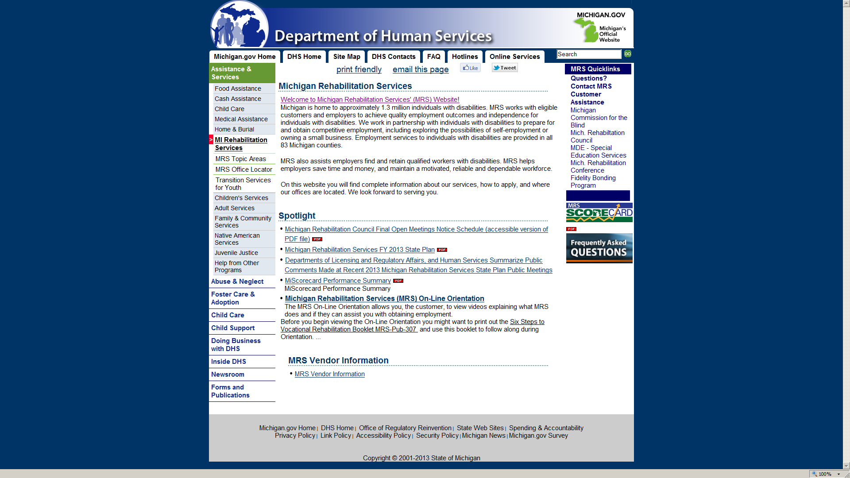

Slide 31
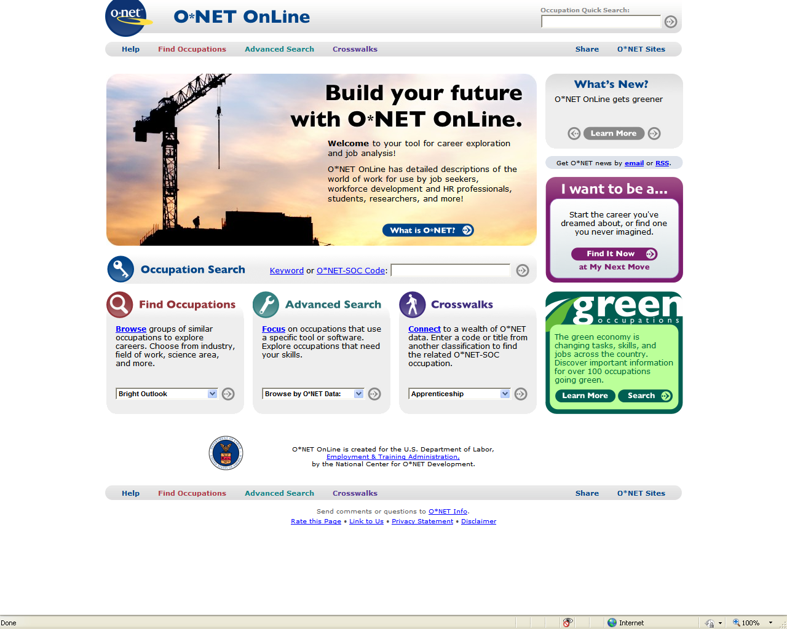

Slide 35
SOME WEBSITES TO REMEMBER
Wayne RESA School-Wide Positive Behavior Support
http://www.resa.net/curriculum/positivebehavior/
Michigan Rehabilitation Services now under Department of Human Services http://www.michigan.gov/dhs/0,4562,7-124-5453_25392---,00.html
Michigan Commission for the Blind now called Bureau of Services for Blind Persons
http://www.michigan.gov/lara/0,4601,7-154-61256_28313---,00.html
Ed Gov- Secondary Transition
http://idea.ed.gov/explore/view/p/%2Croot%2Cdynamic%2CTopicalArea%2C14%2C
Community Mental Health
http://www.waynecounty.com/hhs_mh.htm
http://www.michigan.gov/mdch/0,4612,7-132-2941_4868_4899---,00.htm
O*Net Resource Center
http://www.onetcenter.org/overview.html

