Slide 1
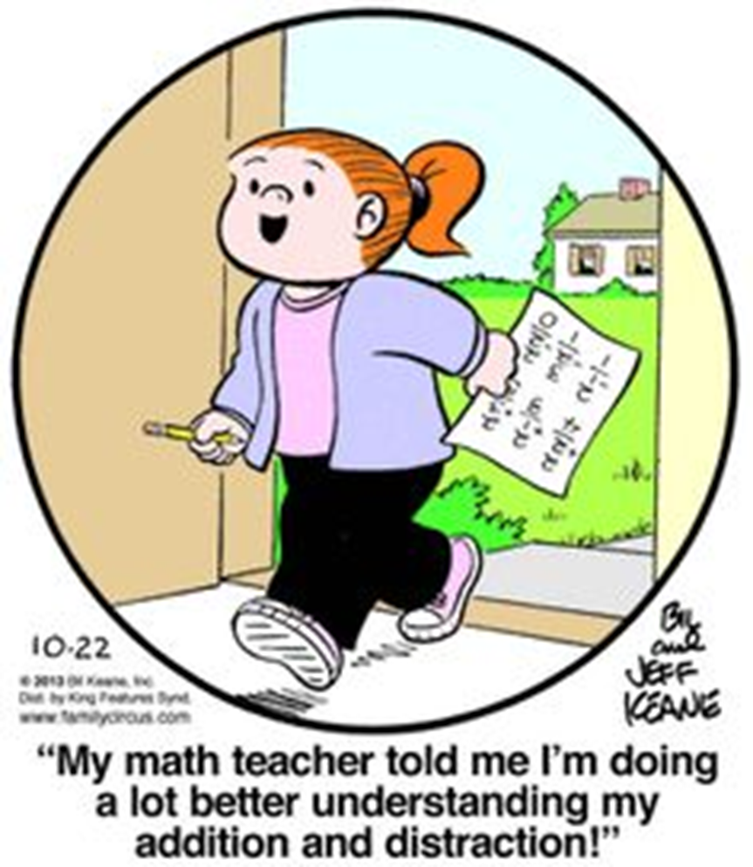

Slide 2

Personal Curriculum explored through
Special Education lenses
Wayne RESA
Special Education Services
Darnella Delfine

Slide 3

16 credits
18 credits 2016

Slide 4
Michigan Merit Curriculum
18 credit hours for graduation.
Content expectations/standards for each of the credit requirements.
Assessments to assure earned credit based on competency must be developed/ implemented by each district.

Slide 6
District Code | District Name | Building Code | Building Name | 1-English Language Arts | 2-Math | 3-Science | 4-Social Studies | 5-VPA | 6-World Lan | 8-Health /PE | 1-IEP | 2-Transfer | 3-General Enhanced | 4-General Modified
82030 | Dearborn City School District | 886 | Dearborn High School |  | 46 |  | 8 | 13 |  | 2 | 18 | 6 | 18 | 27
82030 | Dearborn City School District | 86 | Dearborn Magnet High School |  | 2 |  |  |  |  |  | 2
82030 | Dearborn City School District | 1092 | Edsel Ford High School |  | 19 |  | 1 | 3 |  |  | 11 | 1 | 3 | 8
82030 | Dearborn City School District | 1261 | Fordson High School |  | 16 | 1 | 2 | 6 |  | 1 | 13 | 8 | 1 | 3
82055 | Grosse Pointe Public Schools | 1512 | Grosse Pointe South High School |  | 1 | 1 | 3 | 42 | 1 | 357 |  |  | 382 | 1
82055 | Grosse Pointe Public Schools | 5142 | Grosse Pointe North High School |  | 3 | 1 | 1 | 28 |  | 153 |  |  | 174
82140 | South Redford School District | 2149 | Lee M. Thurston High School | 1 |  |  |  |  | 1 |  |  |  |  | 1
82160 | Wayne-Westland Community School District | 660 | Tinkham Alternative Education |  | 2 |  |  |  |  |  |  |  |  | 2
82160 | Wayne-Westland Community School District | 1950 | John Glenn High School | 2 | 8 | 19 | 5 | 2 | 17 | 33 |  |  | 9 | 36
82160 | Wayne-Westland Community School District | 4407 | Wayne Memorial High School | 2 | 33 | 23 | 2 | 6 | 75 | 100 |  |  | 15 | 123
82160 | Wayne-Westland Community School District | 9241 | Wayne-Westland Adult and Community Education |  | 1 |  | 1 |  | 1 | 1 |  |  |  | 2
Personal Curriculums across Wayne County

Slide 7


Personal Curriculum Defined
“The legislative intent of the Personal Curriculum is to individualize the rigor and relevance of the educational experience and provide a tool to help ALL students succeed with the Michigan Merit Curriculum.”
PC guidelines 2009

Slide 8

Personal Curriculum Defined
The Personal Curriculum (PC) is a process to modify specific credit requirements or content expectations based on the individual learning needs of a student.
It is designed to serve students who want to go beyond the Michigan Merit Curriculum (MMC) requirements and
students who need to individualize learning requirements to meet the MMC requirement.

Slide 9

Personal Curriculum
A Personal Curriculum may be requested for a student that modifies certain areas of the Michigan Merit Curriculum standard requirements.
If granted and all of the requirements for a Personal Curriculum are met, then the local school board may award a high school diploma to a student who successfully completes his or her Personal Curriculum, even if it does not meet the requirements of the Michigan Merit Curriculum standard.
The Personal Curriculum will be considered only after all other options have been attempted, and must meet stringent requirements for determining educational goals and evaluating student progress
Notes:
A list of procedures and steps, or a lecture slide with media.

Slide 10
Prior to considering a PC
Consider …..
What instructional strategies have been used student?
What type of accommodations and supports are in place?
What interventions have been implemented with the student?

Slide 11
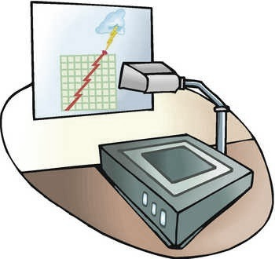
Step 1 Request

Slide 12
Who can request a Personal Curriculum?
A personal curriculum may be requested by:
The parent or legal guardian of a student (380.1278b(5))
A student who “is at least age 18 or is an emancipated minor” (380.1278b(5)(m))
School personnel, based on the “general powers” provision of the Revised School Code (380.11a)
  Current teacher or teacher with expertise/relevant knowledge
  Student’s counselor or acting counselor
MDE PC Guide

Slide 13
Parent Requests
Requests for student without an IEP – after 9th grade.
“Parents of students with an IEP can begin to explore the PC option as early as the 7th or 8th grade when the EDP is being developed.
If granted, the PC goes into effect when the student enters high school. Parents of students with an IEP may also request a PC at any point during the student’s high school career.”
MDE: A Parents Guide to Curriculum: Focus on
Students With An IEP

Slide 14
PC Requests (in effect April 2015)
“If requested by the allowable parties, a PC must be developed”
Does not mean the PC has to be approved
Has to be agreed upon by the parent/ or legal guardian and the superintendent or designee
REMEMBER: The district still has the last say in what modifications can lead to a diploma
  No appeal process
  No recourse
  They can try again
MDE: A Parents Guide to Curriculum: Focus on
Students With An IEP

Slide 15
PC Team
Student
Parent
Counselor OR
Current Teacher (expertise in content being modified)
School Psychologist should attend for student with IEP

Slide 16
PC Team’s Role
Decide whether the student is eligible for a PC
Identify what part(s) of the MMC will be modified
Create a written PC plan that includes measurable goals and an evaluation plan
Create a quarterly progress monitoring system led by parents with each teacher in modified area.
The PC must be agreed upon by a pupil's parent or legal guardian and the superintendent of the school district or chief executive of a public school academy or his or her designee

Slide 17
Helpful documents for team
Helpful information for a PC team:
  Student’s Educational Development Plan
  Student’s IEP (If applicable)
  Student’s current transcripts
  Student’s attendance records
  Students discipline records
  Student’s academic records and test results (district, state, national)
  NCAA Clearinghouse list of Eligible Courses
  Course Guide
  Class Syllabus (for course being considered and/or modified)

Slide 18
PC Modifications: Not Needed
The majority of students will not need a PC in order to meet the MMC graduation requirements. No PC is needed to:
Test out/ Seat Time waivers
Spread Algebra II credit out over 1.5 - 2 years. (Full credit for each semester).
Earn credit for Algebra II for content embedded in a formal career technical program.

Slide 19
Mathematics Modification
 | 1 Credit | 1 Credit | 1 Credit |  | 1 Credit | Total Credits
MMC without PC | Algebra I, Algebra II and Geometry (no sequence required) |  |  |  | Final year math or math-related credit | 4
MMC without PC Modification allowing Algebra II over 2 years for 2 credits | Algebra I and Geometry (no sequence required) |  | Algebra II |  |  | 4
MMC without PC Modification after successful completion of minimum of 2 math credits | Algebra I and Geometry (no sequence required) |  | Algebra II Content in other program |  | Math or math-related credit | 4
MMC with PC Modification after successful completion of 2.5 math credits | Algebra I and Geometry (no sequence required) |  | Algebra II ½ credit |  | 1 Math or math related credit in final two years | 3.5
MMC with PC Student with IEP/ Modification allowed upon entering high school | Whatever is practicable (as determined by state guidelines, the board policy and the PC team)

Slide 20
PC Modifications: Not Needed
Students not pursuing a diploma would not qualify for a PC.
Special education students who do not receive a diploma have FAPE rights until the age of 26.
Certificate of completion/ attendance/participation documents are not recognized by the State and do not end FAPE rights

Slide 21
Local Graduation Requirements
District Credit Hours
Allen Park 22
Dearborn 23
Detroit 23 Grosse Pointe 21
Lincoln Park 23.5-23
Livonia 23
South Redford 23
Wayne Westland 22
Other Requirements
Take/attempt the MME
Out class learning/Community Service/ Work

Slide 22
PC Modifications: Not Needed
Districts cannot reduce the number of credits below what MDE has required
HOWEVER
They can reduce the number of credits they (District) require without a PC
Ex. From 23 credits to only the 18 required by the state.
Local Graduation Requirements
CAUTION!!!

Slide 23
PC Modifications: Not Needed
Remember FAPE:
If you offer an option that only requires the MMC credits for students with IEPs – make sure that option is also available for other students.
IDEA – “Include the award of credit and diploma for completion of academic requirements to the same extent the credit is awarded to students without disabilities”
Local Graduation Requirements
CAUTION!!!

Slide 24
PC Modifications: Not Needed
Districts cannot eliminate specific requirements that MDE has required
HOWEVER
They can eliminate any of their (District) requirements without a PC
Ex. Drop the community service component of their graduation requirement.
Local Graduation Requirements

Slide 25

PC Modifications: All Students
State law also encourages local school boards to ensure that all students receive access to the Michigan Merit Curriculum via "alternative instructional delivery methods" (380.1278b(7)). Traditional coursework does not facilitate curricular access and demonstration of proficiency for all students; diverse delivery methods, interventions, and supports should be implemented to ensure access to the full, unmodified Michigan Merit Curriculum before a personal curriculum is considered.

Slide 26
PC Modifications: GE
A personal curriculum may be requested for any student in order to:
Reduce the Algebra II requirement from 1.0 credit to 0.5 credit.
Exchange the 1.0 PE/Health credit, 1.0 Visual, Performing, and Applied Art credit, and/or 1.0 social studies credit (excluding civics) for additional credits beyond those required in English/language arts, math, science, and/or world languages.
(New) Substitute a formal CTE program for up to 1.0 PE/Health credit, 1.0 Visual, Performing, and Applied Art credit, and 1.0 social studies credit (excluding civics)

Slide 27
PC Modifications: Transfer Student
A personal curriculum may be requested for a student who fits either of the two transfer situations:
Transfers from a school outside of Michigan or
Transfers from a non-public school to a public high school
After completing the equivalent of two years of high school and needs a modification to the MMC based on previous academic experience.

Slide 28

Website Resources
Macomb ISD
Decision Tree
http://www.actpoint.com/mi/

Slide 29
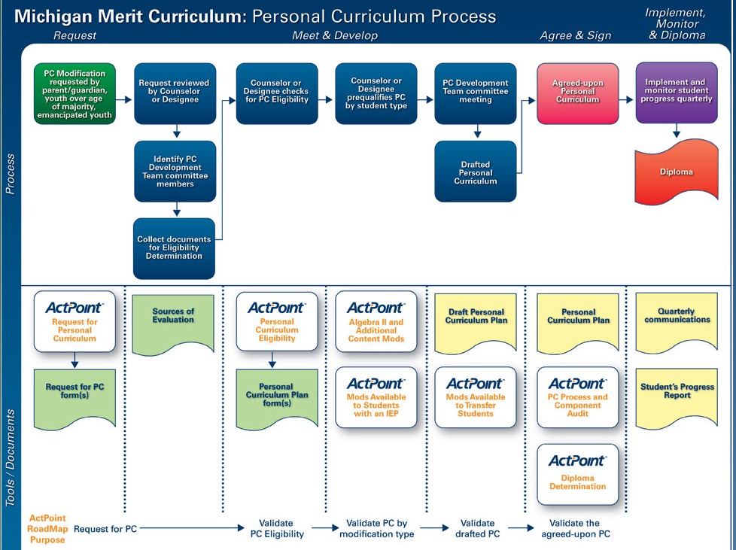

Slide 30
PC Modifications: Special Education
So what about
SPECIAL EDUCATION STUDENTS?????

Slide 31
PC Modifications: Special Education
Section 380.1278b(5)(k) provides that “If the parent or legal guardian of a pupil requests as part of the pupil’s personal curriculum a modification of the Michigan merit standard requirements that would not otherwise be allowed under this section and demonstrates that the modification is necessary because the pupil is a child with a disability, the school district or public school academy may allow that additional modification to the extent necessary because of the pupil’s disability… (if) the modification is consistent with both the pupil’s educational development plan (EDP)… and the pupil’s individualized education program (IEP).” Emphasis and parenthesis added

Slide 32
PC Modifications: Special Education
MDE allows specific modifications of the MMC due to the impact a disability has on assessing or demonstrating proficiency in meeting expectations.
MDE

Slide 33
PC Modifications: Special Education cont…
A student with a disability may request a modification to any part of the Michigan Merit Curriculum if the modification is based on the impact the student’s disability has on accessing or demonstrating proficiency in meeting the MMC expectations.
Every effort must be made to provide students with disabilities full access to the Michigan Merit Curriculum before making modifications.
The student’s response to supports and interventions needs to be taken into account when determining the appropriateness of any modification.
It must be the student’s needs and not the instructional environment that creates the barrier to access or proficiency.

Slide 34
PC Modifications: Special Education cont…
“…additional modification to the extent necessary because of the pupil’s disability.”
MDE
A PC cannot modify so much of the curriculum that it could be considered an alternative curriculum that still leads to a diploma.
Practicable and to the extent necessary both mean to include as much of the MMC as possible. Modifications should only be made where needed – no blanket modifications based on disability.

Slide 35
Practicable defined
Practicable content is the mix of existing MMC content expectations and modifications to those expectations driven by student need, that when achieved, will ensure the student progresses toward his or her identified postsecondary and career goal(s).
MDE

Slide 36
PC Modifications: Special Education
Section 380.1278b(5)(k) provides that “If the parent or legal guardian of a pupil requests as part of the pupil’s personal curriculum a modification of the Michigan merit standard requirements that would not otherwise be allowed under this section and demonstrates that the modification is necessary because the pupil is a child with a disability, the school district or public school academy may allow that additional modification to the extent necessary because of the pupil’s disability… (if) the modification is consistent with both the pupil’s educational development plan (EDP)… and the pupil’s individualized education program (IEP).” Emphasis and parenthesis added
WAIT! – The law said we can do all of that IF ….

Slide 37
PC Modifications: Special Education cont…
“the modification is consistent with both the pupil’s educational development plan (EDP)… and the pupil’s individualized education program (IEP).”
What?????

Slide 38
Educational Development Plans
The Board of a LEA or PSA Shall ensure each pupil in Grade 7 is provided with the opportunity to develop an EDP
The EDP shall be
    developed before the student enters high school
    developed by:
      Pupil
      Under the supervision of the School counselor
      School Psychologist should be included if the student has an IEP
    based on a career pathways program or similar career exploration program.

Slide 39
Educational Development Plans cont…
Personal Information
Career Goal(s)
Educational/Training Goal(s)
Assessment Results
Plan of Action
Parent Consultation/Endorsement (initial plans since students are under 18)

Slide 40
Educational Development Plans
  Modifications must be aligned to student’s Post-Secondary goals as outlined in their Educational Development Plan (EDP).
  Career Goal(s)
  Modifying chemistry may not be advisable for a student interested in becoming a doctor, but for a student who has a goal of becoming a police officer it might be an okay modification

Slide 41
Educational Development Plans
  Modifications must be aligned to student’s Post-Secondary goals as outlined in their Educational Development Plan (EDP).
  Educational/Training Goal(s)
  Modifying the content expectations of Algebra II may not be advisable for a student interested in attending U of M (could be challenging to pass the MME and meet their enrollment criteria). However the same modification for a student interested in attending a community college or a specific trade school might not negatively impact their school goals.

Slide 42
EDP example

Slide 43


Slide 44
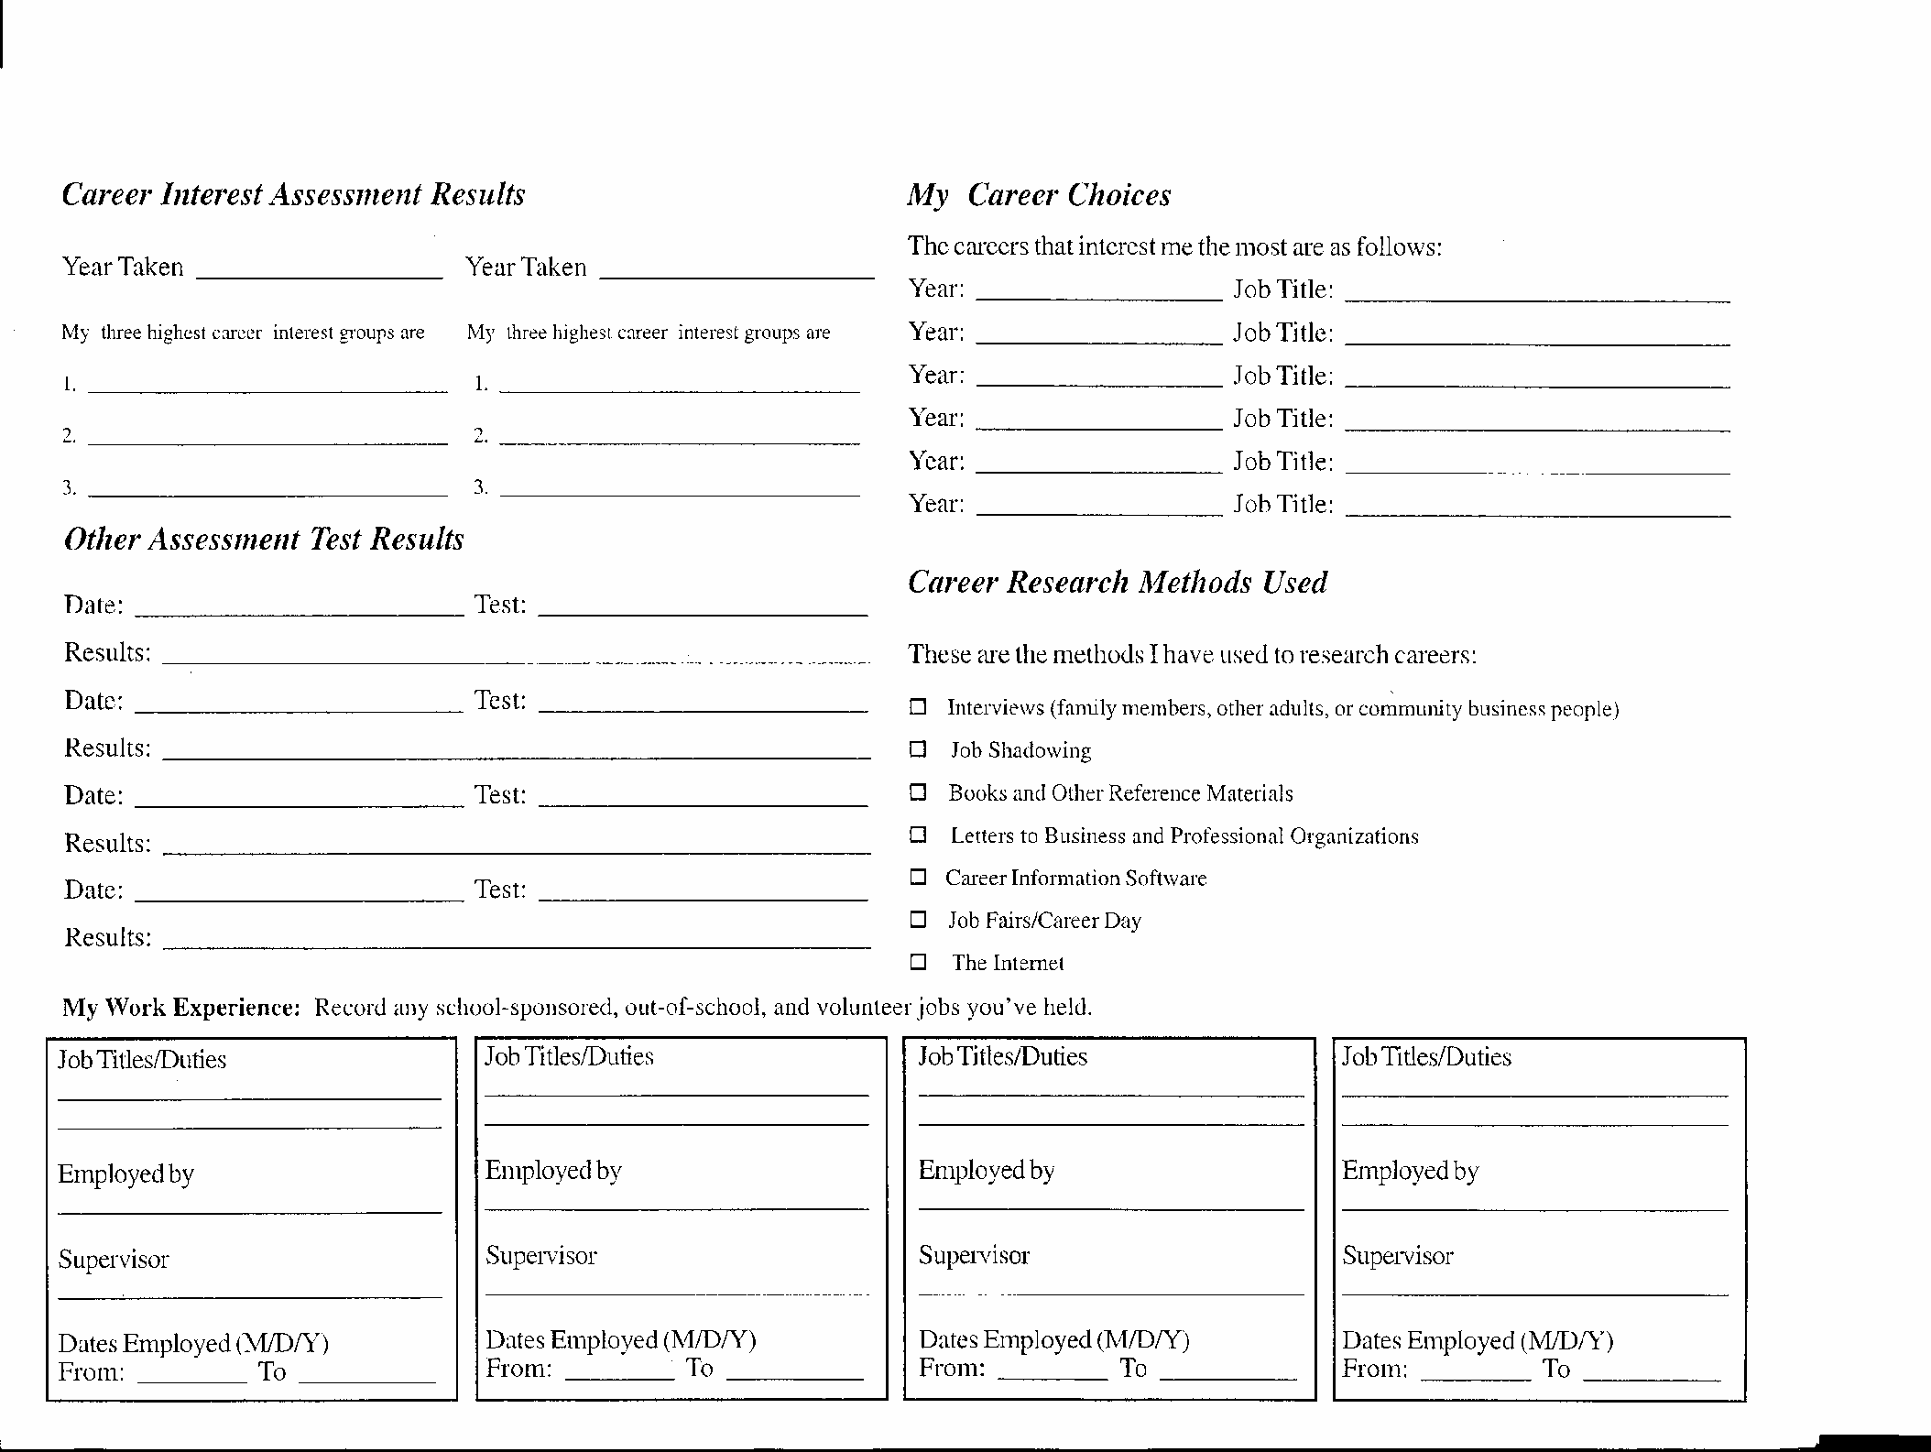
Some districts use Career Cruising

Slide 45
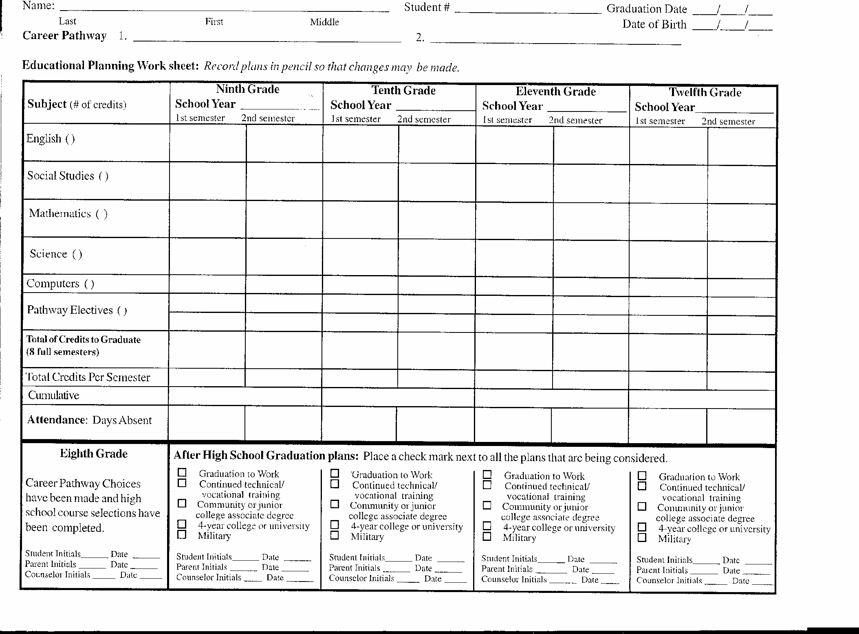

Slide 46
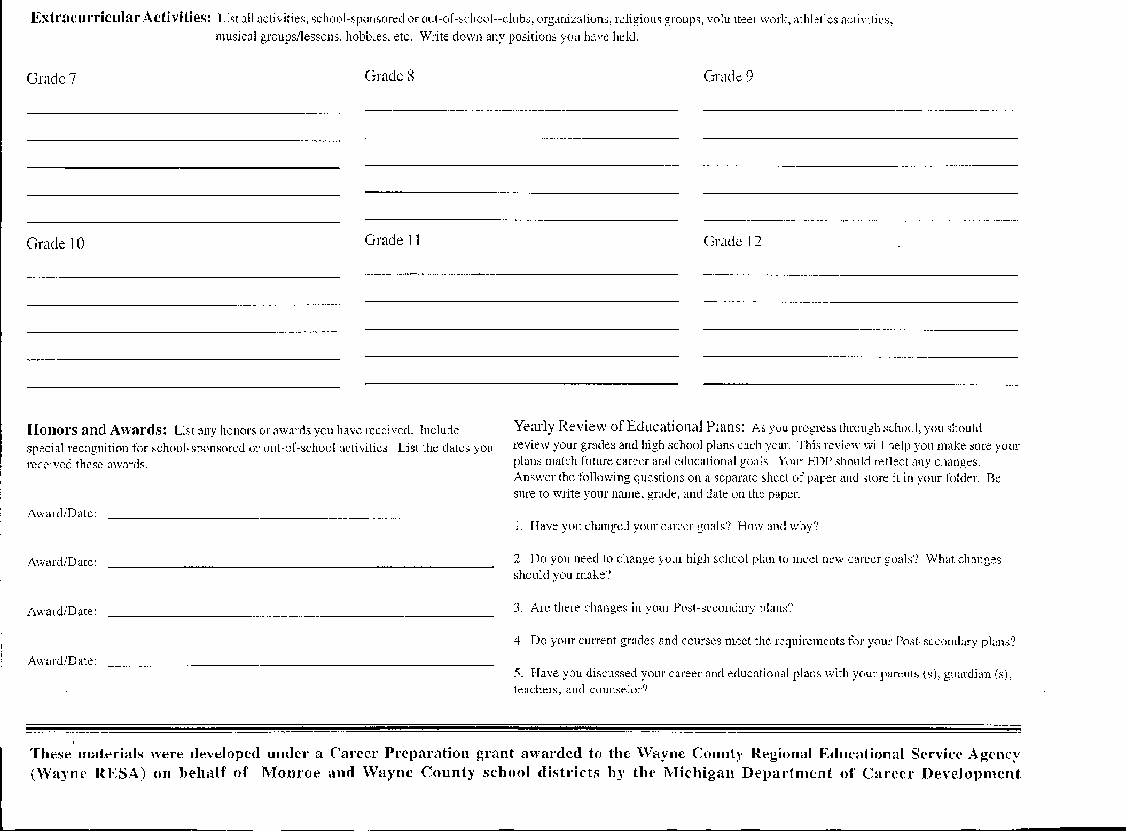

Slide 47
A modification to the MMC is consistent with the individualized education program (IEP) if the modification:
Supports the student's pathway to the completion of the general curriculum and subsequent earning of a diploma.
Incorporates as much of the subject area content expectations as practicable for the student.
Is based on the impact the student's disability has on accessing or demonstrating proficiency in meeting the expectations.
Is based on the student's disability and not the instructional environment that creates the barrier to access or proficiency.
Is based on the student's response to supports and interventions outlined in the IEP.

Slide 48
A modification to the MMC is consistent with the individualized education program (IEP) if the modification is:
Consistent with documented deficits in the area considered for modification.
  Consistent with documented transition goals
  Not about ambiguous connections – need direct links.

Slide 49
IEP -> PC
So how does the IEP impact the PC?
Acceptable topic of discussion at IEPT meeting
BUT
IEP team cannot request or write a PC as a team.
Members of the IEPT may be involved in the process as part of the separate Personal Curriculum Team (School Psychologist, Caseload teacher etc..)

Slide 50
As we saw an EDP is about classes and course of study
An IEP is about access to curriculum
Federal law requires the IEP to identify courses of study that lead to the student achieving IEP goals and objectives, not to specify classes to take.
Focus is on the supports, services and accommodations necessary to progress in the curriculum and chosen career pathway.
An IEP does not override the MMC

Slide 51
IEP PLAAFP

Slide 52
Guiding Questions
What is the student’s disability and present level of academic and behavioral functioning?
Is the student participating in MI ACCESS assessment in any of the content areas?
Looking at their academic history what is the consistent area of concern?
Is the student able to master their grade level Common Core State Standards (CCSS) with accommodations?

Slide 53

Guiding Questions
What is considered mastery?
How much is too much to modify?
What about the integrity of the diploma?
????????????????????????????????????????????????????????????????????????????????????????????????????????????????????????????????????????????????????????????????????????????????????????????????????????????????????????????????????????????????

Slide 54
First
Before the requests
Before the meetings
The Local District needs to make some decisions/create a policy so the PC team has guidance and parameters.

Slide 55
Local Authority
Districts are required to provide an annual notice to parents explaining the PC and that all students are eligible for a PC. Districts are also required to post the notice on their public website.
Districts are not required to have PC board “policy”
BUT…..
A policy builds consistency, provides procedures and a systematic way to handle PC requests
A policy protects the rigor and relevance of your diploma

Slide 56
Local Authority
Districts MUST offer the PC option.
Districts MUST respond to a PC request.
Districts MUST write a PC for every PC requested by an allowable party.
Districts are NOT required to approve all PCs.
Districts are not allowed to offer an alternative curriculum or a separate diploma.
Districts are not allowed to limit the number of PC/ No Caps – Focus on individual student needs only.

Slide 57
Local District PC Policy Considerations
Remember the MMC requires credit to be based on competency not attendance, behavior, or even daily assignments and homework … but proficiency of the standard.
What does that look like?
That’s up to the local district to decide using the state guidelines

Slide 58
Local District PC Policy Considerations cont…
Criteria for what constitutes credit for specific courses.
  The “cut score” a student must achieve to evidence mastery.
  How many or what percentage of content expectations or Power Standards must be mastered in order to receive full credit.
How far they want to depart from local standards to award diplomas for students with a Personal Curriculum.
Criteria for allowable modifications.
BE CAREFUL – You don’t want to take the PERSONAL out of PC
  No lines in the sand – Saying what you will and will not do as blanket statements for all students.

Slide 59

District Policies

Slide 60
Cut Scores
Cut scores are the level that the district has decided demonstrates that the student has met proficiency
  What is the achievement standard that all students must meet – cut scores?
  What, if any flexibility will be allowed in achievement standards for students with learning challenges – alternative cut scores?

Slide 61
Cut Scores
Clare-Gladwin RESD:
60% cut score on 100% of the HSCEs
Alternate cut score of 50%.
Monroe ISD:
60% of the subject area content expectations
40% for students with disabilities.
Saginaw ISD:
Cut Score of 60%
No Alternate Cut Score.
Bay Arenac ISD

Slide 62
PC Forms
MDE White,
White pg. 1 & 4 & Pink
http://www.resa.net/specialeducation/transitionplanning/studentexit/
http://www.inghamisd.org/academic-services/mtss/personalcurriculum/

Slide 63
Sample Completed PC Form

Slide 64
Scenarios

Slide 65
Scenario 1
Jennifer, a tenth grade student, with a cognitive impairment. She reads on a first grade level. Her mother would like her to graduate with a diploma and is requesting a PC for reading in order to modify her MMC reading assignments. Jennifer is currently passing her special education classes, but is not on a diploma track. Her mother would like to see her attend all GE classes and move to a diploma track
Is she eligible for a PC?
If so, what part of the MMC could be modified?
What would you recommend?

Slide 66

Your Turn: Group work

Slide 67
Why a PC?
Opportunity for more students with an IEP to earn a diploma (despite portions of the MMC that may seem to be roadblocks)
Missed Opportunities. Less than 2% of students who have earned a diploma used the PC modification route (27% of the less than 2% are student’s with IEPs). PC Implementation report 2013
A diploma sends a stronger message of disciplined, goal driven, successful individual over a GED. Opens more doors.

Slide 68
PC: Possible Adverse Effects
The following are possible student consequences for modifying (reducing) the credit requirements or content expectations:
Performance on Michigan Merit Exam
Admission to and/or preparedness for success in college/trade school
Eligibility for certain college scholarships or NCAA athletic programs
Ability to secure a job in desired field

Slide 69
Why not a PC?
Student’s lack of school success is not a result of academic challenges but poor attendance, planning, and/or decisions.
Student is not seeking a diploma.
Student’s academic challenges are directly related to severe cognitive deficits that would require modifying too much of the MMC and creating an alternative path to a diploma.
Accommodations would support the student enough to master content without a PC.

Slide 70
Reasons for not approving a PC
The request is not allowed by statute.
Other options for meeting the student’s educational needs are available.
It is not in the best interest of the student (doesn’t align to EDP and/or IEP).
The members of the PC development team cannot reach consensus. Every effort should be made to resolve the disagreement and meet the students needs with a PC.
Too challenging/ Don’t understand how they are done/ Too time consuming.
The district policy does not permit PCs.

Slide 71
Reminder
  Personal Curriculum does not guarantee a diploma.
  The student must meet all the requirements of the PC in order to earn a diploma.
  “If all of the ….requirements are met, then the board of a school district …. may award a high school diploma to a pupil who successfully completes his or her personal curriculum even if it does not meet the requirements of the Michigan merit standard…”
  MCL 380.1277b(5)

Slide 72
Diploma vs. Completion without Diploma
White Handout pg. 5

Slide 73
Reminders: Special Education Limits
  Local districts are the owners and creators of their district PC policy. They can give the PC team as much latitude as they deem necessary. MDE has given the aforementioned guidelines and a few essential elements for students with IEPs:
  Modifications must be directly related to the disability.
  Modifications must be aligned to EDP.
  PC should include as much of the MMC as possible.
  PC must include measurable goals and a progress reporting communication plan for parents.
  The PC must be agreed upon by a pupil's parent or legal guardian and the superintendent.
  MDE: PC Parent’s Guide

Slide 74

Website Resources
MDE
http://www.michigan.gov/mde/0,1607,7-140-6530_30334_49879---,00.html
RESA (Quick Guide to High School Completion for students with disabilities)
http://www.resa.net/specialeducation/transitionplanning/studentexit/
Power Standards http://www.farmington.k12.mi.us/curriculum/maps_hs.php
Decision Tools/ Programs
http://www.actpoint.com/mi/ http://www.misd.net/MT/PersonalCurriculum.htm

Slide 75
Thank You
Comments?
Questions?
Darnella Delfine
delfind@resa.net

