Slide 1
Positive Parenting
PBIS for dads
LaThomas Willis - Wyandotte Public Schools
Derek Nowka - Lincoln Park Public Schools

Slide 2
Taylor Parks Elementary School - Taylor, MI
K-5 Elementary School - 85% of the students qualify for free/reduced lunch.
Taylor Parks hosts monthly "Parent Time Out" meetings, in which parents can have access to professionals who provide positive/encouraging messages.
Kristin Salas - Positive School Culture/Climate Liaison - Taylor Public Schools - contacted Chris McEvoy with a request.

Slide 3
Positive parenting for dads……
Male role models, who could come in and talk with fathers about some positive parenting with their sons and daughters during the “Donuts with Dads” event.
Allow the dads to feel comfortable in the building, and understand that we are partners in their children's education.
Explain the importance of regular attendance, and what can happen if students fall behind in school.
Describe the need for children to have a strong positive role model

Slide 4
POSITIVE PARENTING
Partnering with your child, making a difference in their Day

Slide 5
SHOULD I GET INVOLVED? HECK YES!
* The child’s mom – Regardless of your relationship with your child’s mom, keeping it civil with her is just one less stress for your child to have to deal with. Your child might feel awkward, embarrassed, stressed, anxious, and a host of other negative emotions when you and your ex have a bad relationship. This is not conducive to your child’s academic success. Try to get along with your child’s mom and agree to attend school events, even if you both have to attend at the same time.
* Attend meetings and events – When there are parent-teacher conferences, go. The same is true for any meetings and conferences that are held at your child’s school, whether it’s about special education or the upcoming school year. Make your presence known, and your name and face will be associated with your child.
Events vary throughout the year, from school plays to after-school activities on the school’s campus. Try to attend as many as you can, and maybe suggest some of your own (like Lunch with Dad Day or some such).
* Meet the teacher – Get to know your child’s teacher and show him/her that you are involved and want to stay engaged. The teacher will then be more likely to give you information and contact you about relevant school matters.
* Be aware – As you get more involved and plan more involvement in your child’s school, remember that other kids may not be so lucky. Be careful that you don’t leave any kids out as you plan for dad-child events, and be ready to “fill in” for kids who need an adult male to support them

Slide 6
HOW IMPORTANT IS MY CHILD’S PRESENCE IN SCHOOL
A missed school day is a lost opportunity for students to learn. In this era of increased accountability for states, districts, and schools, the connection between student attendance and learning is being studied more than ever before.
Teacher effectiveness is the strongest school-related determinant of student success, but chronic student absence reduces even the best teacher's ability to provide learning opportunities.
This relationship between attendance and achievement may appear early in a child's school career. A recent study looking at young children found that absenteeism in kindergarten was associated with negative first grade outcomes such as greater absenteeism in subsequent years and lower achievement in reading, math, and general knowledge.
Poor attendance has serious implications for later outcomes as well.

Slide 7
HOW IMPORTANT IS MY CHILD’S PRESENCE IN SCHOOL
· Poor attendance can influence whether children read proficiently by the end of third grade or be held back.
· By 6th grade, chronic absence becomes a leading indicator that a student will drop out of high school.
·Research shows that missing 10 percent of the school, or about 18 days in most school districts, negatively affects a student’s academic performance.
When students improve their attendance rates, they improve their academic prospects and chances for graduating.

Slide 8
HOW IMPORTANT IS MY PRESENCE IN MY CHILD’S SCHOOL
If it takes a village to raise a child, become part of the village
Not every child has a father in their homes, your presences in school can make a difference for your child and their friends!
The U.S. Department of Education says that children whose fathers are directly involved in their schooling are likelier to participate in extra-curricular activities and succeed academically, and are less likely to be expelled or to repeat a grade.
Fatherly involvement can be a strong predictor of classroom discipline and, in the longterm, a lower propensity toward criminality and substance abuse.

Slide 9
10 Ways To Be A Role Model To Your Children
1. Healthy Living
When we eat properly and exercise regularly, not only does it improve our own lives, but it sets the example for our children as well.
Childhood obesity has become an epidemic in American society which can lead to depression and disease.
2. Self-Improvement
Self-improvement should be on our minds continuously. Try new experiences and broaden your horizons. This teaches our children to never stop growing as a human being. There’s always something new to learn in this life. Try to learn something new every day.
3. Serving/Volunteering
Make it a regular habit to get out in your community with your family and volunteer your time and talents. This is one of the best ways to build family unity, teamwork skills, and most of all, generous hearts. Teach your kids to meet the needs of others.
4. Open Up Your Life
Do not hide who you are as a person to your children. Share your past experiences when it is appropriate: mistakes and victories.
Status doesn’t mean a thing, but your attitude and your demeanor mean the world.

Slide 10
10 Ways To Be A Role Model To Your Children
5. Self-Control
Releasing our emotions, whatever they may be, is healthy and reduces stress. How we go about doing that in front of our children, however, has major consequences. As difficult as it can be, it is essential to practice self-control at all times in front of our children. Bite your tongue and control that temper. If need be, take it out in the gym or go for a long run.
6. Right Relationships
We have many important relationships and not all of them are going to be pleasant. Maybe there are issues with your parents, stepparents, brothers, sisters, or ex-wife. Forgive and give grace. Seek to be right in your relationships over being right. Make it as hard as possible for anyone to say anything bad about you. Be an initiator and take always personal responsibility first.
7. Respect and Listening
If you want to teach your kids how to be confident, it starts with showing them respect for who they are and listening to their own unique thoughts. This is a tough aspect of leadership, but the best leaders listen carefully and talk far less. Open your mind and your ears to what your children are telling you. They will, in turn, learn to do the same later in life.

Slide 11
10 Ways To Be A Role Model To Your Children
8. Positive Attitude
There is plenty of negativity to be found in society today. Do not add to the daily chorus your child experiences. Instead, display a positive and reassuring attitude and optimism. They need to be able to look at you and know that you are a believer and not a cynic.
9. Goal Setting
Setting goals is important to give us a benchmark of where we are going and the progress we are making. Implementing and achieving those goals are of equal importance. When our kids see us moving along exactly according to plan, it shows them the importance of organization and self-discipline in their daily life. Help them come up with their own set of goals and praise them when the goals are met.
10. Walk the Talk
The single most important aspect of being your children’s role model is to always say what you mean and mean what you say. Walk the talk. Back up your words with visible and concrete action and be a man of integrity and value. Actions speak volumes. “Well done is better than well said.” – Benjamin Franklin

Slide 12
Great dads
https://www.youtube.com/watch?v=RIjefcYYwUA

Slide 13
SOURCES
https://childdevelopmentinfo.com/how-to-be-a-parent/dads-in-school-tips-for-getting-involved-in-your-childs-education/
https://nces.ed.gov/pubs2009/attendancedata/chapter1a.asp
https://thebestschools.org/magazine/why-schools-need-dads/

Slide 14
Taylor Parks - Feedback
The group was engaged and responsive to the presentation.
Several of the attendees stayed after the presentation to ask additional questions.
The material seemed meaningful and relevant to the group.
A few of the dads agreed to join the Watch Dogs program at Taylor Parks

Slide 15
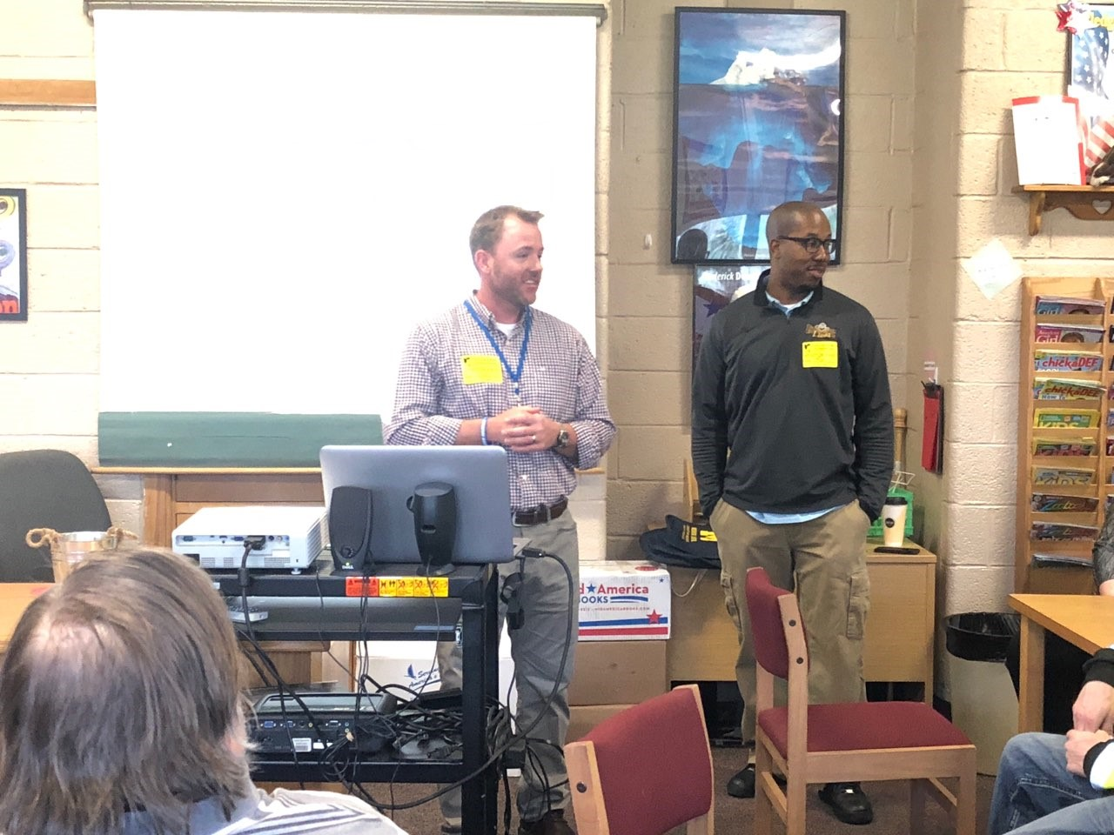
Taylor Parks

Slide 16
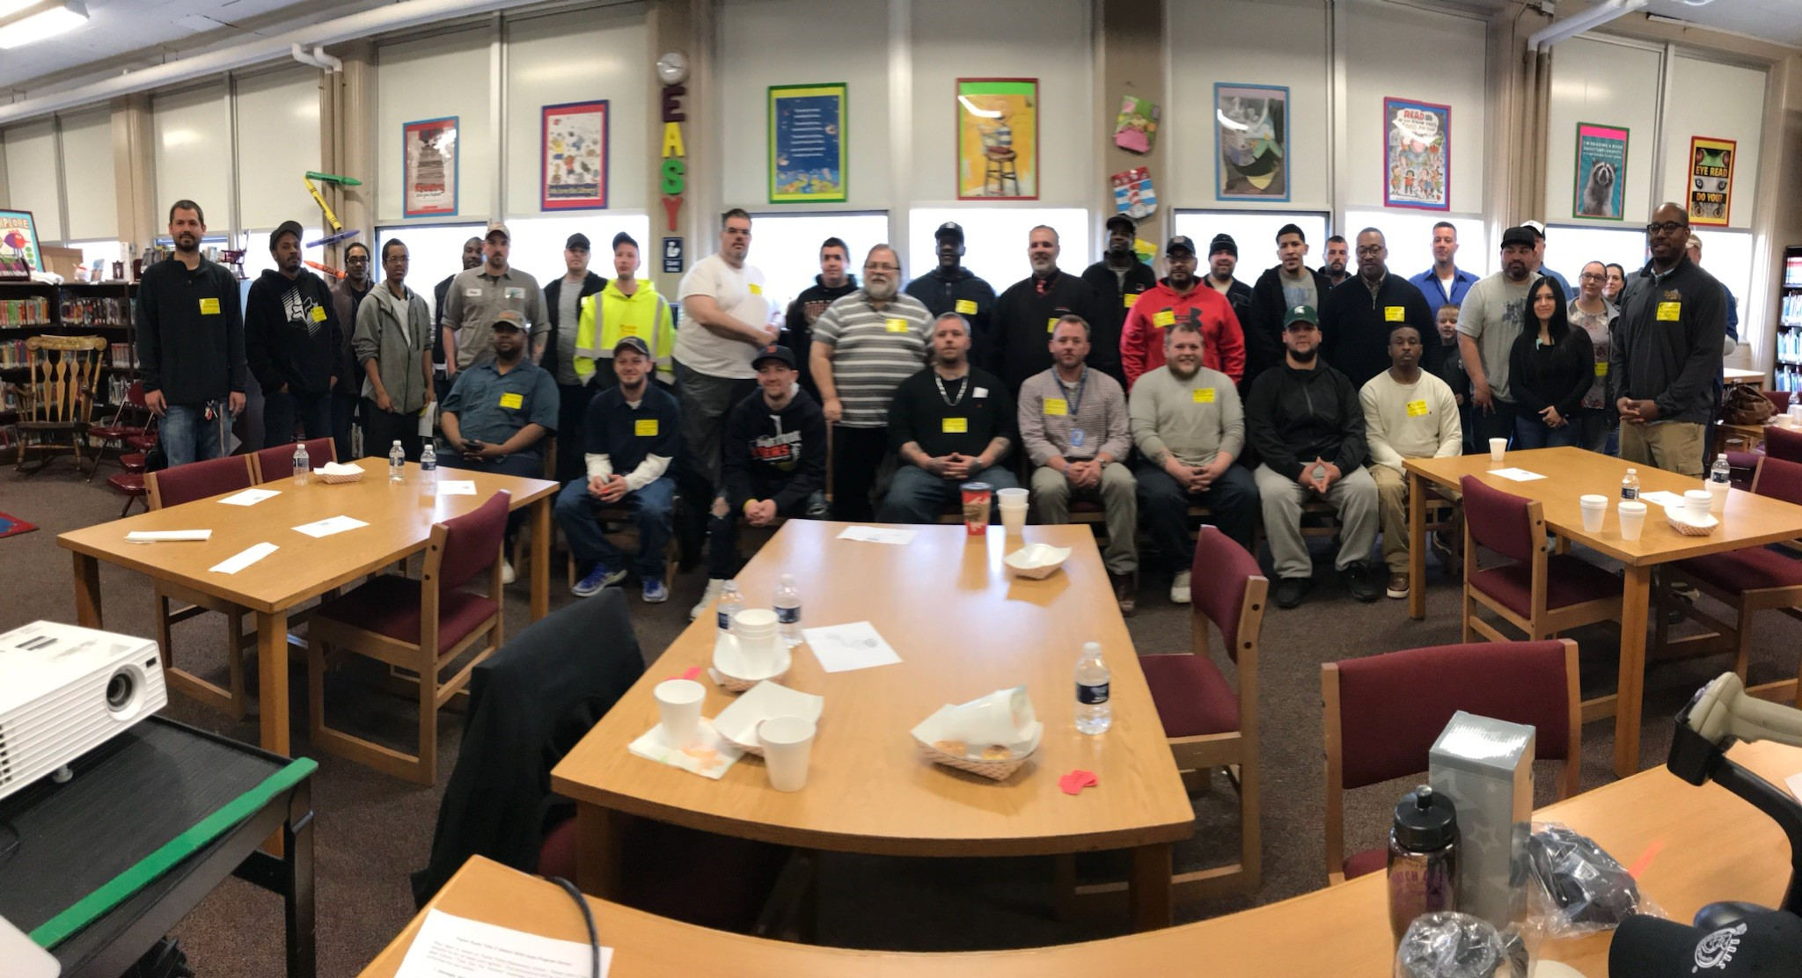

Slide 17
Whats next???
Lincoln Park - Bringing parents on board (2018 PBIS team implementation checklist)
Wyandotte- PBIS 2018-19

