Slide 1

PBIS Tier 2 Interventions
Lincoln Park Middle School

Slide 2

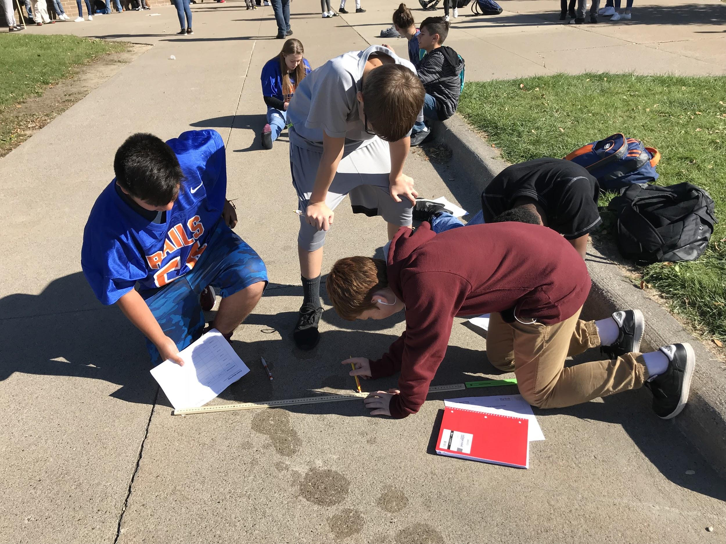
Lincoln Park Middle School
LPMS Demographics:
1,016 students in grades 6th, 7th, 8th
86% Free/Reduced Lunch
44% Hispanic / 40% Caucasian / 16% African-American
Support Staff:
Social Workers
Counselor
Behavior Specialist/Part-Time ASD Behavior Specialist
6th Grade Transition Coach
Police Liaison Officer
Building Culture/Staff Buy-In
Changes that have Supported this Work:
Advisory Period
Restorative Practices
2nd Year of WEB Program

Slide 3
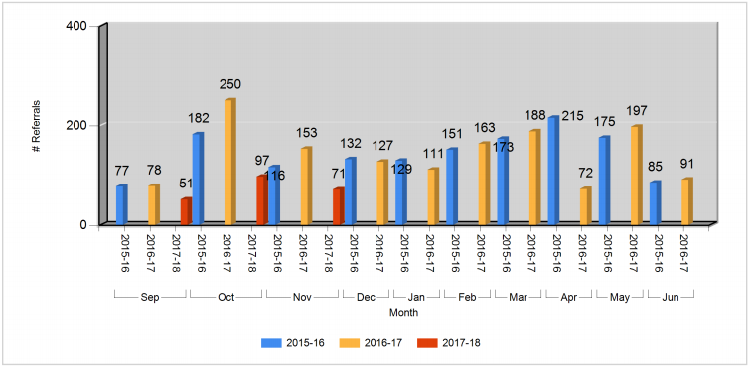
ODR Data
54% decrease in ODRs through November from last year to this year.

Slide 4
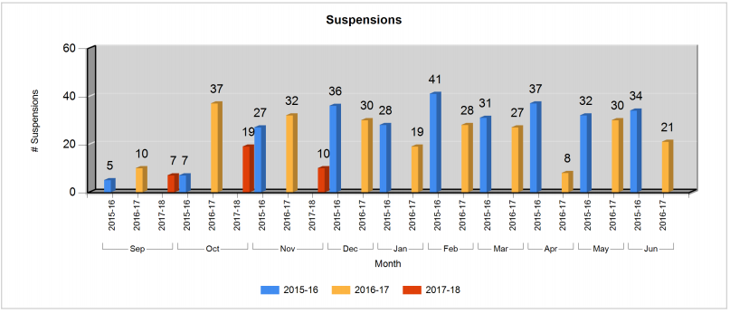
Out of School Suspension Data
54% decrease in OSS through November from last year to this year.

Slide 5
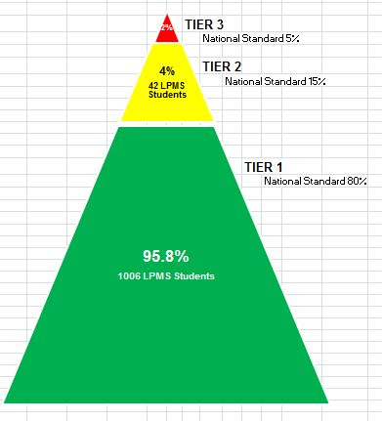
16-17 Data: Tiered Support

Slide 6

Data Driven Lessons
Lesson Plan Committee:
8 teachers & staff
Meet monthly following the data review
Meetings are short ( ~ 30 minutes)
Lesson Plan Content:
Content is determined by previous month’s data
  Area of most ODRs
  Area with significant rise in ODRs
Lessons use videos, activities, scenarios, prompts
  Pbisworld.com
  YouTube
Content focuses on Responsible, Respectful, Safe behavior in that area
Lesson Plan Logistics:
Lesson is typically in a Google Slide
Shared with specific content teacher or completed in Advisory
Staff emphasize problem area with Pride Cards

Slide 7
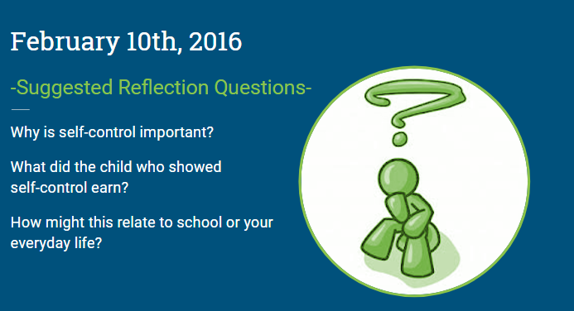
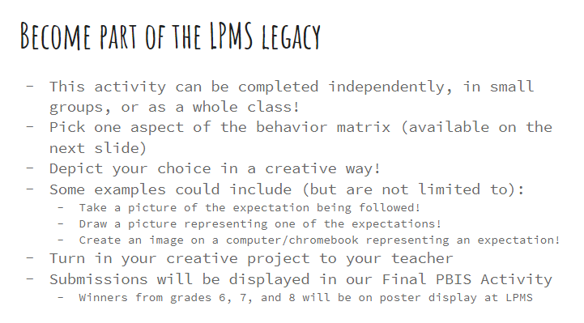
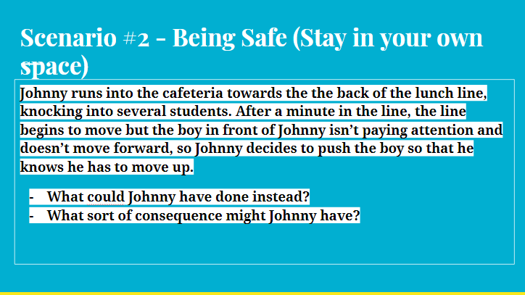
Data Driven Lessons- Content Examples

Slide 8
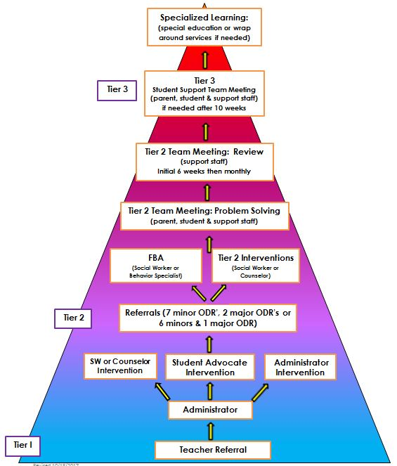
Behavior RTI

Slide 9
Proactive Identification
Incoming 6th Graders Tracking Report
Student referral
Teacher/staff referral
Parent referral
Behavior Tracking Report
Outgoing 8th Graders Tracking Report

Slide 10
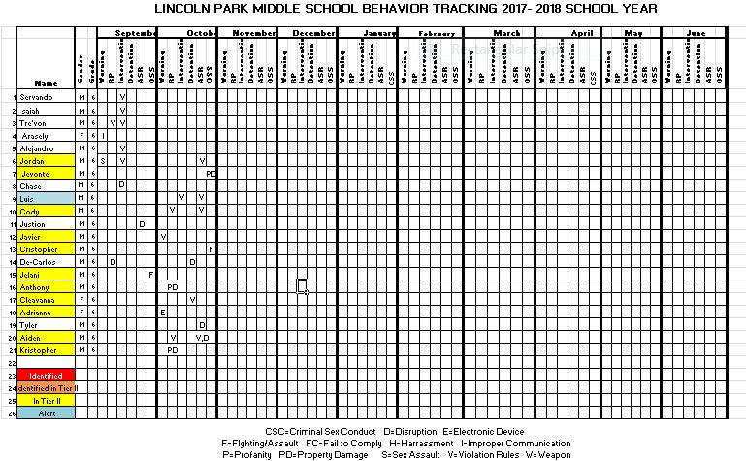
Behavior Tracking Report

Slide 11
Interventions
Restorative Practices - Restorative conferences & apology letters
Check In/Check Out - Daily & weekly
Social Contracts - Completed for all classroom communities (tier 1) & between individuals as needed (tier 2)
Think Sheets - Completed in classroom or office, different versions, determined by need
Take a Break - Preventative strategy, taken in hallway or in main office, often paired with opportunity for physical activity and a Think Sheet
Plan for Success - Completed proactively to orient student to their strengths, challenges, choices and supports
Adult Mentor - Fosters a positive relationship with a neutral school staff member

Slide 12
Interventions
Social Skills Group - Small groups, 4-6 students, by grade and gender. Before school and during lunch
Behavior Contract - Individually or with teacher
Active Supervision - Provides 1:1 supervision and reteaching, often paired with delayed passing time
Attendance Agreement - Plan and supports to improve attendance, academics and behavior
Home/School Behavior intervention Plan - Individualized plan to bring about behavior change, includes reteaching, rewards and consequences and if possible, high involvement from parent/guardian
Other - Highly individualized interventions including delayed passing time, custom schedule, alternative lunch, school helper, active parent support, bus pass, weekly 1:1 meetings with SSW intern, peer to peer support, wrap around and home based services

Slide 13
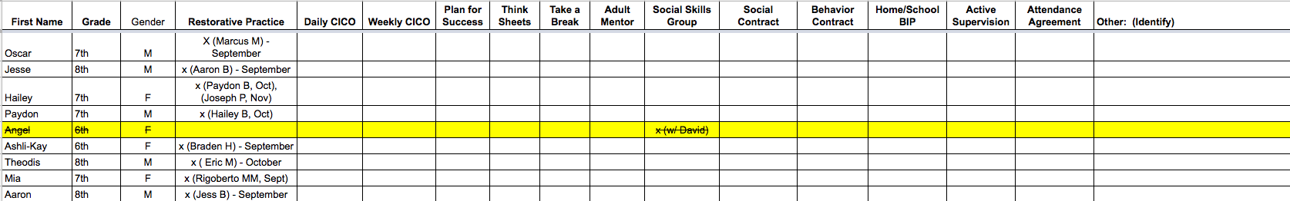
Intervention Tracking Report
https://docs.google.com/a/lincolnparkpublicschools.net/spreadsheets/d/1J3t7_yttawn-bAi5cULv6Sf7lPHluSDIOKAXUEyr8XY/edit?usp=sharing

Slide 14
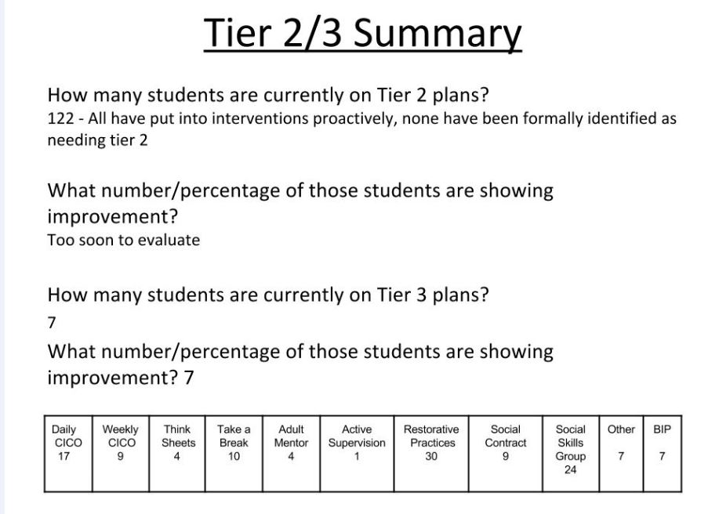
Tier 2/Tier 3 Data Analysis Report

Slide 15
PBIS at LPMS
Susan Minard - susan.minard@lpps.info
Michael Lynch - michael.lynch@lpps.info
Brian Brehmer - brian.brehmer@lpps.info

