Slide 1
PBIS Overview
Hilbert Middle School, Redford Union Schools

Slide 2
PBIS Is Not....
Parties and physical rewards. These are actually just a small part of what a building may integrate into their PBIS framework.

Slide 3
PBIS is...
A Framework, there is no beginning or end. All of your programs from the most basic to the most targeted fit under the umbrella of PBIS

Slide 4
HMS Demographics
475 Students
69% AA, 23% Cau, 7% Hisp
125 IEPs: 14 ASD, 6 HI, 10 Speech only
15 ESL, 9 504 Plan
12 State Residential Care
80% Economically Disadvantaged (2018)
96% 31A (2018)

Slide 5
Tiered Supports

Slide 6
Tier 1 at HMS
Love and Logic
Expect Respect
Recovery Process
Recovery Room
Minors
Positive Rewards: Weekly, Monthly
Alternative Learning Center
Team Interventions

Slide 7
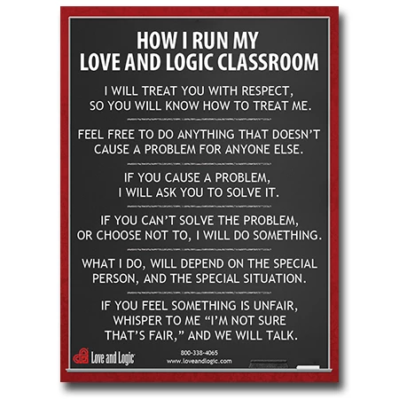
Love and Logic

Slide 8
Love and Logic2
The language of talking with kids
Emotional de-escalation
Avoiding arguing
Good Minutes vs. Bad Minutes
Students responsible for their recovery
Delayed consequences

Slide 9
Expect Respect
Kid to Kid: How to treat each other respectfully
How to talk to each other respectfully
Language of confrontation and de-escalation
Keeping emotions in check
How to let others know if they have injured you
How to be an upstander
See PPT 2

Slide 10
Recovery Process

Slide 11
1

Slide 12
Recovery Room

Slide 13
Minors

Slide 14
Majors

Slide 15
7 Factors

Slide 16
Alternative Learning Center
Formerly In-school Suspension
A discipline alternative for all students that last an hour or up to 2 days.
The ALC has a certified teacher who communicates with the teacher of record for each class about the student’s work.
General ed = no absence.
The ALC teacher gives one-on-one help.
Many students like the small, quiet working environment.

Slide 17
Team Interventions and Referrals

Slide 18
Tier 2 Supports
Monitored weekly by the Hilbert Intervention Team
Principal
Dean of Students
Behavior Interventionist
Social Worker
Counselor
Attendance Liaison
In-houseTherapist
PBIS Coordinator

Slide 19
Lesser Interventions

Slide 20
CI/CO
PPT3

Slide 21
Threat and Bullying Protocols
Helps delineate between transient and serious situations
Widely accepted instruments for guiding investigations
Helps students in serious situations get the help they need
Helps guide the restorative process
Transparent tool that can be shared with parents and staff

Slide 22
Threat and Bullying Protocols2

Slide 23
Threat and Bullying Protocols3

Slide 24
Tier 3 Supports
The most intensive, typically 1 on 1 interventions with building specialists (psychologists, social workers, counselors, etc.)

Slide 25
Tier 3 Supports2
FBA and BIP
School/Home plan
Program Modification
Transition Program (2nd Chance)
Wrap Around

Slide 26
Tier 3 Supports3
FBS and BIP
School/Home plan
Program Modification
Transition Program (2nd Chance)
In-house Therapy (Lincoln Behavioral)
Wrap Around

Slide 27
2nd Chance
It’s an intervention program for Hilbert students who struggle with being successful in a typical middle school environment.
It is housed at the Keeler Center, 17715 Brady, Redford, MI 48240.
The main focus of the program is social/emotional learning and meeting behavioral goals while at the same time taking core classes (Math, ELA, Science, Social Studies) online.
When students meet their behavior goals and maintain a 70% in their core classes, they are ready to re-enter Hilbert Middle School.
Because students are considered Hilbert Middle School students, they can participate in all Hilbert sports, extracurriculars and events.
Transportation is provided to and from Keeler via Hilbert.
The environment is small and there is a higher adult to student ratio. Students will also be assigned a peer mentor.

Slide 28
Wrap Around
PPT 4

Slide 29
Questions…
Andy Christopherson, Principal
christa@redfordu.k12.mi.us

