Slide 1

PBIS @ P-CCS
Wayne RESA
Middle School Forum
Facilitated By:
Anthony Ruela & Rania Hammoud

Slide 2

Snapshot of P-CCS
Plymouth-Canton Community Schools
  Third largest school district in Wayne County
  Approximately 17,500 Students
  3 High Schools on 1 campus
  1 Alternative Education High School
  5 Middle Schools
  14 Elementary Schools
  1 Early Learning Academy
  Successful IB, Arts, and STEM Academies

Slide 3
Snapshot of P-CCS2
Demographic Group | 2015 | 2016 | 2017 | 2018 | 2019 | 5 yr Percent Change
Total Enrollment | 18,667 | 17,336 | 17,404 | 17,492 | 17,491 | -6.30%
Economically Disadvantaged | 3,290 | 2,712 | 2,565 | 3,184 | 3,594 | 9.20%
English Language Learners | 995 | 1,025 | 1,046 | 1,240 | 1,159 | 16.50%
Students with IEPs | 1,859 | 1,701 | 1,665 | 1,682 | 1,740 | -6.40%
Total White | 13,406 | 12,286 | 12,163 | 12,041 | 11,875 | -11.40%
Total African-American | 1,797 | 1,689 | 1,678 | 1,643 | 1,650 | -8.20%
Total Hispanic | 704 | 657 | 736 | 783 | 827 | 17.50%
Total Asian | 1,948 | 1,931 | 2,030 | 2,231 | 2,350 | 20.60%
Two or More Races | 725 | 684 | 715 | 720 | 715 | -1.40%
Total American Indian | 66 | 62 | 56 | 51 | 48 | -27.30%
Total Native Hawaiian | 21 | 27 | 26 | 23 | 26 | 23.80%

Slide 4

PBIS @ P-CCS
10 PBIS Schools (5 Middle and 5 Elementary)
Recognizing PBIS as a framework to support ALL students
District-wide initiatives aligned with PBIS implementation:
  MTSS
  Culturally Responsive Teaching
  Restorative Practices

Slide 5
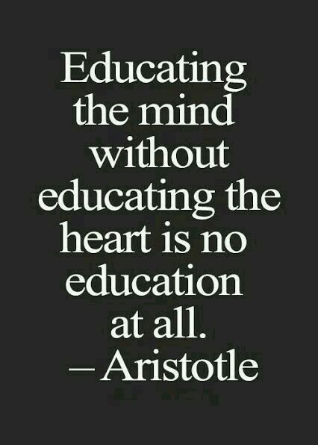
Culturally Responsive PBIS
P-CCS is committed to:
Recognizing that behavior and learning are interconnected
Using engaging, culturally responsive instruction to ensure all students “see themselves” in their schooling
Supporting and meeting the needs of our students by being trauma informed and shifting from a model that asks, “What is wrong with you?” to one that asks, “What happened to you?”
Developing rapport and caring relationships with students and families
Teaching administrative and teaching staff strategies for neutralizing implicit bias in discipline decisions

Slide 6
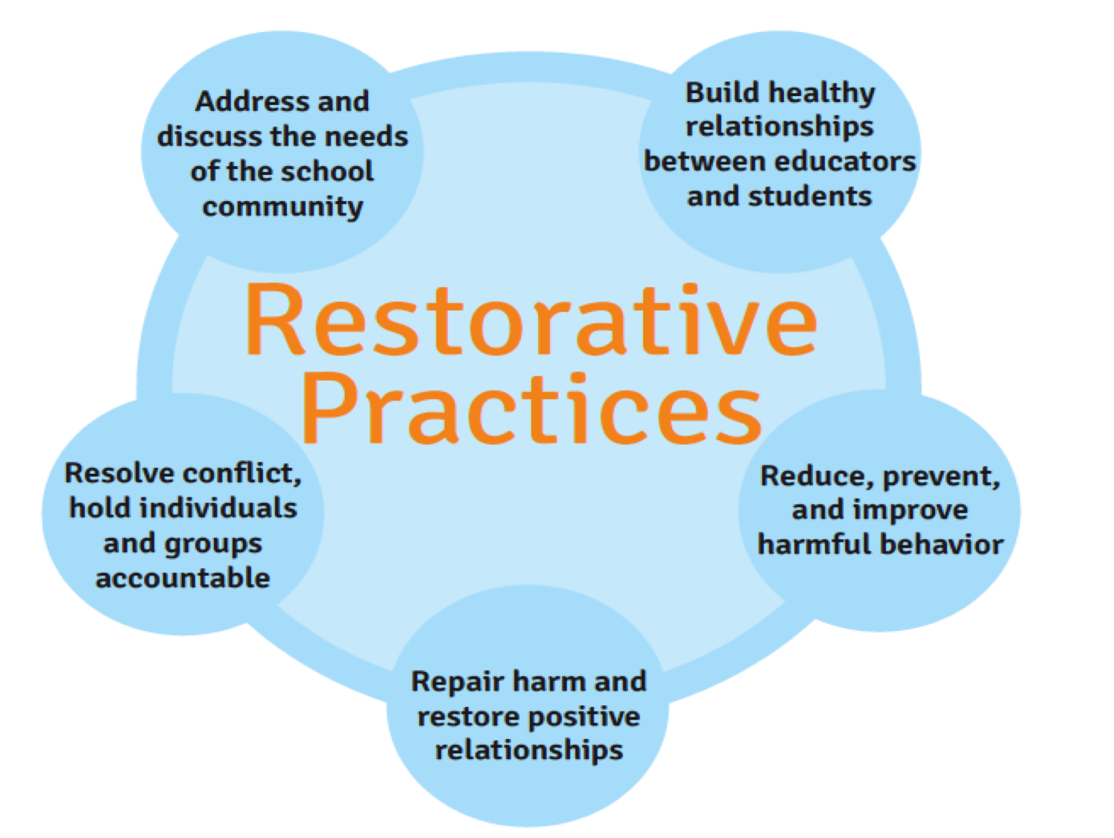
Restorative Practices
Source: Restorative Practices: Fostering Healthy Relationships & Promoting Positive Discipline in Schools​. 2014​

Slide 7
Results
10 Years Ago
Averaging about 20 expulsions a year
Past 5 years
Averaged 3 expulsions per year
2018-19 School Year
0 expulsions

Slide 8
Results2
2019-20 School Year - 17,491 students
  District suspensions - 986
      ES - 323 - < 25 per building
      MS - 304 - < 60 per building
      HS - 359 - < 120 per building

Slide 9
Results3
2019-20 School Year
  Percent of students receiving at least one suspension
      ES - 1.3 % (7,100 students)
      MS - 2.6% (4,022 students)
      HS - 2.0% (6,458 students)

Slide 10

East Middle School
Scott Burek Kayline Jurmo
Ursula Mason

Slide 11
Our PBIS History
Eighth Year PBIS School
  Year One & Two
    PBIS approach was more punitive
    Students were excluded from school-wide reward events for any and all discipline
    Remarkable Rockets had no value
    No PBIS kickoff or re-teaching of the PBIS matrix

Slide 12
Our PBIS History2
  Year Three to Present:
    PBIS leadership promoted a more culturally proficient philosophy
    PBIS kickoff, calendar, & re-teaching of matrix
    Weekly & quarterly celebrations that ALL students can buy their way into
    School Store and Business partnerships raised money
    Separation of discipline from PBIS celebrations

Slide 13
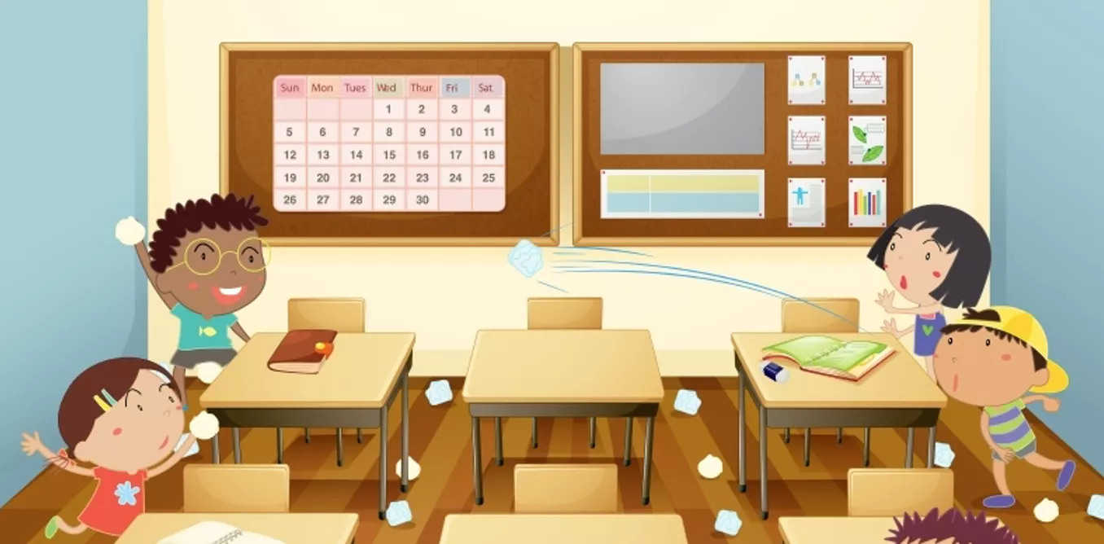
Separation of
PBIS & Discipline
Fixation on Discipline Data in Years One & Two
  Led to overemphasis on catching students demonstrating negative behavior
  Led to students, parents, & staff to view PBIS negatively
  Led to school wide incentives to become unimportant
  Had no effect on decreasing discipline issues

Slide 14

Separation of
PBIS & Discipline2
Focus on Promoting Positive Behavior Year 3+
  Led to focusing on students doing the right thing
  Led to students, parents, & staff to view PBIS as a positive framework
  Led to incentives being highly valued
  Decreased overall discipline issues building wide

Slide 15

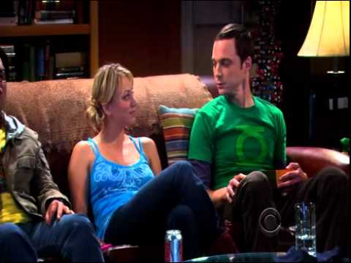
AST PBIS
“The Big Bang Theory” experimented with positive reinforcement.
Students need to have 4 positive interactions with the teacher for every negative interaction.

Slide 16
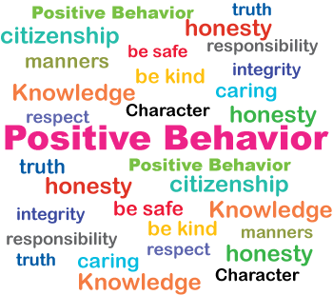
Rewarding Students for Demonstrating Positive Behavior
Seeing a student help another student
Students who help clean up
Students who are listening/following directions the first time asked
Students who are staying on task while working together
Students who are participating in class discussions
Students who have no missing assignments Classroom contests
All school spirit days
School wide examples of great behavior (assemblies)

Slide 17
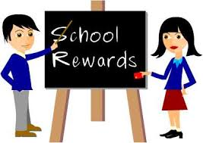
Classroom & Building Rewards
Classroom Rewards:
  School Supplies
  Class Privileges
  Oops Coupons
  Prizes
Building Rewards:
  Principal for a Day
  School Store
  Quarterly Celebrations

Slide 18
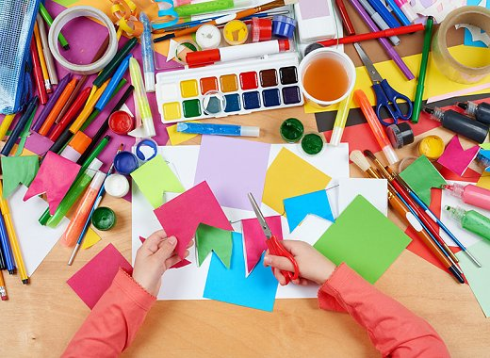
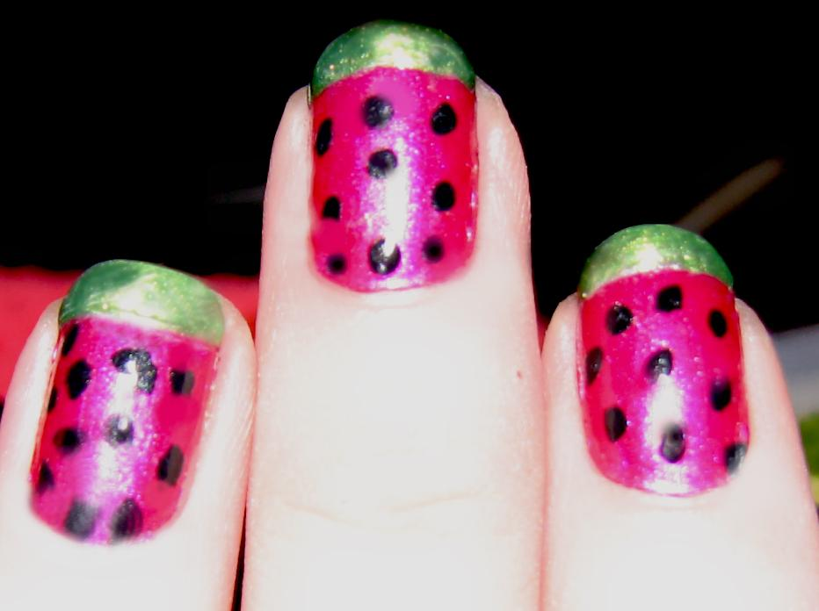
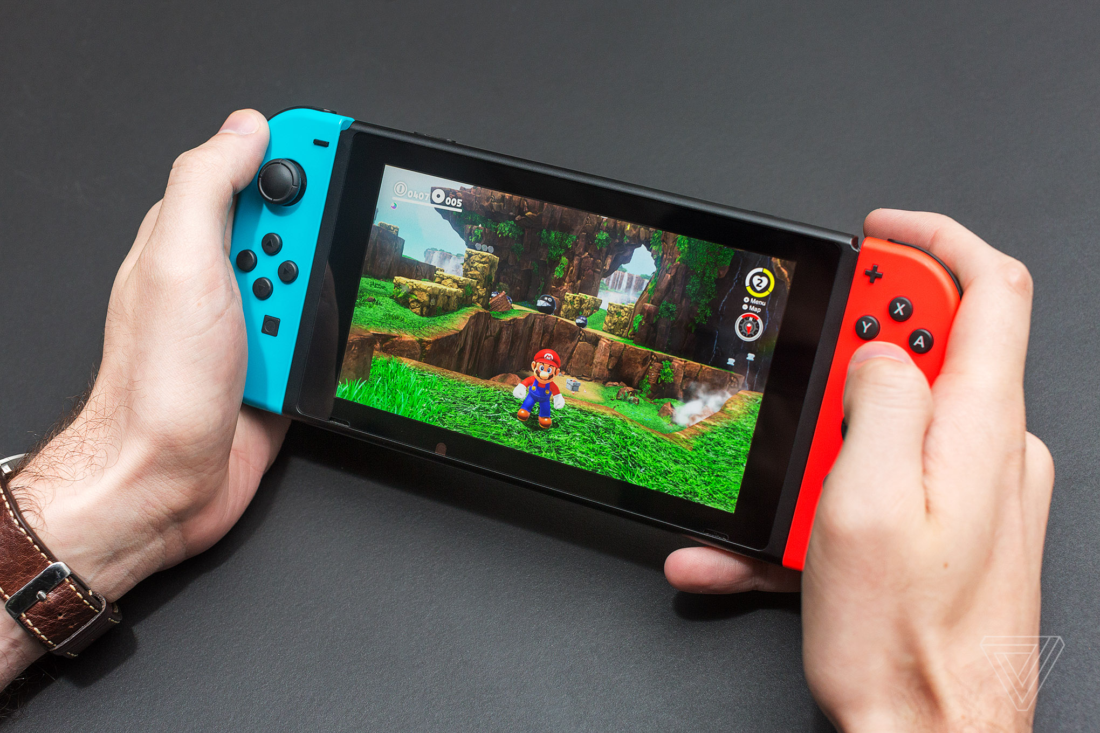
Hallway Shakeup
Each Hallway has a different theme
  Gaming - Wii games
  Bring your own electronics
  Dance
  Open Gym
  Health and Beauty
  Arts and Crafts
Students automatically get one wristband to a hallway of their choice
Students can purchase a second wristband with PBIS points to go to a different hallway at halftime

Slide 19

The Amazing Race
Students form teams of 6-8 in their grade level, come up with a theme and costumes for their team and sign up at lunch.
Each grade level’s teams complete a series of 10-12 “Minute To Win It” activities
Prizes are awarded for finishing in 1st, 2nd, and 3rd place, as well as best team spirit
Students can purchase food with PBIS points
Staff and Parent Volunteers run the games and supervise.

Slide 20
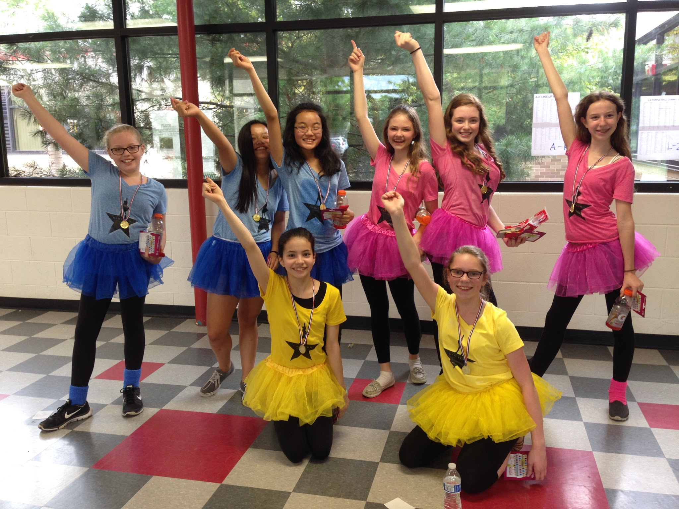
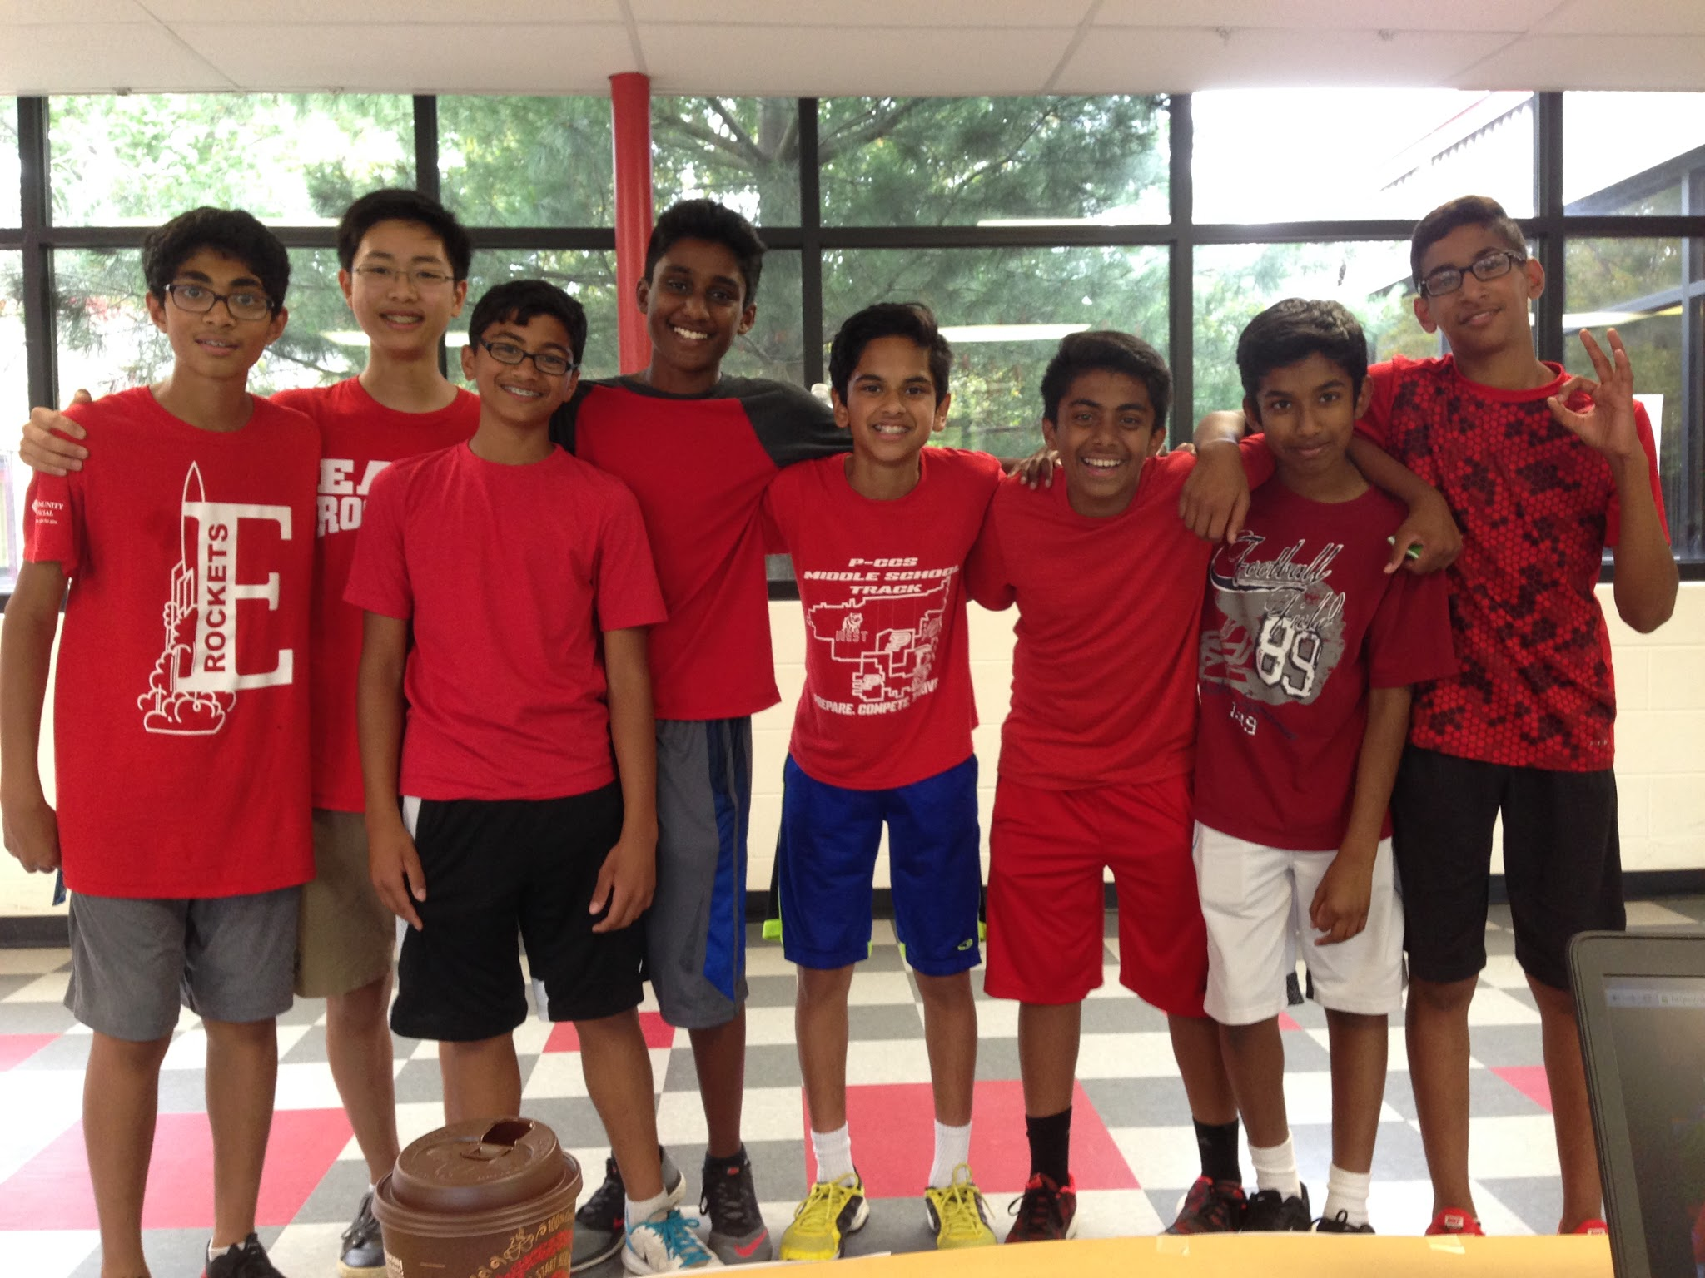
The Amazing Race2

Slide 21

Classroom Coupons
Create coupon templates to use for your classroom store that kids can purchase to redeem. Select a time to open your store for students to purchase coupons. Some coupon ideas:
Switch your seat for the day
Listen to music during work time
Cut odd or even problems from homework
Half off homework
Leave class 2 minutes early - bring a friend
Sit in the comfy seat
Get these coupons and more at bit.ly/pbiscoupons

Slide 22

Rocket Points
Mrs. Ursula Mason - Choir Teacher
Earned rocket points are used to purchase a variety of classroom items/privileges
The teacher reserves the right to postpone the payment of an item or privilege for an appropriate time for her and the class as a whole
The teacher may or may not honor a privilege from another class
All purchase requests must be made before the tardy bell on Friday

Slide 23
Choir Rocket Point Store
Choir Rocket Point Store | # of Rocket Points
Choose next week’s “Artist of the Week” | 20
Make the next week’s music trivia question | 5
Sit in Mrs. Mason’s black chair, stool or class chair | 20
1 minute performance for class | 5
Use background music during “open mic” | 10
Play piano (during passing time) | 5
Lead a physical/vocal warm-up (on day other than “Leadership Friday”) | 5
Extra Entry in Friday Raffle | 5
Purchase Pencil (when available) | 5
Leave class 2 minutes before bell with one friend | 10

Slide 24

West Middle School
Lauren Kulczycki

Slide 25
PBIS Class Meetings
30 minute meetings with the Assistant Principal to share behavior data, school tips, and advice with students
Meetings are held during Primetime
Student expectations are reviewed by referring to the West PBIS Matrix Chart
  Topics are sometimes different for each grade level
Collect feedback from students about the school environment: Participating in surveys and sharing ideas on improving the overall school climate

Slide 26
Supporting Students
Include a teaching component/restorative piece with each consequence
  Reflection assignments/learning packets by Advantage Press (sample)
Using Alternatives to Suspension
  Restorative Practices
  Community Service
  Tier 2 Supports
    Check in/Check out
    CSI Training for all staff - Administrator led

Slide 27
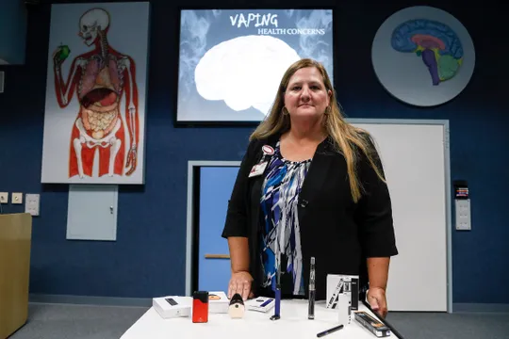
Middle School Vaping
Majority of past suspensions involved students vaping
Being proactive by educating students about the dangerous effects of vaping
Vaping 101 - Cheryl Phillips - St. Joe’s Mercy Health
https://tinyurl.com/MichiganVaping

Slide 28

Caught You Being Awesome
Staff members give out “Caught You Being Awesome” tickets when students are demonstrating random acts of kindness by helping others, stepping up to certain challenges, and/or going above and beyond in school.
Students who receive these tickets will come down to the office to turn in their tickets and redeem a prize (school supplies, open gym passes, snacks, etc).

Slide 29

Bulldogs of the Week
At the end of each week, the “Caught You Being Awesome” tickets are entered in a weekly drawing for a $5 gift card, free lunch/treat from the cafeteria, or a free book.
One winner from each grade level is selected.
West also includes two staff members
Names are announced on the PA as our “Bulldogs of the Week.”

Slide 30
Promoting Staff Buy-In
Implementation needs to be quick and easy!
Support is provided by all members of the PBIS Team
PBIS professional development is included in staff meetings:
  Topics include analyzing behavior data, increasing student engagement, classroom management, active supervision, building positive relationships with students, and restorative practices
Everyone using the same language
  Defining each infraction and determining how to respond to negative behavior
PBIS reminders/tips are sent periodically via email
Staff surveys administered several times during the year

Slide 31
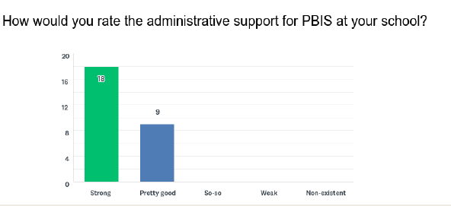
Providing Administrative Support
2018-2019 PBIS End of the Year Staff Survey

Slide 32
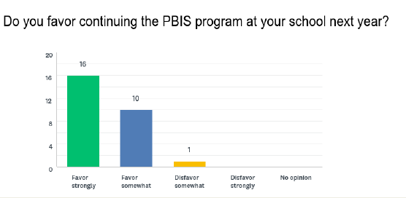
PBIS Works When Implemented with Fidelity!
2018-2019 PBIS End of the Year Staff Survey

Slide 33

Liberty Middle School
Jamie Wells
Leslie Anderson

Slide 34



PBIS Rewards System
Buried in paper tickets, tokens or PawS?????

Slide 35
Disclaimer...
Does cost $$$$
No, you can NOT use the PBIS grant money to purchase the App

Slide 36
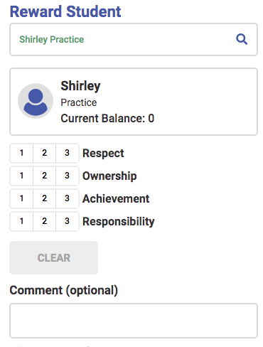
How does it Work?
Staff members can recognize positive student behavior from anywhere in the school using the mobile app, or from the convenience of their desks using the web portal.

Slide 37
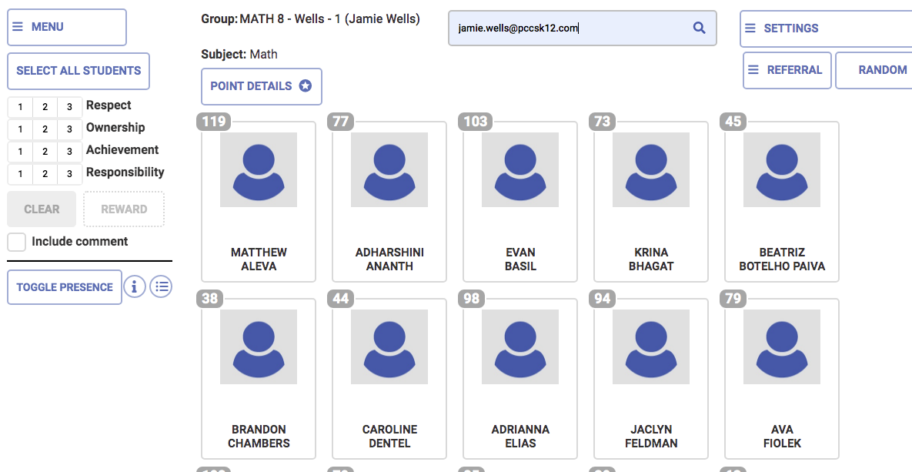
How does it Work?2
Recognize Positive Behavior on the Desktop Portal
Organize your classes into groups
Select the expectation and number of points
Give points to one, some, or all of the students, and see the results instantly

Slide 38
WOW… What else?
School & Teacher Stores
Shop by adding items into the cart and checkout
Purchase the items for your students and points are instantly updated to reflect the purchase
  Adjust quantities in your cart and the integrated inventory system automatically adjusts your on-hand quantities
  Redeem now or redeem later if the student wants to save that homework pass for another time
  Rewards can also be redeemed from the mobile app which means the store is open wherever you are
Personalize with the ability to create individual teacher stores.

Slide 39
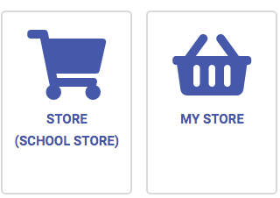
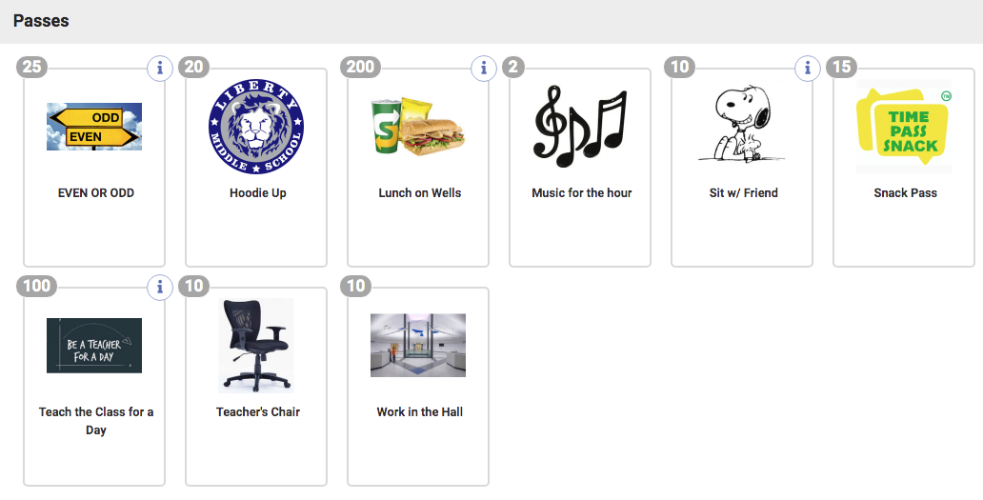
Stores

Slide 40

Events
Easily register and track who is attending an event
Events can be set up to deduct student points, like a purchase from the store, or to qualify students based on points earned in a grading period or year

Slide 41
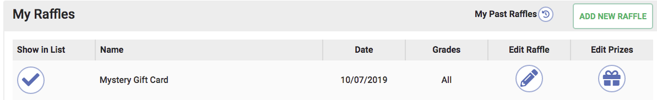
Raffles
Easily register students
Raffles can be set up to redeem or qualify from a balance

Slide 42
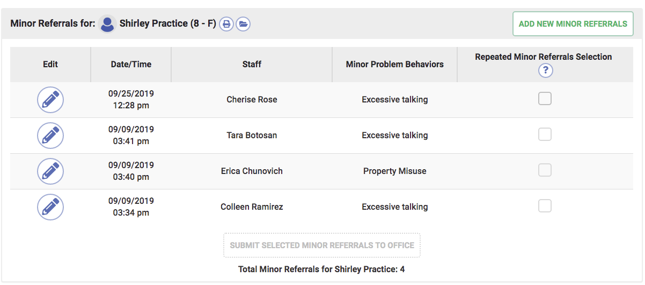
Add ons
Advanced Referral System
The Advanced Referral System (ARS) shares all of the advantages of the rest of PBIS Rewards – it eliminates paperwork, can be utilized anywhere in the school with the mobile App, and tracks all aspects of referrals automatically.
On the spot
Office supported
  See what happened
Staff can see it all
  Every student in the school

Slide 43

Check in/Check Out
Check-In/Check-Out (CICO) system for students in PBIS Rewards
Eliminates headaches with paper
Clear view with progress
Data helps students to progress back to Tier 1
Personalize goals

Slide 44

Discovery Middle School
Alex Noroyan
Meagen Hudson

Slide 45

Supporting Students Academically
SLAMS Program
  Focused academic assistance that is available for all students at Discovery Middle School
  Each letter of SLAMS stands for a subject and matched with a day of the week
    Monday: Science
    Tuesday: Language Arts
    Wednesday: Arts
    Thursday: Math
    Friday: Social Studies
  Offered during homeroom

Slide 46

Eagles of the Week
  A way to recognize students for their wonderful behavior, kindness, respect and helpfulness to others
  Announced over the loudspeaker on Fridays.
        Student names are displayed on the TV monitors around the school
  Acknowledge and reward the positive contributions that our DMS students make on a daily basis
  Staff and Students can be nominated
  450 Responses in 18/19

Slide 47
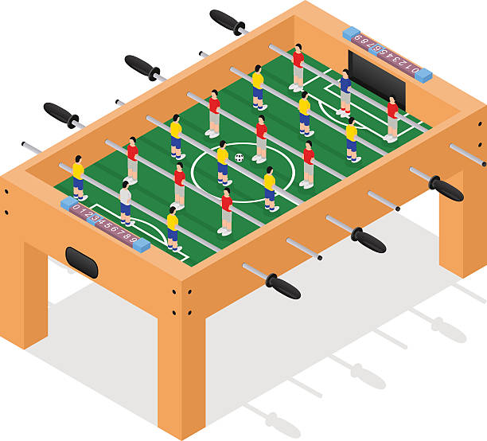

Lunch With The Administrators
  Administrators eat lunch with students new to the school/district (September, October, November)
  Recommendations made by teachers (December-June)
  Allows administrators to make POSITIVE connections with students
    Reward students who deserve it
    Teachers are welcome to join
    Pizza, pop, ice cream and games!

Slide 48
Quarterly Rewards
This year, each grade level is responsible for planning their quarterly reward.
        Quarter 4 reward is the end of the year grade level field trips.
  Past rewards have included: Kona Ice, Open Gym, Activity Day, Movies and Snacks.
  Rewards take place during the school day.

Slide 49

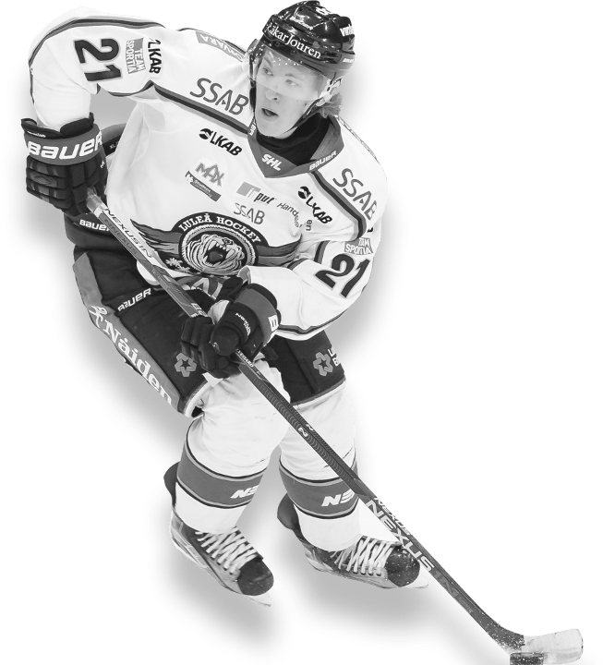

DMS
USA HOCKEY GAME
BUILDING WIDE PBIS ACTIVITY
AN WEDNESDAY,
DECEMBER 10TH

Slide 50
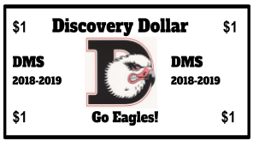
Discovery Dollars
$$ DISCOVERY DOLLARS $$
Why save them?
PBIS Reward Parties!
PBIS Monthly Raffles!
School Store!
Classroom Rewards!
Notes:
Discovery utilizes Discovery Dollars in numerous ways. They are given for positive behavior and can be used for classroom rewards, at the school store, and for monthly PBIS raffles.

Slide 51







PBIS RAFFLES
Student Raffles
Save your Discovery Dollars for the PBIS Raffles to:
Enter to win as many times as you want into each raffle during lunch!
You can win gift cards and other prizes MONTHLY!
April and May’s Raffle will be drawn on Friday, May 31st.
You may enter at lunch starting Tuesday, May 28th!
Notes:
Students look forward to the monthly PBIS raffles which include gift cards to places relevant to them. We asked a few groups of students where they would want gift cards to.

Slide 52
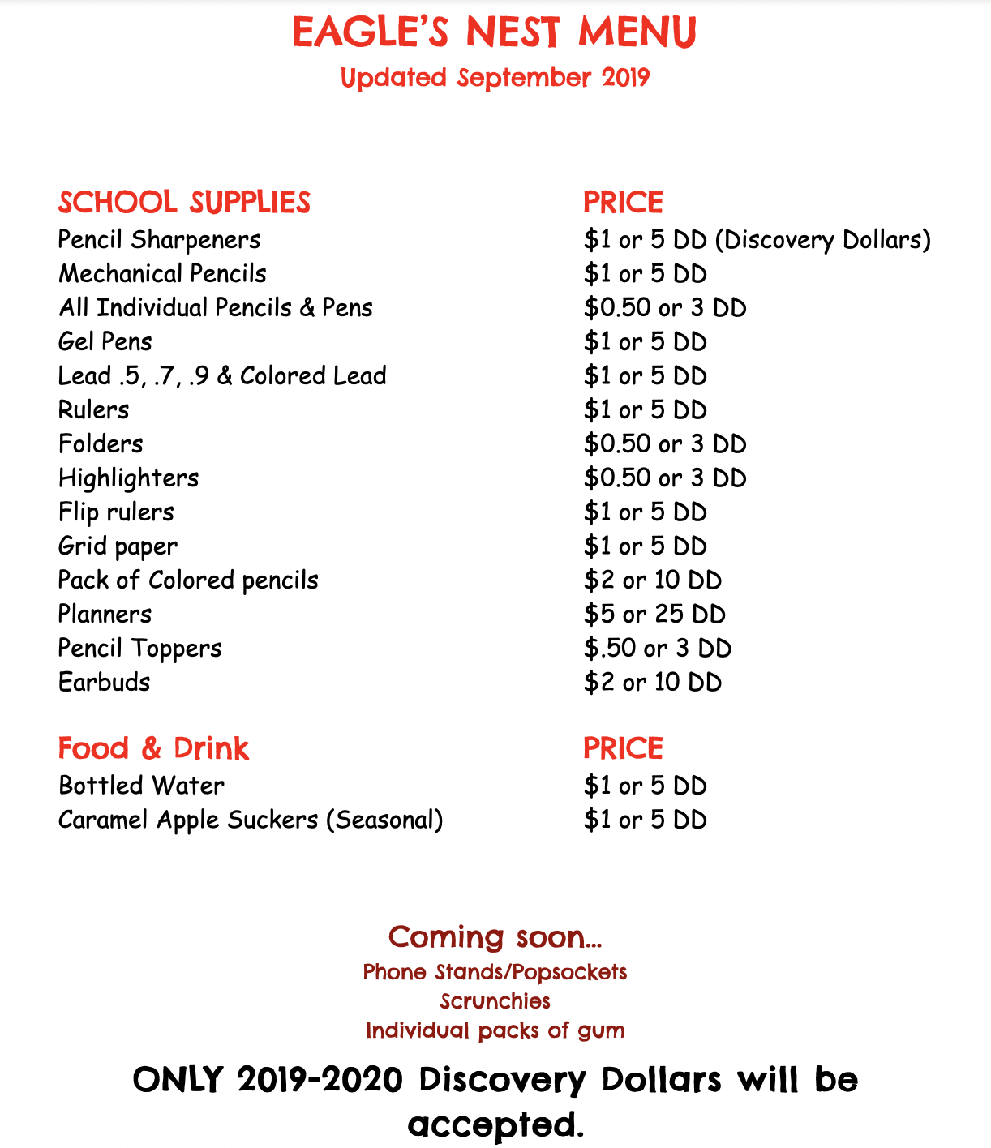
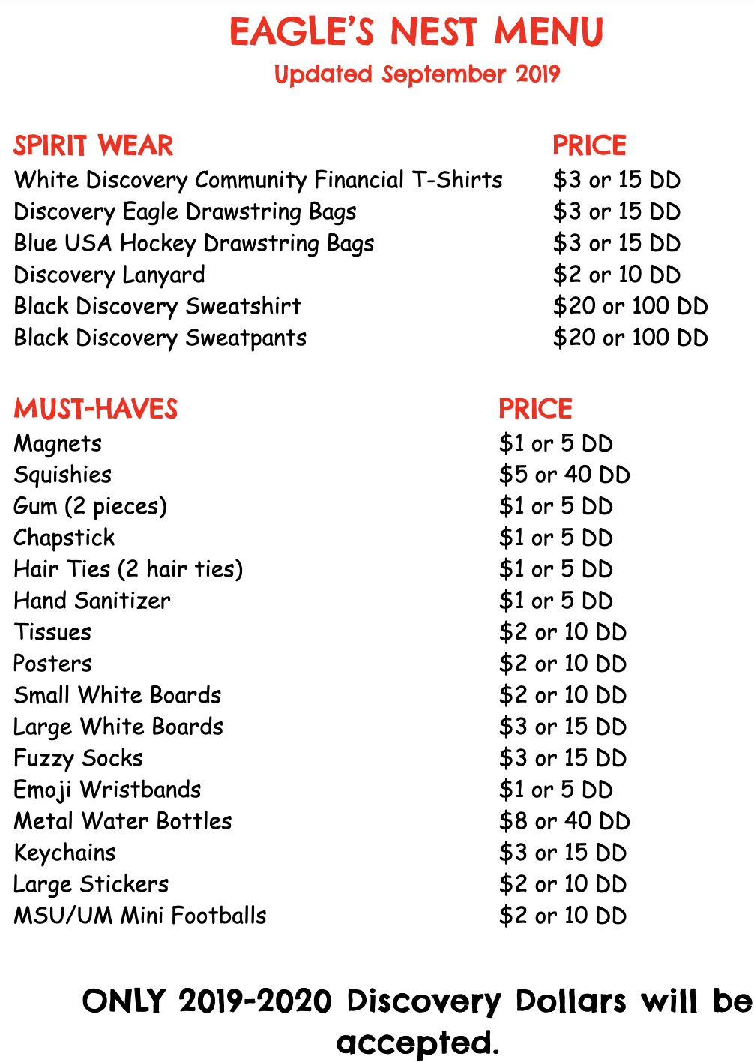
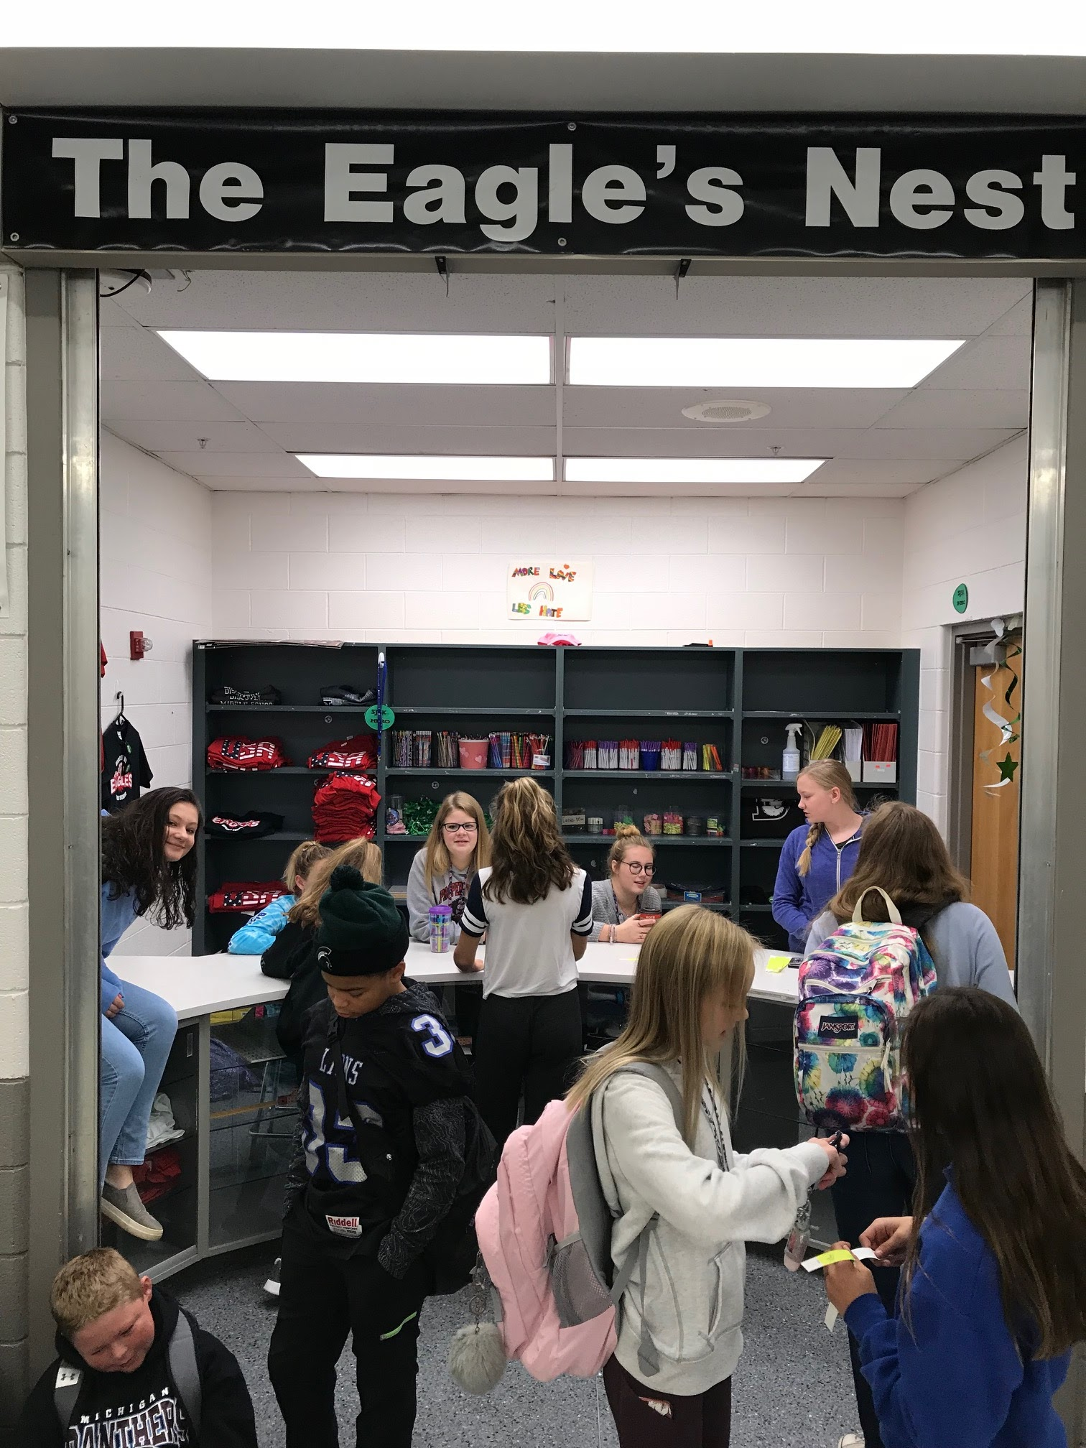
SCHOOL STORE
Eagles Nest Menu

Slide 53

Pioneer Middle School
Chris Moore

Slide 54
Pioneer Middle School
Homeroom Activities:
Teach and Model Expectations
Team Building
Door Decorating
Culturally Proficient Instruction
Targeted Re-Teaching of Expectations
Grade Level or Class Meetings
Morning Games

Slide 55
Pioneer Middle School2
6th Grade
BE RESPECTFUL
BE RESPONSIBLE
BE SAFE
DEMONSTRATE PERSEVERANCE

Slide 56
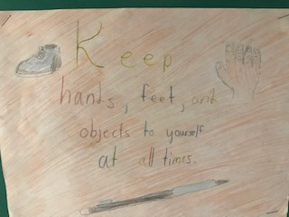
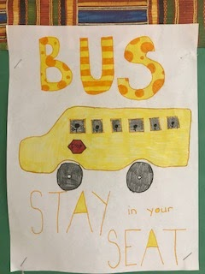
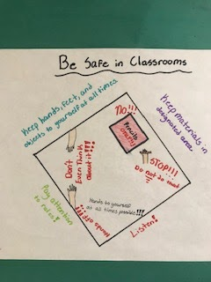
Pioneer Middle School3
7th Grade
Notes:
Forming a community of learners (adults and students)
The most essential outcome of this phase is to establish that racial, cultural, and economic differences are real- and they make a difference in education outcomes.
Acknowledging each person’s unique cultural narrative
Clarifying the process of growth toward cultural competence
Connecting adult competence with student outcomes
Research shows that three factors have a major effect on students motivation and performance:
Their feelings of belonging
Their trust in the people around them
Their belief that teachers value their intellectual competence
CPI Activities include: Self Assessment and Bias questions, Building Identity, Diversity of Beliefs, Human Rights Activities, Circle of Viewpoints Routine,

Slide 57
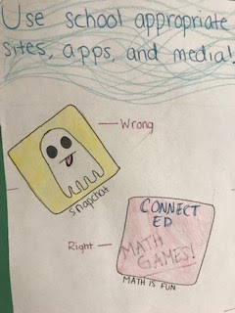
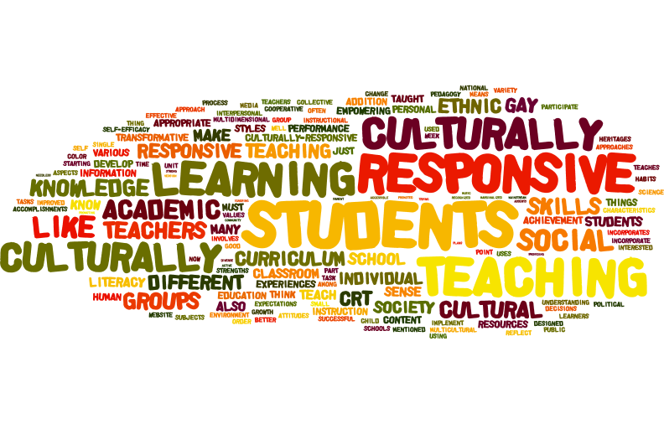
Pioneer Middle School4
8th Grade

Slide 58

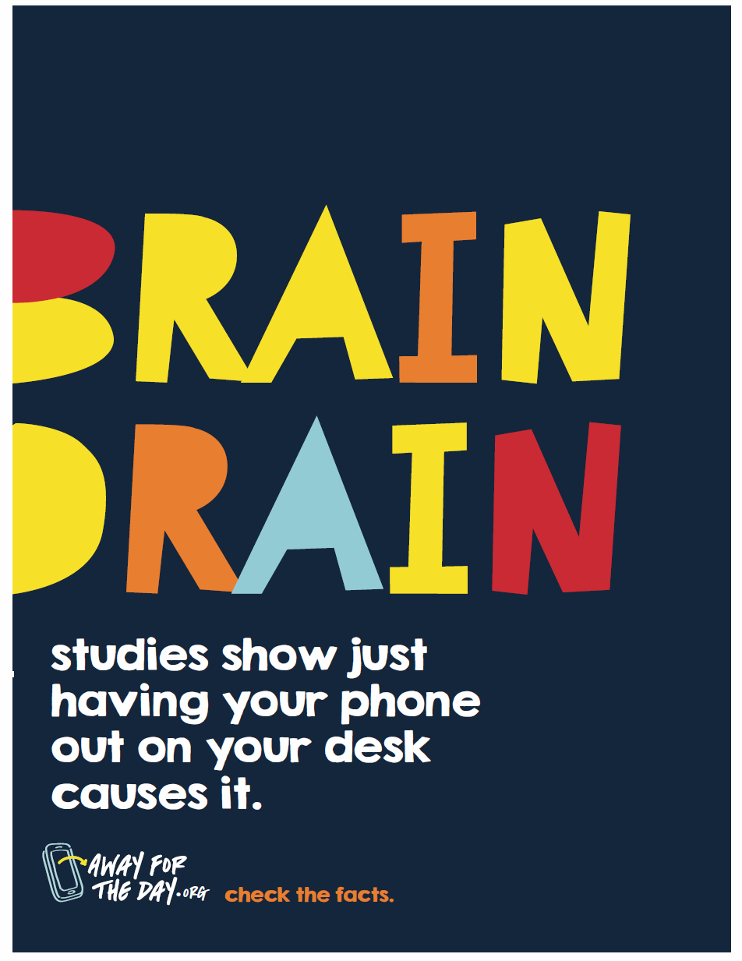
Away for the Day

Slide 59


Thank you
Contact
Rania.Hammoud@pccsk12.com
Anthony.Ruela@pccsk12.com

