Slide 1
PBIS for Students with ASD
Center Forum 2019
Derek Nowka, Ed.S. and Lauren Szypula, MA.Ed, CTP-E
ASD Behavior Specialists, Lincoln Park Public Schools

Slide 2
Lincoln Park Public Schools
District Size: slightly under 5,000 students
5 elementary schools, 1 middle school, 1 high school, 1 post-secondary school
District implementation of PBIS began in 2006
878 students with IEPs serviced within the district
225 students in the ASD program from pre-K through post-secondary
3 general education behavior specialists, 2 ASD behavior specialists, 1 general education OT, social workers in every building, student advocates in every building, special education speech pathologists and OTs for students with IEPs

Slide 3
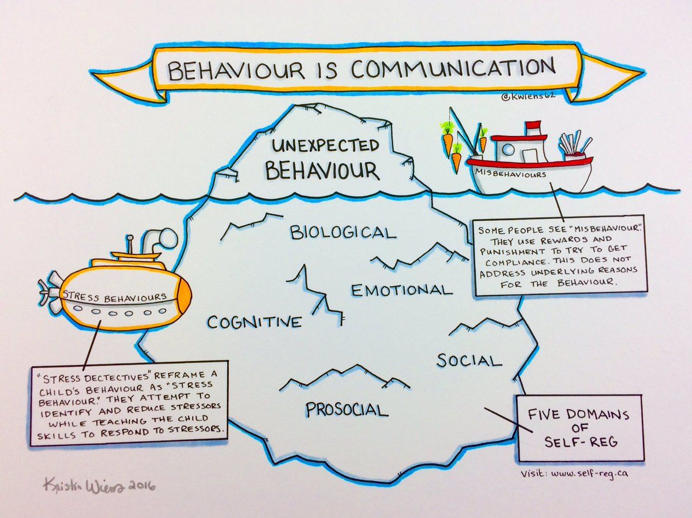
Core deficits for students with Autism
Social
Communication
Behavior

Slide 4
Benefits of PBIS for Students with Autism
Working together to PREVENT challenging behaviors and ensuring that expectations are achievable for ALL
Provides consistent, clear expectations
Prevents challenging behaviors
Creates a supportive environment
Teaches new skills/replacement behaviors
Provides a whole school team approach
Promotes social skills
Promotes communication development
Encourages a system for positive praise or rewards

Slide 5
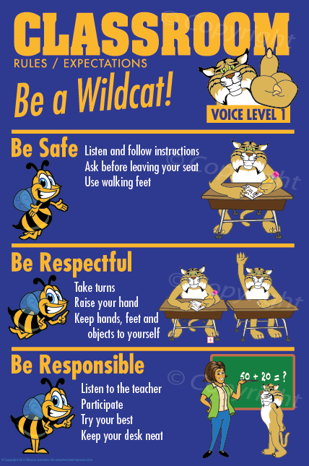
PBIS: Prepping the classroom environment
Rituals and routines should be inclusive and designed to decrease the frequency and duration of problem behaviors
An opportunity to earn their way back if an infraction occurs should be implemented
Teachers to model, remind, visually support, and enforce behavior rules and expectations consistently and revise them if necessary

Slide 6
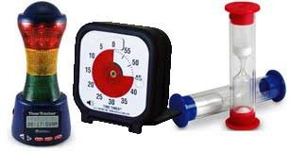
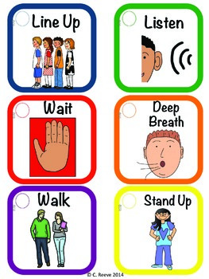
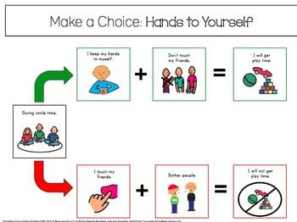
PBIS: Providing Visual Support
Verbal communication of expectations and rules should use simple language and, when feasible, be accompanied by visual representations

Slide 7
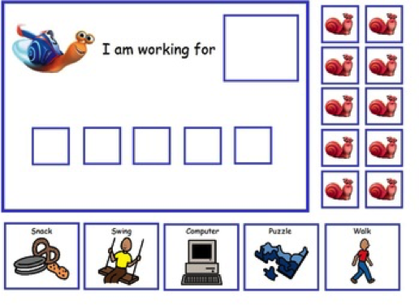
PBIS: Creating a system of rewards
Creating and implementing a reward system based on students’ interests will encourage students to buy into the rules and routines established in the classroom with the expectation that doing so will get them what they want in the end
Reward systems that acknowledge students for positive behavior should include both verbal praise as well as tangible rewards such as those found in a token economy system that students can accrue over a designated period

Slide 8
Tier 1...How does that work for students with autism?
Teach, teach, and RETEACH behavior expectations and procedures on a regular (if not DAILY) basis
Implement visuals to pairs with the expectations and procedures
Develop a positive reinforcement system for the class. You may develop individual systems as well as a system for the class as a whole---These should be DIFFERENTIATED as based on some sort of preference assessment
Set-up a consistent and clear consequence system that ALL staff working with your students will implement
Establish procedures for supervision and actively supervise students
Determine the best means for instruction that meet all students individual needs (small group, whole group, centers, 1:1) and evaluate your personal classroom management style

Slide 9
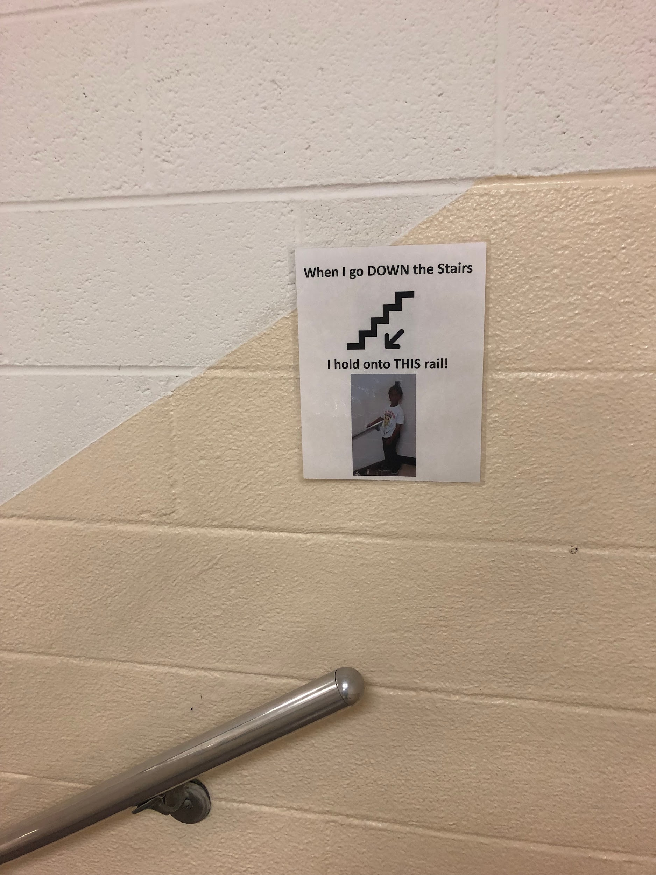
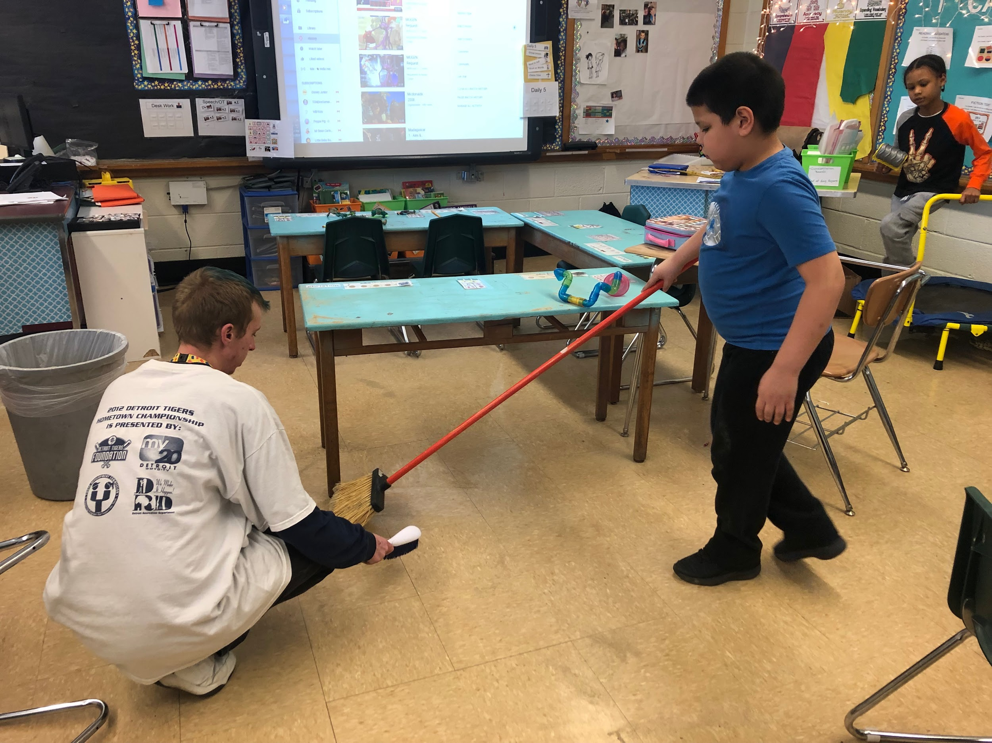
Tier 1 examples

Slide 10
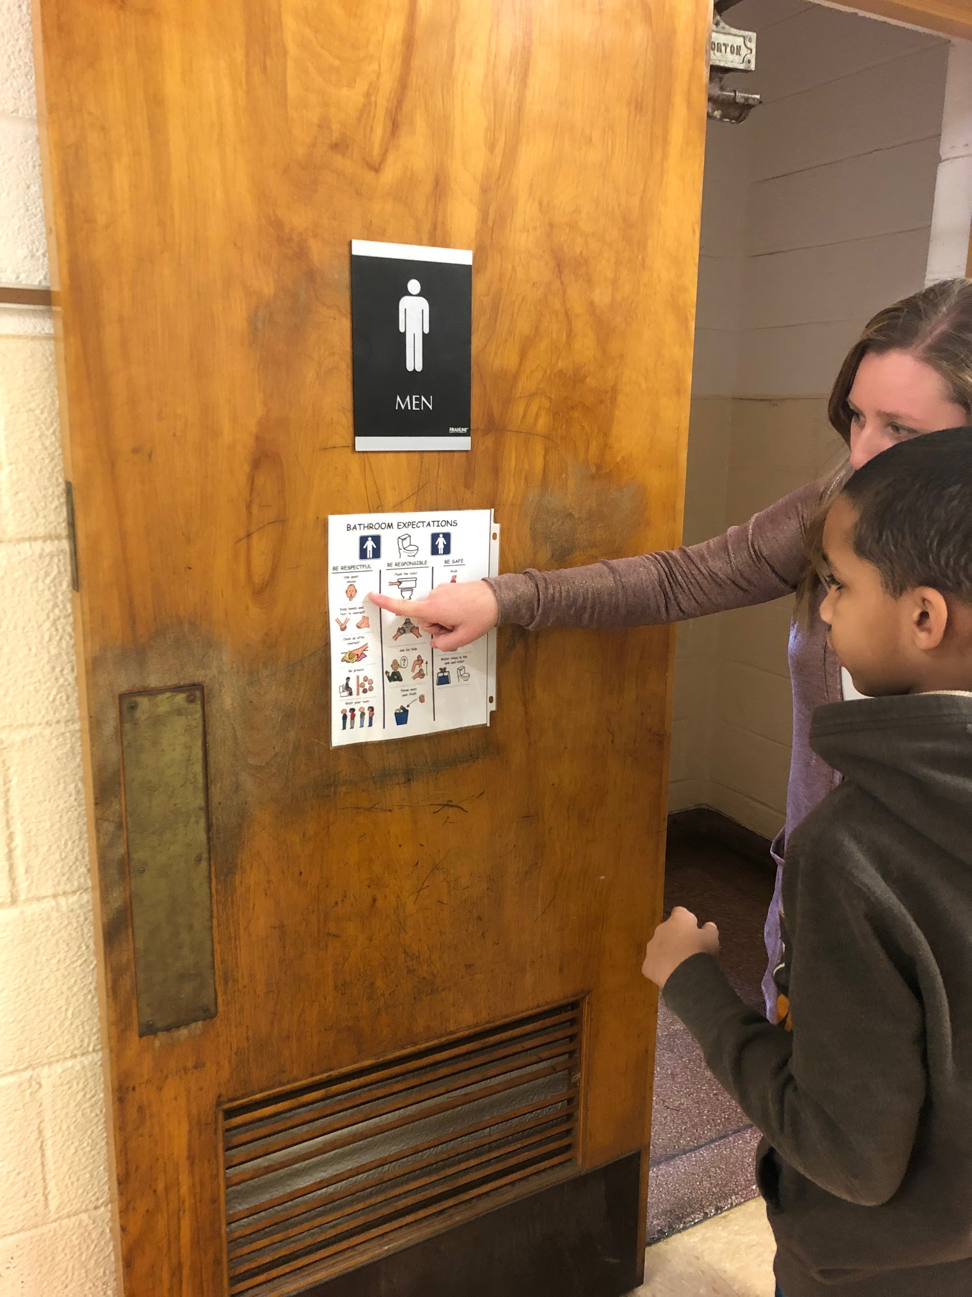
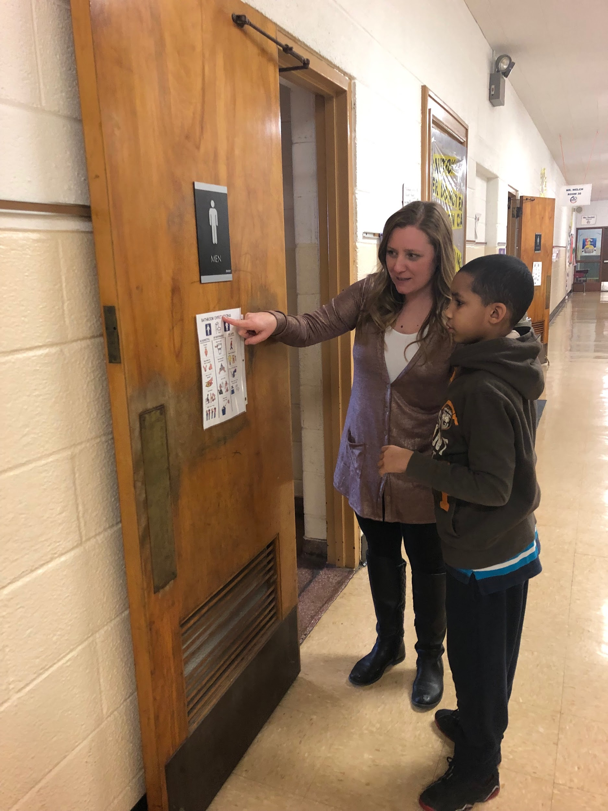
Tier 1 examples

Slide 11
Tier 2...How does that work for students with autism?
Determine social skill deficits and target those areas with social skills training, co-teaching models, social work supports, or social skills groups
Develop SIMPLE behavior plans as needed ***consider this phase 1, what is working? What motivates the student? How can we supplement instruction?
Predetermine alternatives to suspension with your building teams and administration. How can you avoid a manifestation???
Increase academic supports for students, are you meeting their IEP goals? If not, what can we change? What services can be added? What accomodations are needed?
Can you provide a general education peer to work with the student? How can a peer or mentor help meet the needs of the student?
EVALUATE your classroom management...AGAIN!

Slide 12
Tier 3...How does that work for students with autism?
DATA, DATA, DATA!!! Do you think it is time for a positive behavior intervention support plan? Meet with your team, discuss and provide evidence for what you have tried (strategies, accommodations, behavior supports, etc), and then obtain consent from the parent or guardian to begin the FBA (functional behavior analysis) process.
*Determine what behaviors exist, clearly define the behavior, and track data
*Complete the FBA and any supplemental assessments beneficial to the process--identify the function of the behavior
*Create a behavior plan that clearly defines the behavior, establish replacement behaviors that will meet the function of the behavior needing to be changed as well as the intervention process. Continue taking data!!!! Are the interventions working?

Slide 13
Tier 3 Wrap-Around Procedures
1-5%
Establish a relationship with the family
Create a team, including community and agency representatives
Assign roles and responsibilities to each team member
Meet at least monthly to review data and agree on strategies moving forward
Think about short and long term objectives
Understand that this process may take 1-2 years or more
**Collectively agree that failure is not an option**

Slide 14
I’ve done an FBA, we’ve written a PBIS plan...now what?
DATA, DATA, DATA...YES there is a point to collecting all of this DATA
Implement the plan with FIDELITY across all academic settings, be sure that ALL team members are fully aware of the plan and how to implement the plan
Continue to collect data and REVIEW and ANALYZE the data with your TEAM every 4-6 weeks at a behavior review meeting. Meetings should occur minimally on a quarterly basis.
Revise the behavior plan as needed and as behaviors change
Consult with outside agencies, physicians, and others relevant to the student’s care who have insight into the behavior plan process

Slide 15
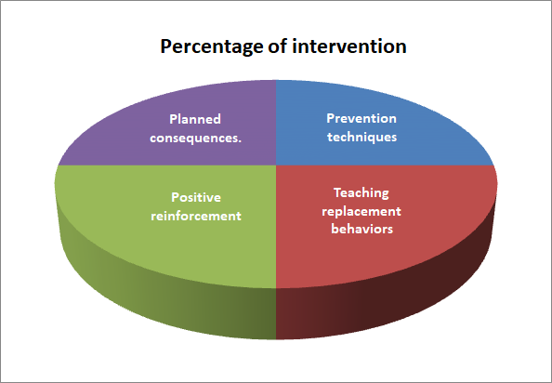
Teaching Replacement Behaviors
Components of the PBIS plan
Prevention Strategies
Replacement behaviors
Positive Reinforcement
Planned Consequences

Slide 16
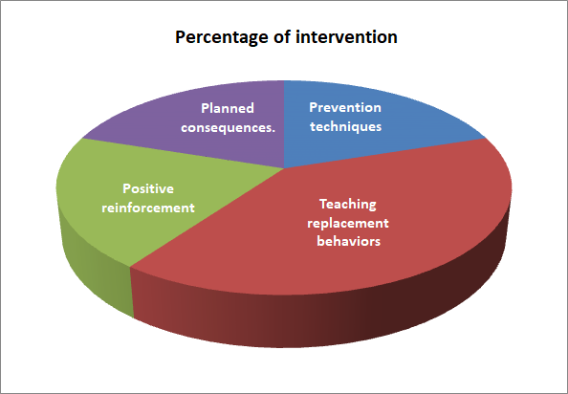
Teaching Replacement Behaviors
Components of the PBIS plan
Prevention Strategies
Replacement behaviors -
Positive Reinforcement
Planned Consequences

Slide 17
Teaching Replacement Behaviors
Behavior: Elopement from class during math instruction
Function: ESCAPE | Replacement: Ask for a break | Replacement: Ask for help
 | Break will be honored:-can be as short as 60 sec, no longer than 2 min | Help will be provided
 | Reinforced with praise or small edible reinforcement | Reinforced with praise or small edible reinforcement

Slide 18
CICO - check-in/check-out
Why should we try it?
Improves student accountability
Increases structure
Improves student behavior and academics when other interventions have failed
Provides feedback and adult support on a daily basis
Improves student organization, motivation, incentive, and reward
Helps students to self monitor and correct
Students get involved and excited about the program, enjoying the structure, support, and incentives of the intervention
Leads to maintenance free responsible behaviors, habits, and effort
Offers a relatively short amount of time to implement, and review effectiveness

Slide 19
CICO - check-in/check-out
I am Safe I am Responsible I am Respectful
CICO can be implemented school/program-wide as way for students to self-monitor behavior
For teachers, it can be:
- An effective “quick-check” of behavior before beginning each period.
- A chance to conference and debrief with students before they exit
 | Monday | Tuesday | Wednesday | Thursday | Friday
1st 7:50-8:48
2nd 8:53-9:51
3rd 9:56-10:54
4th 10:59-12:39
5th 12:44-1:42
6th 1:47-2:45
S = Satisfactory N = Needs Improvement

Slide 20
CICO - check-in/check-out for Tier 3 students
Month 2018-2019 | Academic Classroom Hour
 | 1st | 2nd | 3rd | 4th | Lunch | 5th | 6th
September | 1/18 | 0/18 | 1/18 | 0/18 | 0/18 | 0/18 | 0/18
October | 0/20 | 0/20 | 2/20 | 1/20 | 0/20 | 2/20 | 0/20
November | 0/16 | 0/16 | 1/16 | 1/16 | 1/16 | 3/16 | 0/16
December | 0/15 | 0/15 | 1/15 | 1/15 | 1/15 | 1/15 | 0/15
January | 0/14 | 0/14 | 0/14 | 4/14 | 1/14 | 3/14 | 0/14
February | 0/16 | 0/16 | 1/16 | 5/16 | 2/16 | 1/16 | 0/16
Totals | 1 | 0 | 6 | 12 | 4 | 10 | 0

Slide 21
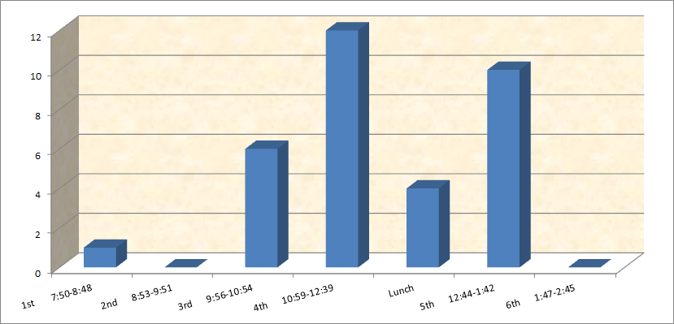
CICO data - What does it tell us?
It tells us that our student is struggling during 4th and 5th hour.
It tells us that we need to investigate what is happening during these times.

Slide 22
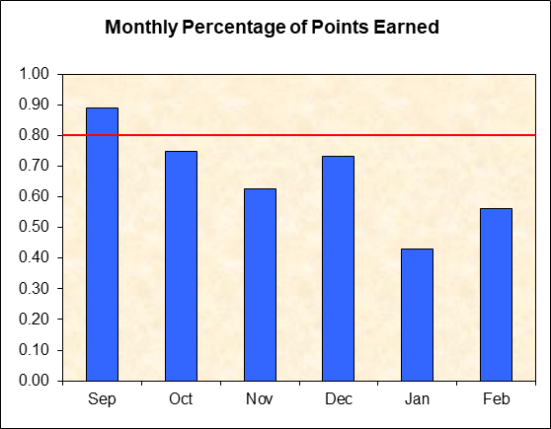
CICO data - What does it tell us?
It tells us that incidents of behavior have steadily increased from September through January.
It tells us that we need to revise, regroup, and refocus our strategies.
Change in interventions

Slide 23
CICO - Positive reinforcement -LPHS
Weekly average of “S” | Classroom | Specific activity/reward
100%-90% | Donaldson/Szypula | Technology Room
89%-80% | Voltattorni | Arts and Crafts
79%-70% | Nikischer | Game Room
69%-0% | Vargo | PBIS reteaching

Slide 24
LP Middle School LINKS/High School P2P
Middle School LINKS
30 general education students
ALL ASD students participate whether they push-in to a gen edu class with a peer or the peers push-in to the ASD classes (reverse inclusion)
The peer to peer supports are there to be friends, role models and social liaisons linking students with autism to the rest of the school and helping them access atypical middle school experiences with the greatest amount of independence possible.
High School Peer-to-Peer
36 ASD students, 22 participate in peer to peer (61%)
4 students act as peers for an entire classroom, so that every student in the ASD program has access to a peer at least one hour per day.
During the 2016-2017 school-year, only 6 students in the ASD program attended a general education class. This school-year, 12 students attend a general education class. 8 of which attend multiple general education classes per day.

Slide 25

What does is mean to be a peer?

Slide 26

Students with autism accessing PBIS clubs
PLAN ahead
TEACH and REVIEW expectations before each meeting
COLLABORATE with a buddy or peer and provide TRAINING for that buddy
PROVIDE visuals for the student and club leader
CO-FACILITATE a club with a general education teacher or staff
BRIDGE the gap for an INCLUSIVE setting

Slide 27

Anime Club
Men’s Club
Women’s Club
Music Club
Movie Club
Karaoke Club
Dog & Cat Club
Yearbook Club
Gamers Club
Yoga Club
Conflict resolution
Safe and healthy relationships
Appropriate social interaction
Hygiene
Bully awareness and prevention
Self advocacy
10 clubs currently in place at Mixter School, with at least 20 staff members involved as facilitators.
#teamwork
Choir
Lunch Club
Gym
STEM
Track
Band
Robotics
Gen-Ed curriculum with Peer support!

Slide 28
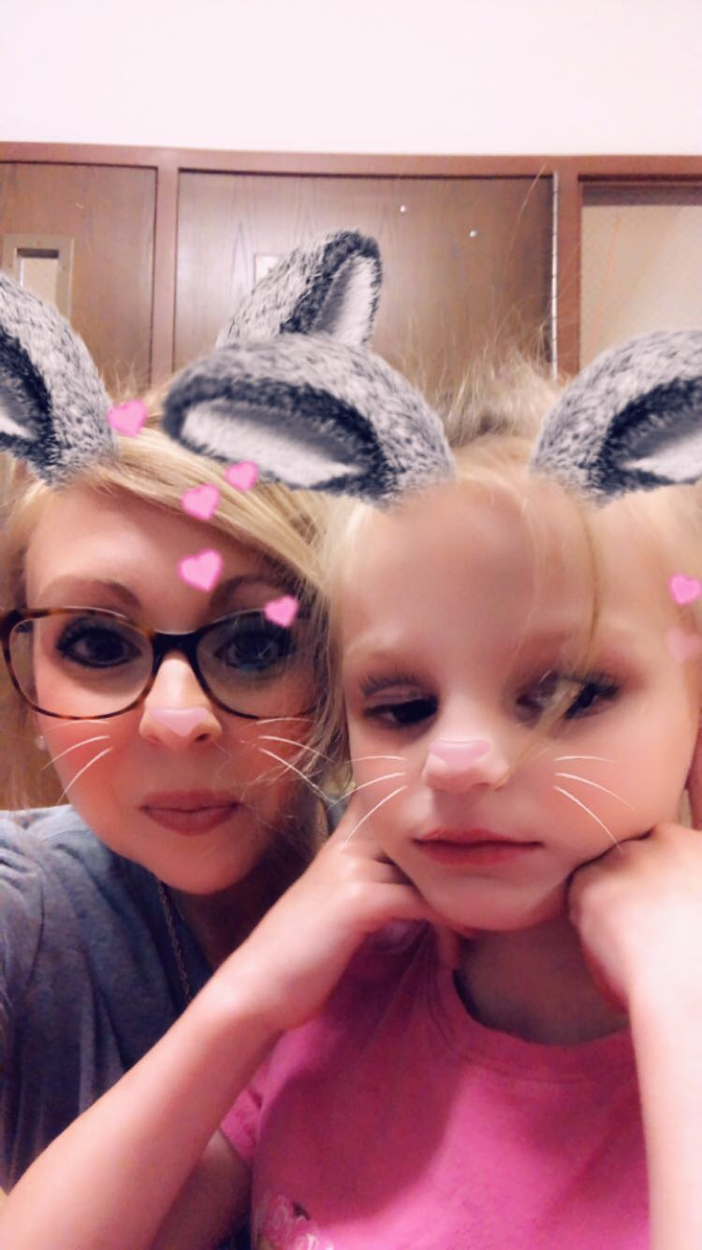
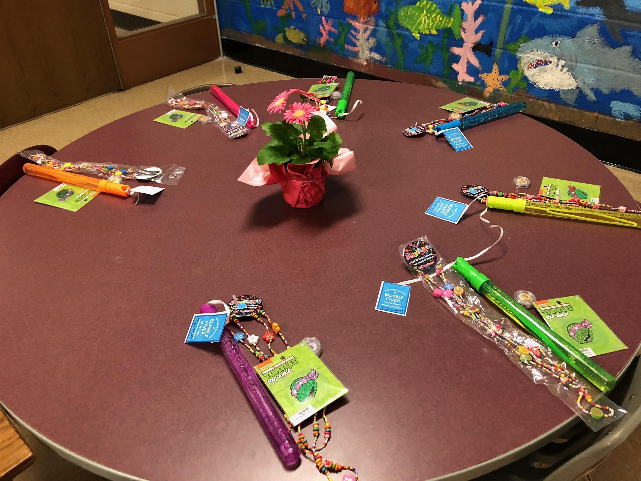
Elementary Social Groups/Girl’s Club
Elementary general education peers who push-in to ASD classrooms for additional support, play groups, peer modeling.
Lunch buddies
ASD classrooms who buddy up with a general education classroom to facilitate co-taught instruction
ASD students who access whole school PBIS clubs with general education peers
Girls club for ASD female students (approx 12) to promote social interaction as well as positive play

Slide 29
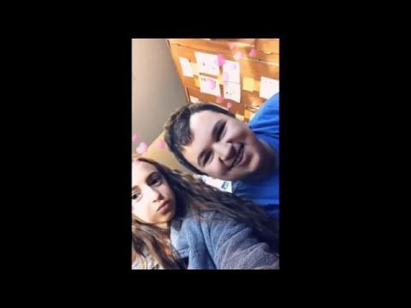
Peer-to-peer at LPHS

Slide 30
Questions??? Comments???
Contact Information
Derek Nowka: derek.nowka@lpps.info
Lauren Szypula: lauren.szypula@lpps.info

