Slide 1
Grosse Pointe Public Schools
Grosse Pointe North High School and Grosse Pointe South High School
School Wide Positive Behavior Support

Slide 2
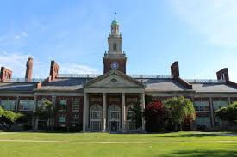
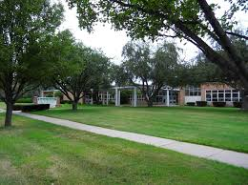
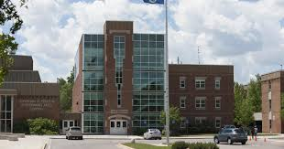
Schools
Two High Schools
Three Middle Schools
Nine Elementary Schools
One Early Childhood Center

Slide 3

Student Demographics
Some statistics….
We have 7,652 students
74% White
17% African American
4% Hispanic
4% Two or More Races
20% economically disadvantaged
13% have a disability
#OneGP

Slide 4

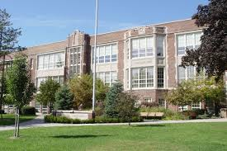
PBIS History
Started at one school Defer Elementary…..
Five years ago PBIS became a district initiative

Slide 5
Structures
District Level Coordinator
External Coach
Internal Coach
District Level Support
https://www.smore.com/msbxf

Slide 6
2019-2020 District Areas of Focus
Alternatives to suspension
Disproportionality in ODR and suspension
Developing Sustainable Professional Development
Alignment of code of conduct to PBIS and Restorative Practices
Alignment of PBIS with other initiatives

Slide 7
Grosse Pointe South
High School
Joseph Sprysak, Assistant Principal

Slide 8
Grosse Pointe South High School Demographics
1,524 students attend Grosse Pointe South High School
9th - 348 10th - 362 11th - 384 12th - 401 *14th - 28
84% White 7% African-American 4% Hispanic 3% Asian or Pacific Island
77 teachers
97% of students go on to post-secondary institutions of learning ; 87% four year colleges
More than 60% participate in sports and extracurricular activities
34 varsity sports and 78 clubs
AP classes - 23 different courses
AP exams taken - 1,187 with 68% earning a 3 or higher

Slide 9
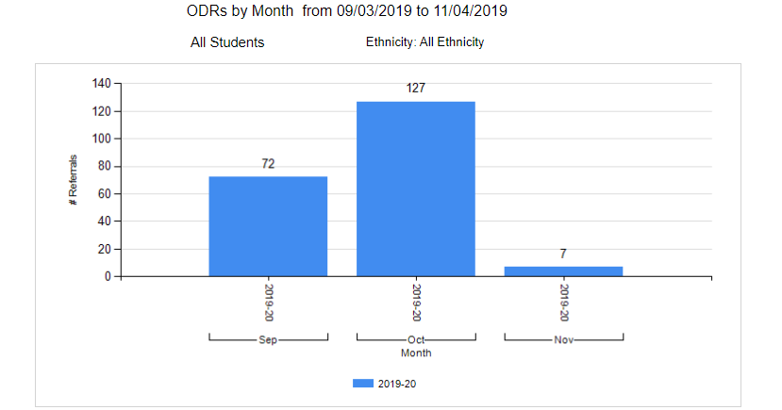
PBIS Data (South)4

Slide 10
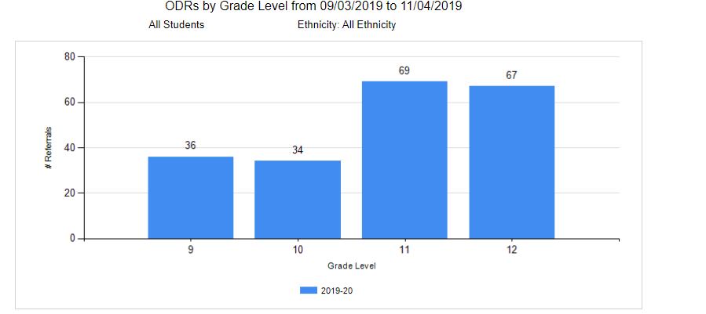
PBIS Data (South)3

Slide 11
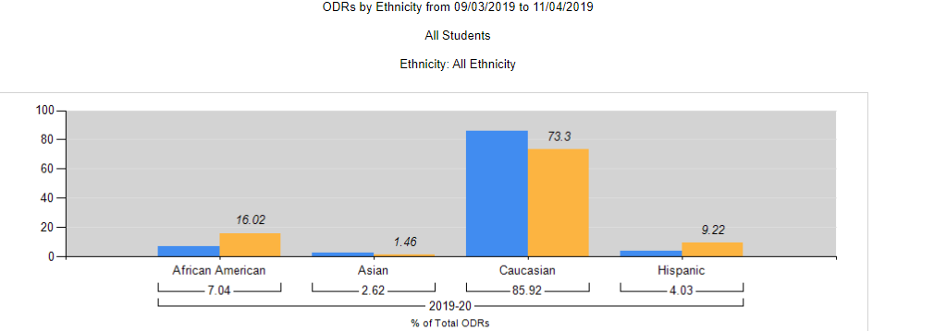
PBIS Data (South)6

Slide 12
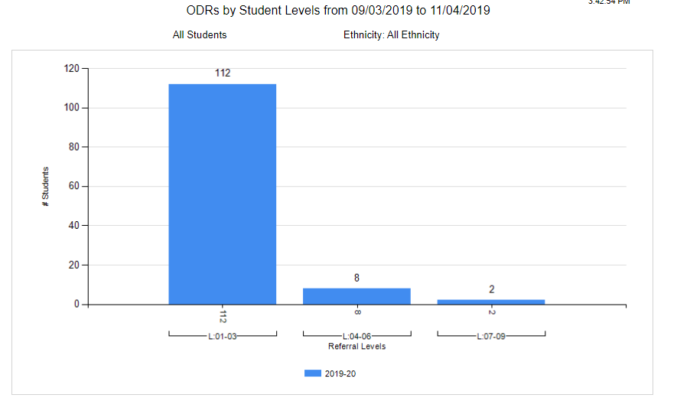
PBIS Data (South)

Slide 13
Tier I Team Operations
Meets once a month
The team consists of school administrator, central office administrator, data coach, five teachers, counselor, school social worker and school psychologist
Reviews PBIS data trends
Discusses options and strategies
School culture discussions - reminders of strategies we use and new strategies when available
Matrix revisions, instructions, and placement of signage
Lesson plans for implementation
Staff presentations
Staff survey review (fall) instructions (spring)

Slide 14
Lesson Plan for Day 2 of School - Tier I
Please have a discussion with your students with regard to expectations at each of these locations. Below is a list of the locations and some brief explanations you can use as talking points, if you so choose. Please use positive language and direction when working with students regarding the PBIS location posters.
Arrival and Departure (First Hour)
Be On Time - Arrive to your classes and other events in a time that allows you to get all necessary materials and be seated - ready to start right away.
Park In Designated Areas - Park in assigned parking spots and lots.
Heads Up - Be Cautious - Keep your eyes on your surroundings. Texting can be dangerous while walking and driving.
Use Sidewalks & Crosswalks - While walking, use the sidewalks and crosswalks to ensure safety. This way, all drivers know where to expect you.
Drive at Appropriate Speeds - Exercise caution and slow speeds when driving to ensure safety.
(Lesson Plan Provided for Review)

Slide 15
Lesson Plan for Day 2 of School - Tier I2
Lunch Area (Fifth Hour)
Eat In Designated Area - Eat your lunch in the commons, cafeteria or front lawn. This includes your food and beverages.
Make Healthy Decisions - Choose foods and beverages that are healthy.
Use Proper Language & Volume - Keep your conversations positive and among the people you are sitting with. Remember that there are classes going on nearby that may be distracted by a loud conversation while they are trying to learn.
Dispose of Trash - Dispose of all trash in the trash cans and all recyclable materials to the blue recycling bins.
(Lesson Plan Provided for Review)

Slide 16
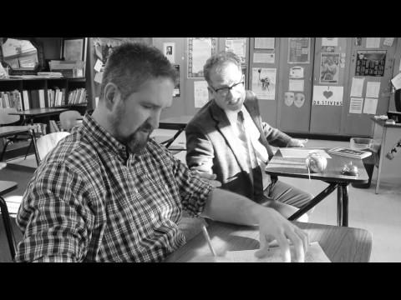
PBIS Video: Don’t Cheat

Slide 17
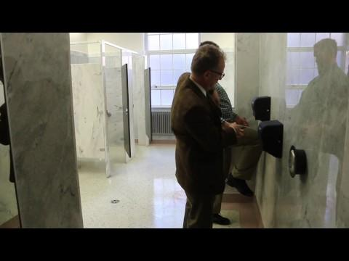
PBIS Video: Restroom Behavior

Slide 18
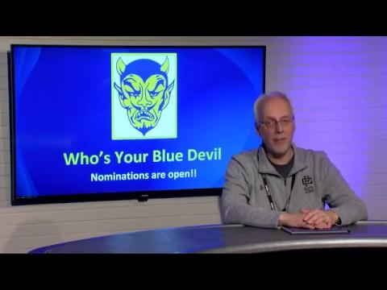
School Culture: Who’s Your Blue Devil?
Student-made video
Highlights key points
Applies to staff, students and volunteers
Certificates
Small gift - keychain, cookies, gift cards etc.
Online and hardcopy applications

Slide 19
Tier II Team Operations
Meets once a month
The team consists of school administrator, central office administrator, teachers, counselors, school social worker and school psychologist,
Review data provided by the data coach
Reviews new students and their profiles with the team
Discusses and develops strategies for the new students on the list
Currently developing Tier III criteria and strategies

Slide 20
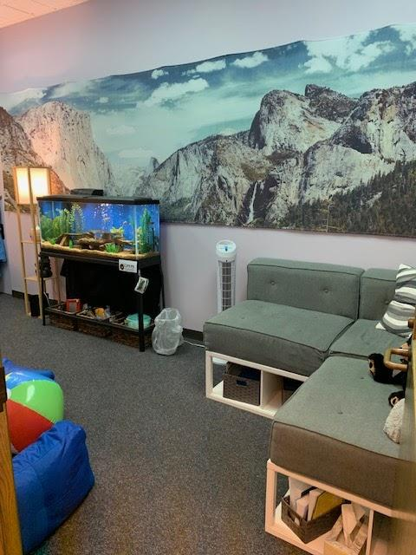
Chill Room - Trauma Informed Practices
Located in the counseling center
When students feel stressed or anxious
Students check in with counselor
QR code scanned to track time
Designed for 15 minutes or less
Weighted Blankets
Weighted Teddy Bear
Muted lighting

Slide 21
Male and Female Mentoring
Students are recommended by administration, teachers, coaches and counselors.
Tier II Team may recommend mentoring as an intervention strategy
Leadership skills are emphasized
Student mentors are also within the group to help establish peer resources
Meetings are held monthly during the school day

Slide 22
Tier 2: Flowchart Process
Pre- Tier 2 Meeting
District Technical Analyst (Seth Cueny) pulls student data for Counselors twice per month.
Failure report is cross referenced with ODRs by Student List report
Students who have 3 or more ODR’s per semester and are failing two or more classes are prioritized as “at risk” students
Data Coordinator (Hernandez) creates/updates Academically At-Risk document
Notes:
Beth

Slide 23
Data
Sample report

Slide 24
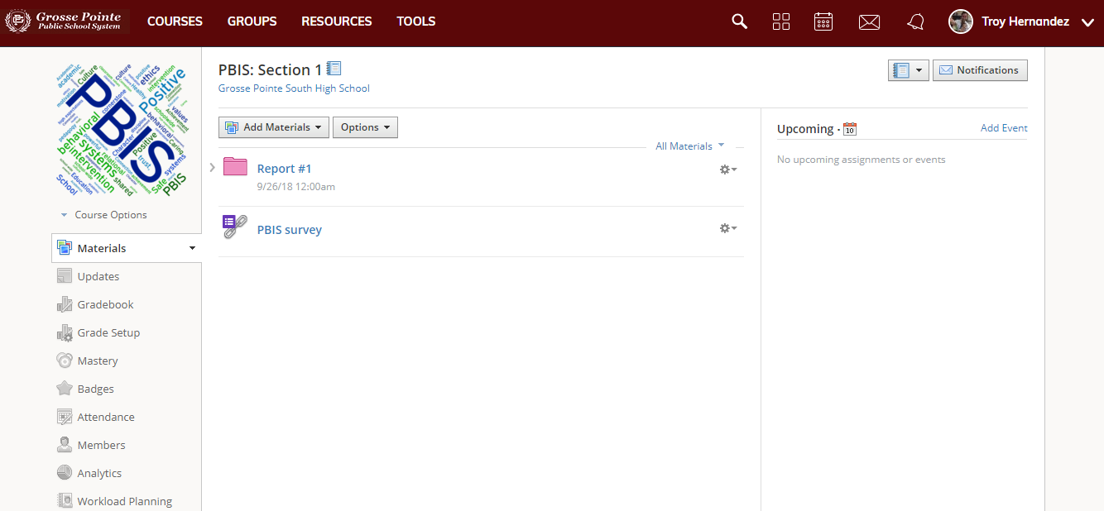
Schoology link and survey

Slide 25


Grosse Pointe North
High School
Katy Vernier, Assistant Principal

Slide 26
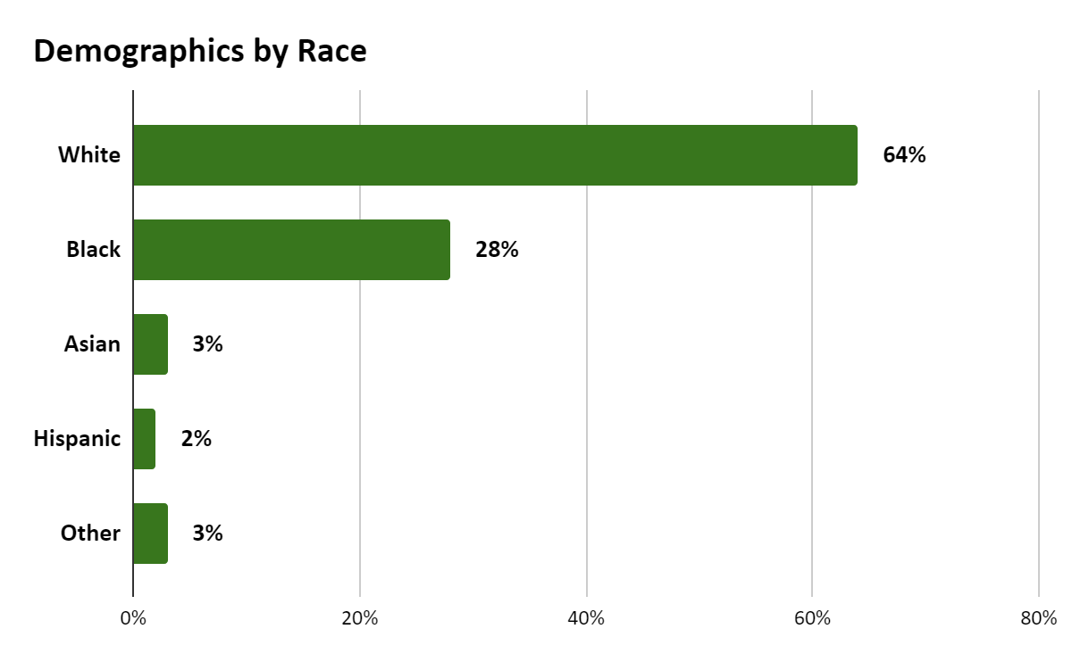
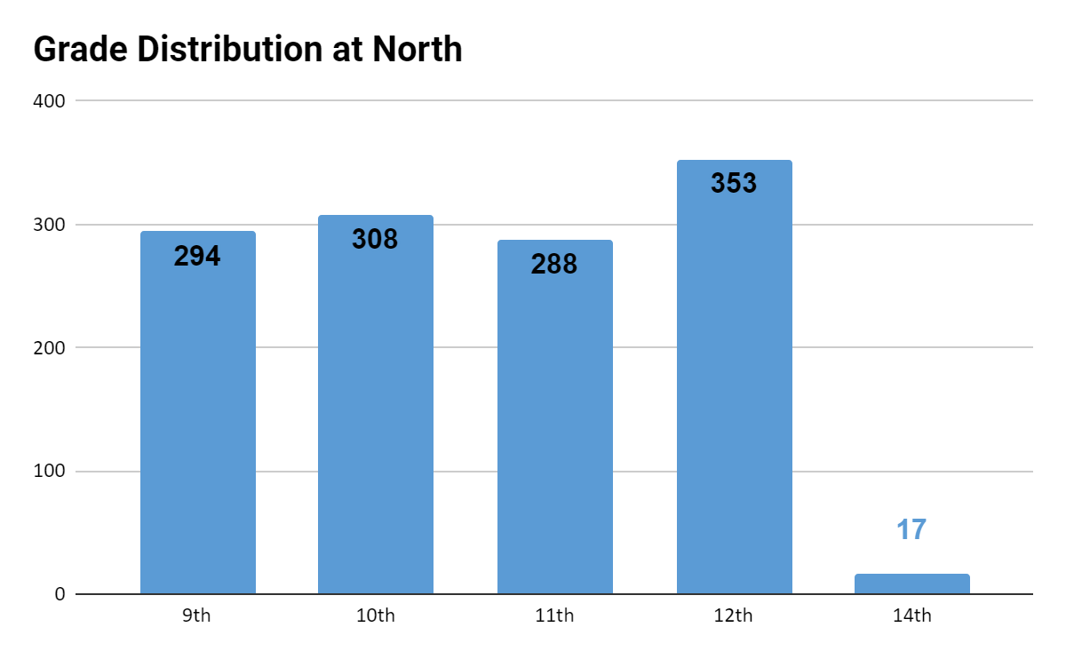
Grosse Pointe North High School Demographics
There are currently 1260 students at North. Approximately 20% are FRL. There are 90 faculty members. The graduation rate is approximately 95%.

Slide 27
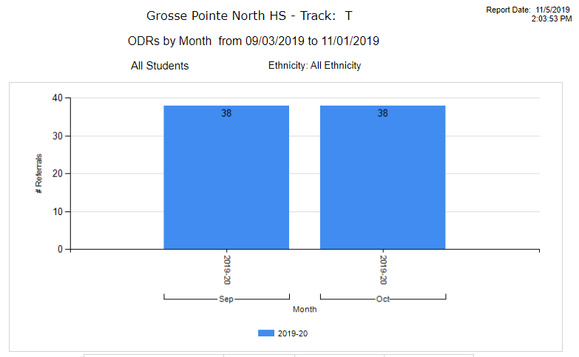
Grosse Pointe North PBIS Data

Slide 28
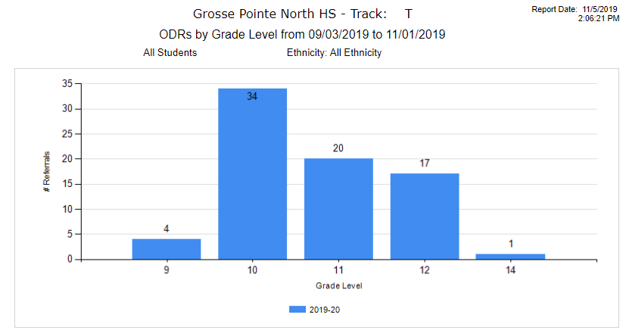
Grosse Pointe North PBIS Data2

Slide 29
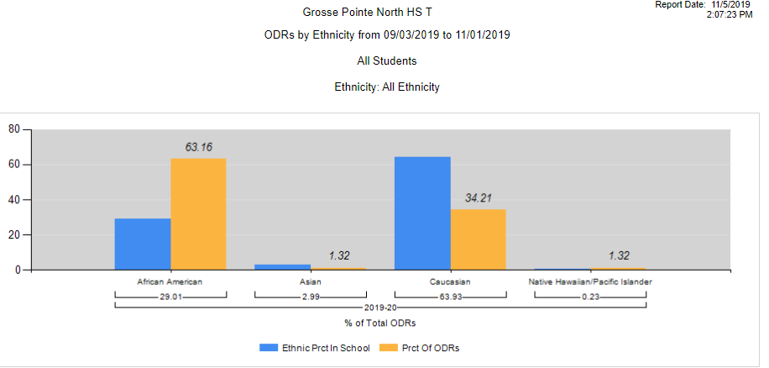
Grosse Pointe North PBIS Data3

Slide 30
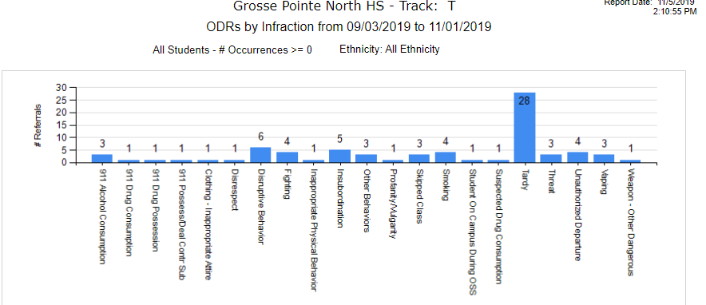
Grosse Pointe North PBIS Data4

Slide 31



Grosse Pointe North High School
TIER 1 TEAM
Administrator
2 Behavior Specialists (Special Ed teacher/SW)
Social Worker
Psychologist
2 Counselors
6 General Ed Teachers (academic/elective)
Notes:
ACES-Trauma informed practices

Slide 32
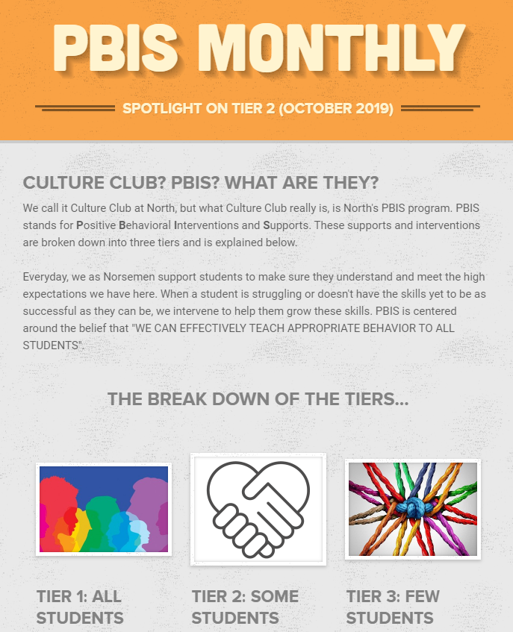
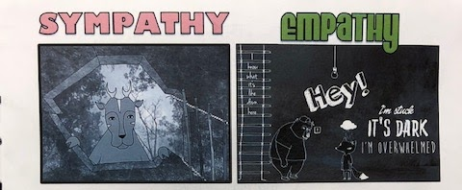
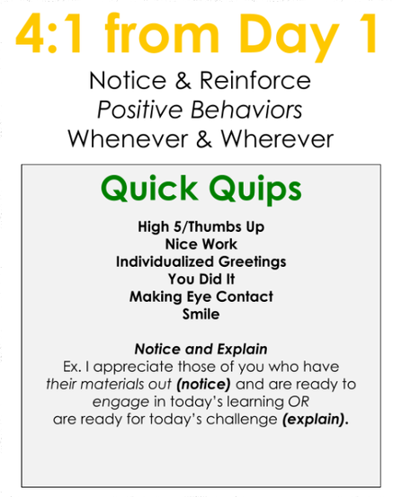
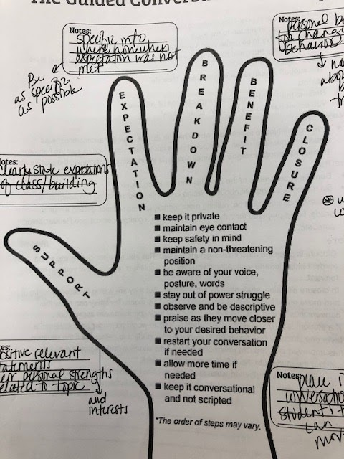
Grosse Pointe North High School2
TIER 1
Notes:
Working on transparency around the work and the data
Coaching Behavior (teach content vs. teach behavior)

Slide 33
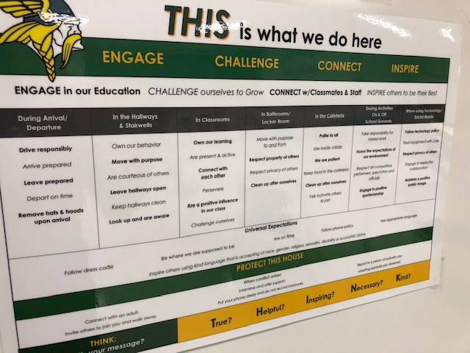
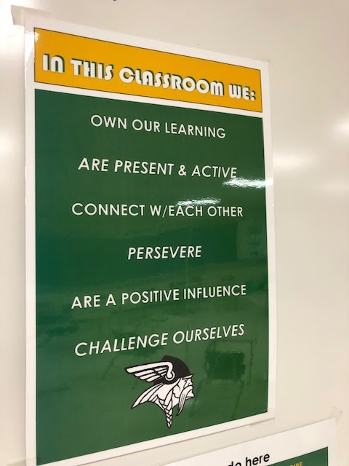

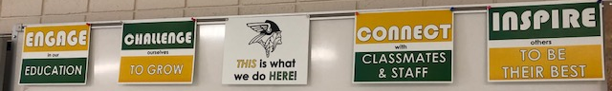
Grosse Pointe North High School3
TIER 1

Slide 34
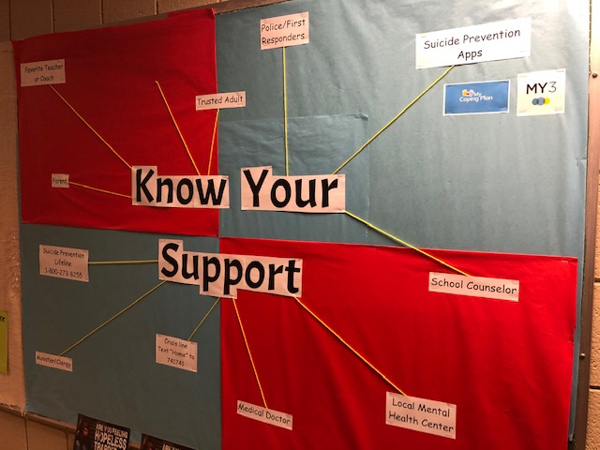
Grosse Pointe North High School4
TIER 1
New student Groups
High School 101
Suicide Prevention
Student Self-care
9th grade Resilience lessons
Career Exploration
Post-Secondary Planning
Notes:
Counselors going into classrooms, new student groups

Slide 35
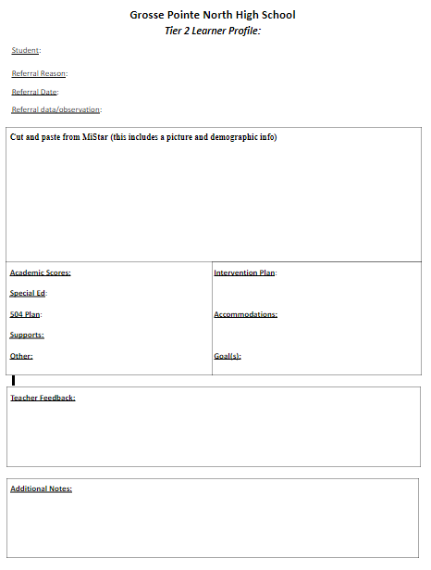
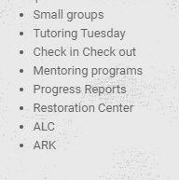
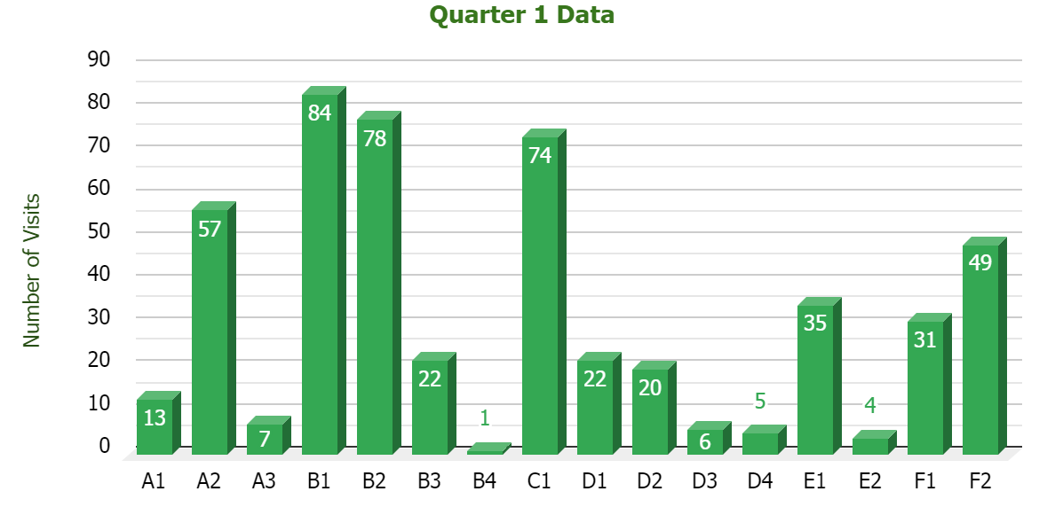
Grosse Pointe North High School5
TIER 2 TEAM
Administrator
2 Behavior Specialists (Special Ed teacher/SW)
Social Worker
Psychologist
1 Counselor
4 General Ed Teachers

Slide 36
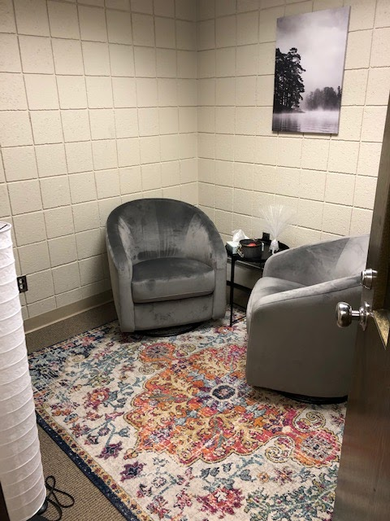
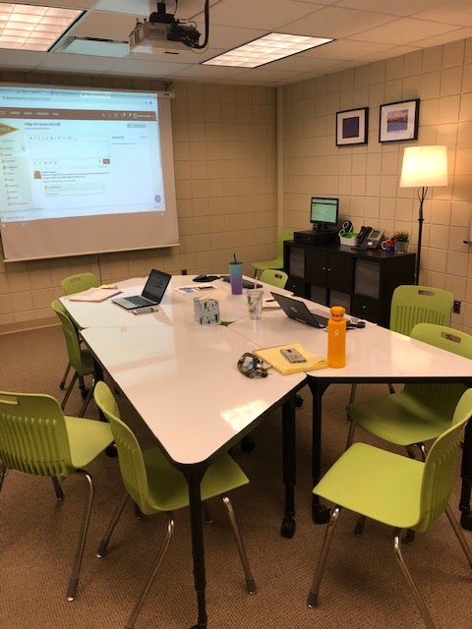
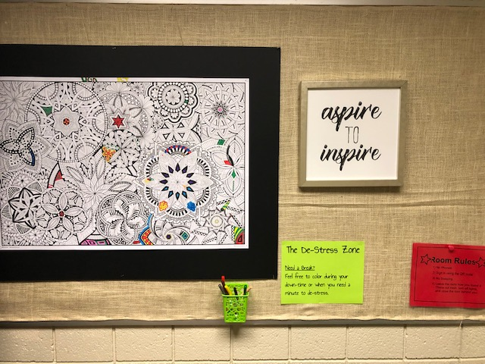
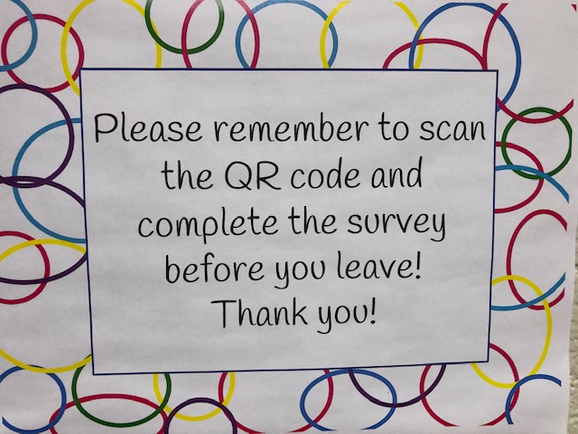
Grosse Pointe North High School6
TIER 2
Notes:
Tutoring Tuesdays
Chill Space
Counselor Individual Meetings for academic achievement and attendance from the data

Slide 37
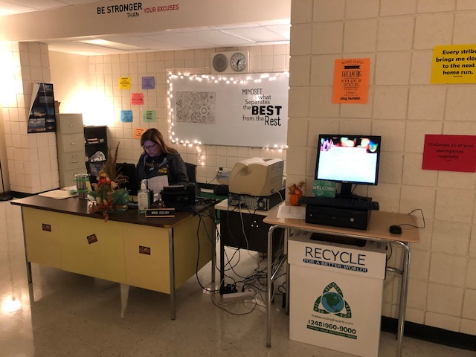
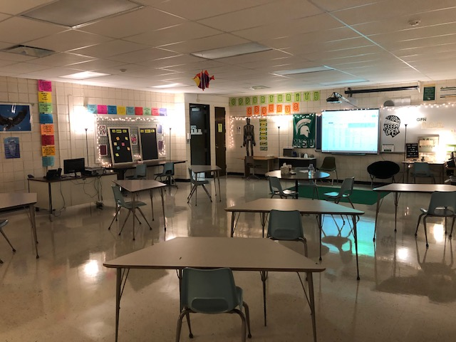
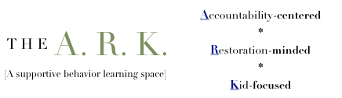
Grosse Pointe North High School7
TIER 2
Notes:
Make your mARK emails that focus on coaching behaviors

Slide 38
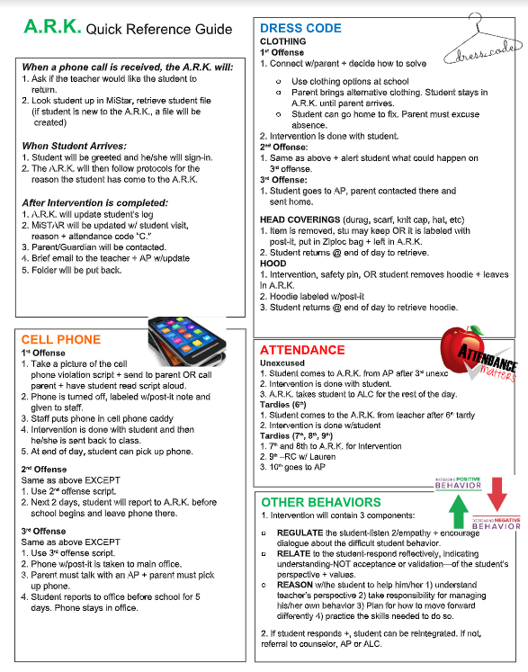
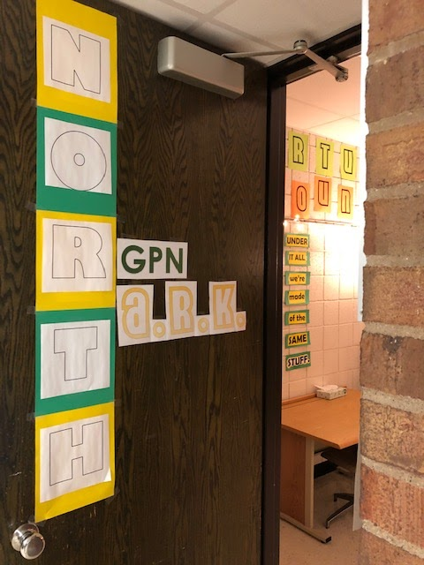
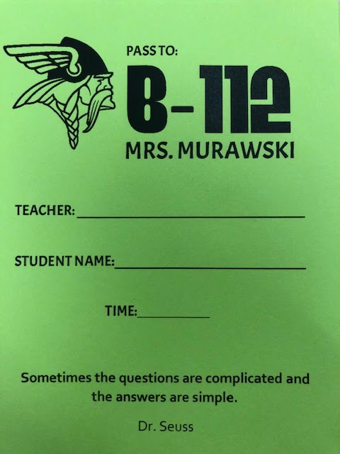
Grosse Pointe North High School8
TIER 2

Slide 39
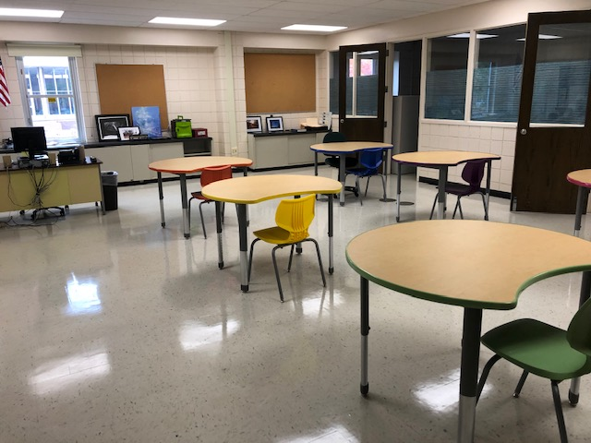
Grosse Pointe North High School9
TIER 2
ALC
Academic
Learning
Center
Notes:
Learning space
Academic ALC
Re-entry space (separation to sick kid to coming back from a hospitalization)

Slide 40
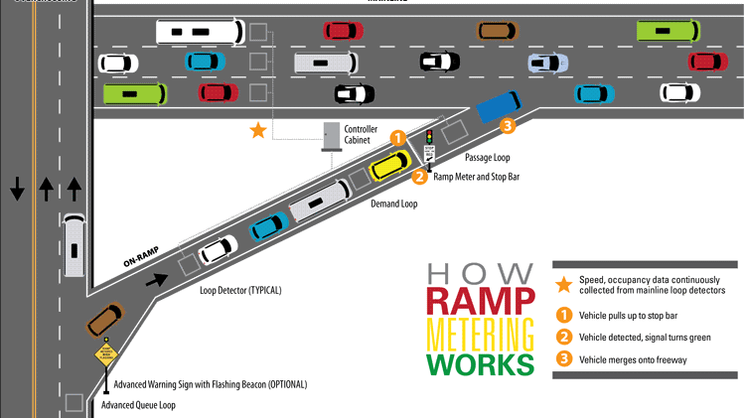
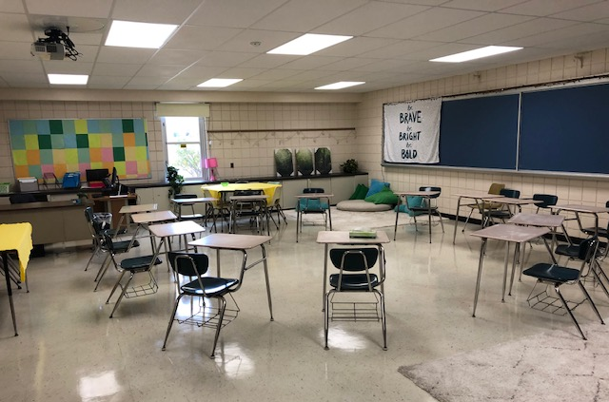
Grosse Pointe North High School10
TIER 2
The RC
Restoration
Center
Notes:
Restorative Practices
In the 2019-20 school year, North’s behavior interventionist programming will center on helping our neediest students stay on the road. It will also create a “ramp” back, when students have been unsuccessful. As the behavior interventionist, Lauren Klein will be specializing in various services students need to begin to navigate and thrive behaviorally:
Conflict mediation
Counseling groups
Individual intervention sessions
Restorative Practices (including restorative conferences and circles)
Restoration Services:
Direct intervention with students who have been separated from classes (those on the verge of out-of-school separation)
Direct intervention with students after out-of-school separation from classes/school
Creation of behavior plans to help students repair relationships and reconnect to the school/classroom community
Monitoring and supporting student growth plans
Assistance in The A.R.K.

Slide 41
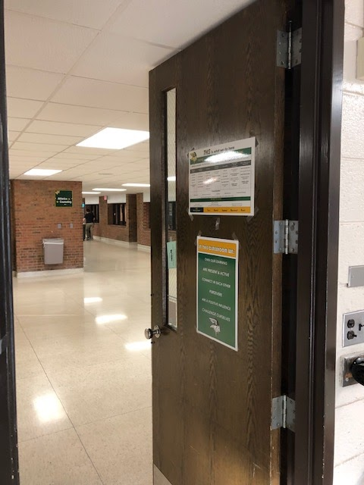
Grosse Pointe North High School11
Next Steps:
Transparency with data
Consistent plan for teaching Tier 1 behaviors
Including the student voice with Tier 1
Analyzing the programs that have been put in place

Slide 42
Contacts:
Susan Lucchese: lucches@gpschools.org
Aimee Miller: millerai@gpschools.org
Joseph Spryszak: spryszj@gpschools.org
Katy Vernier: verniej@gpschools.org

