Slide 1
PBIS & Restorative Practices
Kayrl Reynoso Chris McEvoy
Consultant Consultant
reynosk@resa.net mcevoyc@resa.net
Wayne RESA
2019-2020

Slide 2


PBIS & Restorative Practices2
Do we stop using PBIS when we start using Restorative Practices?
Importance of Alignment
PBIS is a framework into which Restorative Practices fits.
We can move forward aligning both PBIS and Restorative Practices.

Slide 3
PBIS Framework
“PBIS is a framework or approach for assisting school personnel in adopting and organizing evidence-based behavioral interventions into an integrated continuum that enhances academic and social outcomes for all students.”
https://www.pbis.org/

Slide 4
PBIS Framework2
A systems-based strategy to create a “host environment” in schools to reduce problem behaviors and improve school climate
Three-tier intervention logic
Behavioral interventions
Team-based planning and implementation
Systematic use of student-level behavior
Data to support decisions and improve program implementation
Systematic use of intervention fidelity assessments to guide implementation
NOT a single “program” but rather the “vessel” for many approaches
Integrating Multiple Evidence-Based and Promising Practices in Schools (jeffs@uoregon.edu)Integrating Multiple Evidence-Based and Promising Practices in Schools (jeffs@uoregon.edu)

Slide 5
Why Consider Restorative Practices?
The “Rethink Discipline” Law, enacted in August 2017, requires that schools consider the use of restorative practices and “lesser interventions” prior to a suspension or expulsion of a student.
Restorative Practices can positively influence school climate and culture as well as provide alternatives to suspension for students who need Tier 2 & Tier 3 interventions.
RP promotes teaching empathy, taking responsibility for behavior, and providing restitution to the victims of an incident.
Punishment-based consequences often do not go far enough and do not teach students how to take responsibility or repair the harm they have caused.
RP are restorative for both the offender and the victim.

Slide 6
Rethink Discipline
Effective August 1, 2017
Michigan School Code
Sec. 1310d. (1) Before suspending or expelling a pupil under section 1310, 1311(1), 1311(2), or 1311a, the board of a school district or intermediate school district or board of directors of a public school academy, or a superintendent, school principal, or other designee under section 1311(1), shall consider each of the following factors:
(a) The pupil’s age.
(b) The pupil’s disciplinary history.
(c) Whether the pupil is a student with a disability.
(d) The seriousness of the violation or behavior committed by the pupil.
(e) Whether the violation or behavior committed by the pupil threatened the safety of any pupil or staff member.
(f) Whether restorative practices will be used to address the violation or behavior committed by the pupil.
(g) Whether a lesser intervention would properly address the violation or behavior committed by the pupil.
Does not apply to a student being expelled for possession of a firearm
Notes:
Rebuttable presumption >10 days

Slide 7
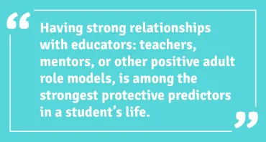
Why Consider Restorative Practices?2
Strong relationships motivate change.
PBIS & Restorative Practices both focus on strengthening relationships.
PBIS & Restorative Practices Video from the National Forum:
https://www.youtube.com/watch?v=ORBp0Witx58&feature=youtu.be

Slide 8
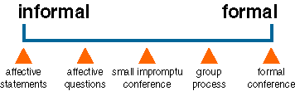
Restorative Practices on a Continuum
Restorative interventions follow a continuum from informal to increasingly formal.
At the beginning of the continuum is the use of affective statements and questions that can be used in any setting school-wide.
Use of such language can promote a restorative school culture.
Small conferences or circles are more targeted interventions that require more time and planning.
Formal restorative conferences involve a facilitator, willing participants, are scripted, and are specific to an individual incident.

Slide 9
Restorative Practices within Tier 1
Goal is to create school-wide systems that use restorative language and interventions.
Restorative language that uses affective statements and questions promotes an empathic culture.
Community-building circles promote community, safety, and harmony within the classroom and school.
“Restorative justice is a philosophy, not a model, and ought to guide the way one acts in all of one’s dealings.” –RealJustice Conferencing Handbook

Slide 10

Building Positive Classroom Environments www.iirp.edu
Building positive classroom community can reduce problem behavior significantly.
Restorative practices promotes inclusiveness, relationship-building and problem-solving, through such restorative methods as circles for teaching and conflict resolution.

Slide 11
Building Positive Classroom Environments2 www.iirp.edu
Circles are an intervention that facilitate classroom discussions on difficult issues such as disruptive behavior, bullying, or defiance.
Students are encouraged to reflect on and take responsibility for their actions and come up with plans to repair harm.
Circles can be community-building in nature or problem-solving.
Creating community within the classroom promotes a safe, inclusive environment where students are comfortable to share about themselves and seek help when needed.

Slide 12
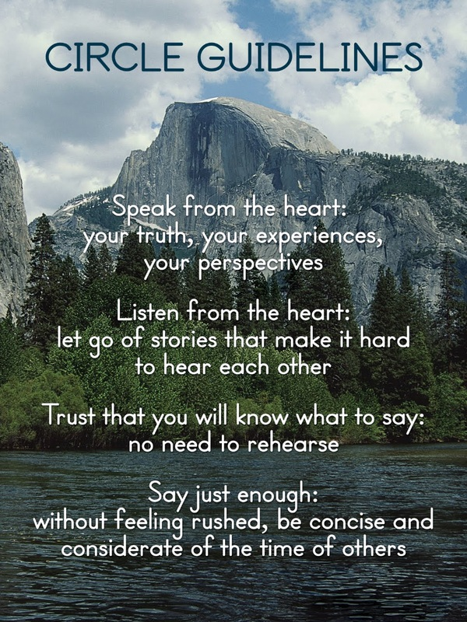
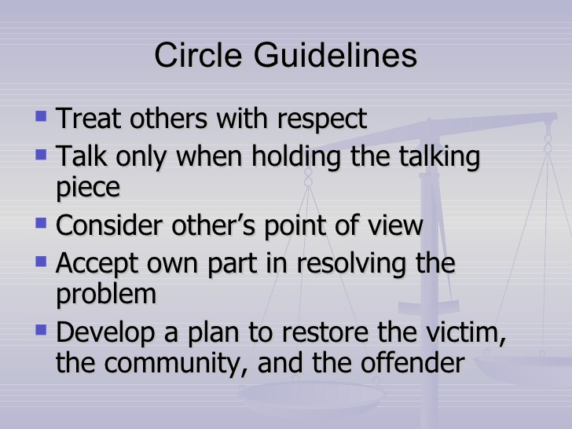
Restorative Circle Guidelines

Slide 13
Community Building Circles
Tier 1
Students practice listening, taking turns, and showing empathy.
Talking piece is introduced.
Low-risk/non-controversial questions are asked to promote community.
Riskier questions are asked to promote intimacy.
Trust is built. Students feel a sense of belonging.
All sharing is voluntary.
Example community-building questions: Who is a hero of yours (real life, movies, book) and why? What is your favorite meal?
Example trust-building question: When have you had a conflict with someone and what happened?

Slide 14
Responding to Behavior
RealJustice Training Manual
International Institute for Restorative Practices
Use affective statements: “Jason, you really hurt my feelings when you act like that. And it surprises me because I don’t think you want to hurt anyone on purpose.”
Create informal restorative interventions by asking affective questions when an offense occurs: “What happened?” “What were you thinking about at the time?” “Who do you think has been affected?” “How have they been affected?”
Do not ask, “Why did you do that?” Focus is on what, who, and how questions.
Provide those who have been affected an opportunity to express their feelings, if willing.
Incorporate affective statements and questions into classroom management techniques such as private student/teacher conferences and conflict-resolution between peers.

Slide 15
Sample:
Basic Consequence Sequence for Minor Infractions
Corrective Feedback
Time-Out/Reflection
Privilege Loss
Parent Contact
Buddy Classroom

Slide 16
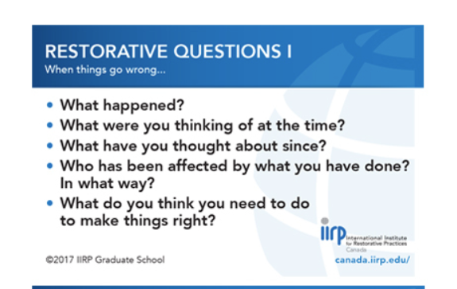
Restorative Chat Questions

Slide 17
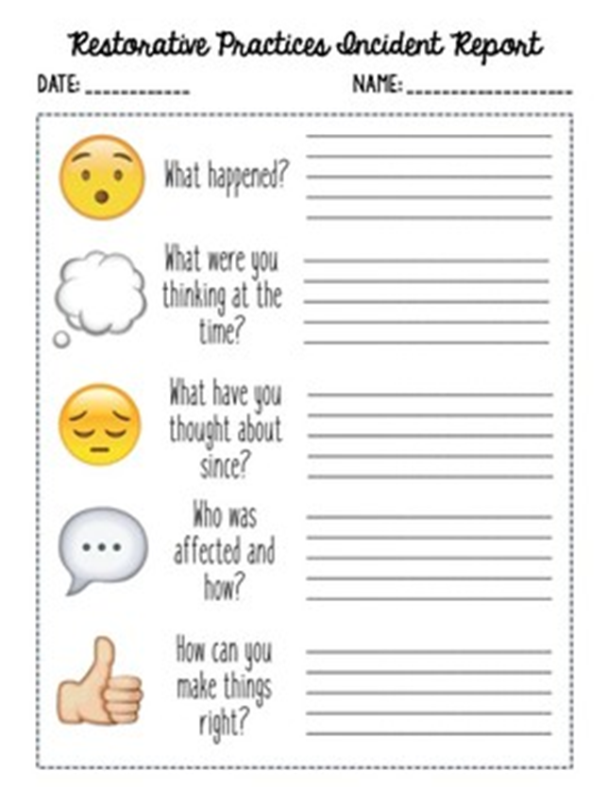
Restorative Practices Think Sheet

Slide 18
Restorative Practices within Tier 2
Response to Harm Circles
Amos Clifford Center for Restorative Practices
Response to Harm Circles address more specific behavioral problems.
A circle would require a facilitator who is trained and can prepare for the circle.
Circles may include a small group of students or an entire class that is struggling with behavior.
Circles are structured, have guidelines, and follow a script to facilitate discussion and problem-solving.
Students are empowered in the circle to check in, identify the problem, discuss the harm it has caused, brainstorm how to repair the harm, and come to an agreement on a solution.
Circles promote trust-building and help students take ownership of a problem.

Slide 19
Response to Harm Circles
Tier 2
Response to Harm Circles focus on discussing a challenging situation that affects a classroom or a small group of students.
Name the issue clearly and accurately.
Students or staff may identify the issue.
Students who caused the harm learn how their actions affected others and their community.
Agreements will be created by the students to facilitate problem-solving.
Students and staff will follow-up on agreements/solutions to the identified problem.
Schools may choose to have a trained facilitator to run these types of circles as an alternative to suspension.

Slide 20
Restorative Practices within Tier 3:
Restorative Conferences
Restorative conferencing is a formal way to address a specific, high-level behavioral infraction or violation of rules/laws.
A referral to a restorative conference may take place in lieu of a suspension or to shorten a suspension period.
All participants must be willing to participate in a restorative conference (the offender and the victim, as well as their families, if applicable).
A trained facilitator gathers background information via interviews and reviews of incident reports regarding the specific offense.
A restorative conference takes place, facilitated with a script, with the intention of identifying the problem, recognizing the harm that was caused, and coming to an agreement regarding how to repair the harm.

Slide 21
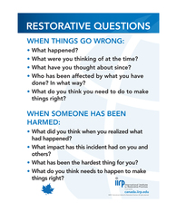
Restorative Conferences:
Tier 3
Restorative conferences do not ask “Why” the offender participated in the offense. Rather, a trained facilitator follows a script of questions for both the offender and the victim to help elicit empathy, understanding, agreement, and problem-solving.

Slide 22
Keep In Mind…
In order to facilitate restorative circles and conferences, training is required.
Always use data to drive your decisions on who receives Tier 2 & Tier 3 interventions as these are more intensive and time-consuming.
Consider using Restorative Practices as an alternative to suspension.
Participants must be willing to engage in a restorative circle or conference.

Slide 23
Restorative Practices within a PBIS Framework
Restorative practices are a positive approach to dealing with problem behavior and fit into school’s three-tiered PBIS framework.
Using restorative language, affective statements and questions, and Community-Building Circles facilitate positive culture & climate. (Tier 1)
Response to Harm Circles can also take place in a classroom or with a small group of students and address ongoing problematic behaviors. (Tier 2)
Restorative Conferences take place in a formal setting, address a high-level behavior infraction, and use a trained facilitator. (Tier 3)
Restorative circles and conferences promote empathy, ownership of behavior, and problem-solving. The goal is to “restore the harm” rather than just punish offenders.

Slide 24
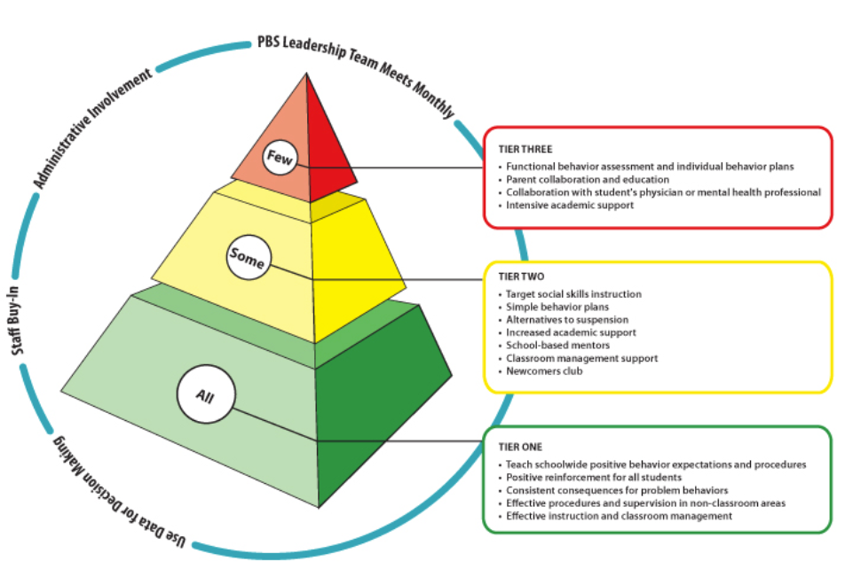
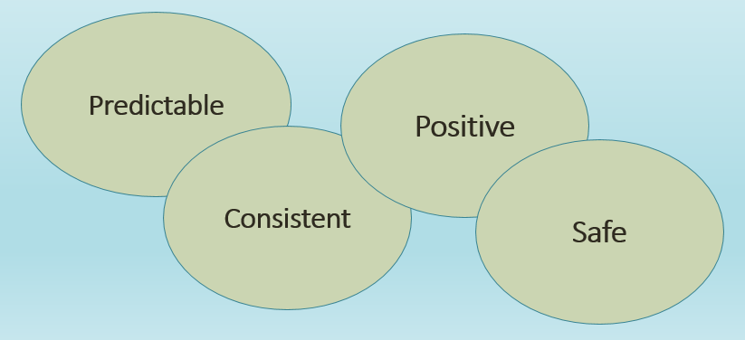
PBIS Framework22
The fundamental purpose of PBIS is to make schools more effective & equitable learning environments. Rob Horner, Co-Director of the OSEP Technical Assistance Center for PBIS

Slide 25
The Three Tiers of Restorative Practices
Tier 2 RP Practices: Affective language, Restorative Dialogue, Responsive Circles (problem solving and repairing harm)
The Three Tiers of Restorative Practices
Adapted from http://www.healthiersf.org/
Tier 3
Intensive RP Interventions
Restorative Conferences & Re-Entry
Restorative Practices Principles
Equity of Voice
Inclusive decision-making practices
Shared ownership of classroom and school-wide values
Non-punitive response to wrongdoing
Promoting empathy & ownership of behavior
Tier 2 Targeted RP Interventions
Affective language
Restorative dialogue
Responsive Circles (problem solving and repairing harm)
Tier 1 Universal/Prevention Focus
Developing social/emotional capacity
Building relationships & community
Responsibility for self & others
Accountability
Addressing school-wide and classroom behaviors
Affective statements & questions
Restorative dialogue impromptu conferences
Community building circles
Responsive classroom and school-wide circles
Foundation: Restorative Principles and Values

Slide 26
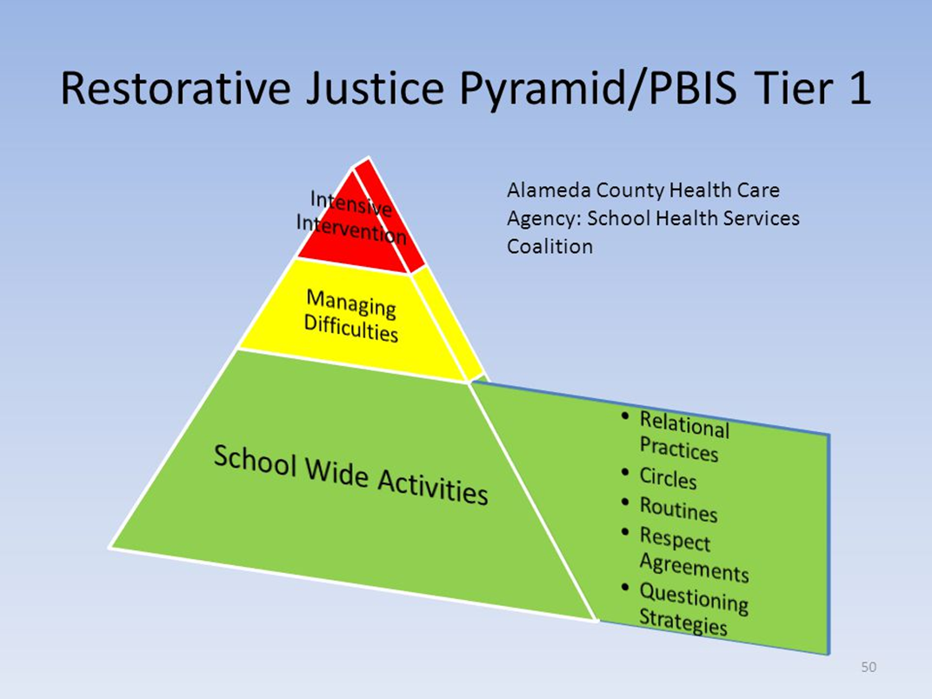
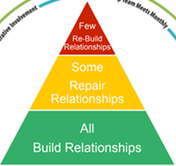
PBIS Framework
& Restorative Practices

Slide 27
Restorative Practices Trainings
Offered at RESA
0339 Restorative Practices Days 1 & 2
Day 1: Introduction to Restorative Practices Training focuses on the key concepts of Restorative Practices and how they are used to build strong, healthy relationships, resolve challenges, and build social capital. The concepts involve reflection and awareness of one's self and one's practice. Day 2: Using Circles Effectively applies the fundamental processes of Restorative Practices and enables participants to practice the techniques, including how to optimally utilize circles in any setting. As part of Wayne RESA's course offerings, participation in Restorative Practices Days 1 & 2 (Introduction to Restorative Practices & Using Circle Effectively is a prerequisite to attending Restorative Practices Days 3 & 4 (Facilitating a Restorative Conference). Black Family Development, Inc., a licensed partner of the International Institute of Restorative Practices, facilitates this formal Restorative Practices training. Please Note: In addition to learning skills to support positive relationship development and improve overall school climate and culture, participation in this course prepares schools to knowledgeably consider use of restorative practices as required in Michigan's "Rethink Discipline" legislation (Public Acts 360-366 of 2016).
December 17 & 18, 2019
8:00am-3:30pm

Slide 28
Restorative Practices Trainings
Offered at RESA2
0346 Restorative Practices Days 3 & 4
Facilitating a Restorative Conference focuses on techniques to facilitate a formal conference involving a "victim" and an "offender." Restorative conferences allow those who have been most affected by an incident to share their feelings, describe how they have been affected, and develop a plan to repair the harm done and prevent recurrence. Participant learning will include: - Analysis of true stories that illustrate the emotional dynamics and healing potential of restorative conference as compared to more punitive approaches; -interactive exercises that help to identify who should be invited to a conference and how to prepare them for the conference; - Role-plays to assist in developing the ability to facilitate a conference and apply restorative practices fundamental concepts; and - Approaches to reintegrate people who have caused harm back into the community. As part of Wayne RESA's course offerings, participation in Restorative Practices Days 1 & 2 (Introduction of Restorative Practices & Using Circles Effectively) is a prerequisite to attending Restorative Practices Days 3 & 4 (Facilitating a Restorative Conference). Black Family Development, Inc., a licensed partner of the International Institute of Restorative Practices, facilitates this formal Restorative Practices training.
March 24 & 25, 2020
8:00am-3:30pm

Slide 29
Resources
https://www.resa.net/curriculum/schoolwide-positive-behavioral-interventions-supports/
International Institute for Restorative Practices www.iirp.edu
Teaching Restorative Practices with Classroom Circles, Amos Clifford, Center for Restorative Practices
RealJustice Conferencing Handbook: The New Real Justice Training Manual, Terry O’Connell, Ben Wachtel, Ted Wachtel
www.pbis.org

Slide 30

Thank you

