Slide 1
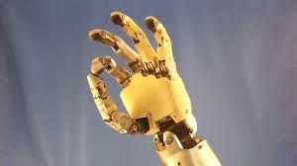
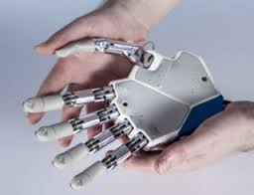
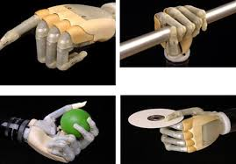
Give Me A Hand

Slide 2
Engagement
Make a fist with your hand.
Try to pick up any object on your desk.
How would you tie your shoe, eat dinner, write?

Slide 3
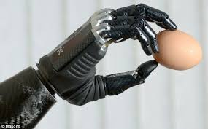
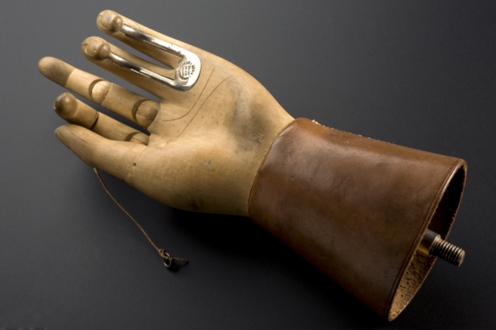
Biomedical Engineers
Biomedical engineers can solve these problems with a prosthetic hand.
Prosthesis is an artificial attachment to replace a missing body part.
Prosthetics used to be motionless
Modern prosthetics move when triggered by electrical signals

Slide 4
Be a Biomedical Engineer
Design Challenge
You will design a prosthetic hand/grabber
The prosthetic hand will pick up and move each of the objects (criteria)
Use only the materials in your baggie (constraint)
Operated by a variety of people on your team (constraint)

Slide 5
Your Materials
DESIGN MATERIALS:
FOR EACH TEAM
6 wooden craft sticks
8 rubber bands of various sizes
3 paperclips
2 index cards
1 plastic spoon
1 plastic fork
Masking tape
TEST MATERIALS:
FOR TEAMS TO SHARE
Cotton balls
Pencils
Containers of marbles
Plastic cups
Sheets of paper
Notes:
Here are the materials you will have to work with. Each team will have a ziploc with their team materials. I will put test materials on your tables for you to share as a table.
Give a moment to look through list.
I will say that if you are not finding just the right rubber band I am willing to trade out for another in this rubber band box if you need to.

Slide 6
Plan and Design
you have a few minutes (2 min) to discuss with your team and sketch out what you would like to build.

Slide 7
Design Tips
Think of your own thumb and fingers as the electrical impulses to make your prosthetic hand move
KEEP TESTING YOUR DESIGN and make improvements as you go along.

Slide 8
Challenge-does your device pick up
Cotton balls
Pencils
Containers of marbles
Plastic cups
Sheets of paper
Share your designs with the other families.
What worked for you?
What challenges did you face?
What adjustments did you make?

