Slide 1
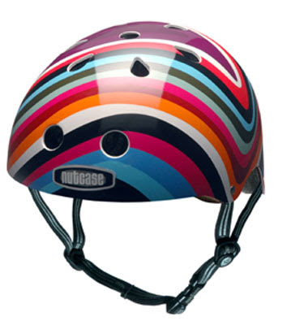
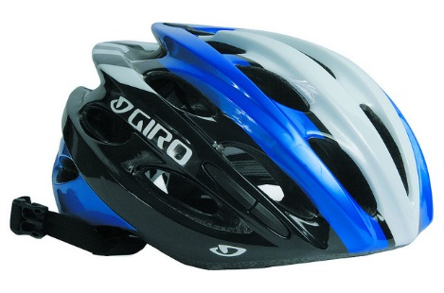
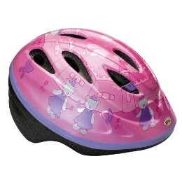
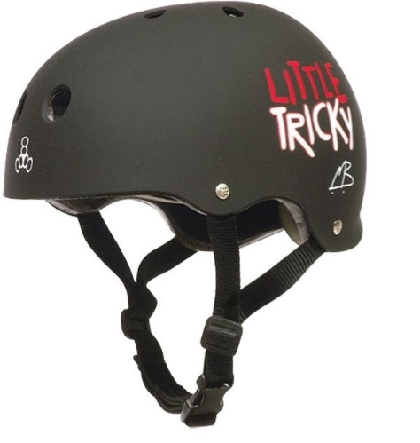
Brain Saver

Slide 2
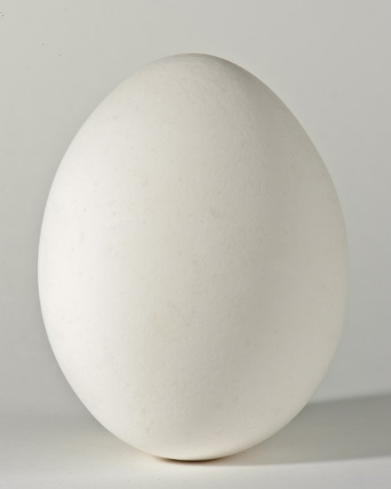
Engagement
Watch as the egg is dropped and discuss the following questions:
What happened?
What if the egg was your head, hitting the ground in a fall while riding your bike or skateboarding?
What should you do to protect your head?

Slide 3
When is it important to wear a helmet?
Should you wear a helmet when:
Riding a bike? Reading a book?
Sleeping at night? Downhill skiing?
Snowboarding? Riding in a car?
Taking a walk? Rollerblading?
Playing hockey? Playing football?
Playing soccer? Swimming?
Taking a boat ride? Riding a horse?

Slide 4
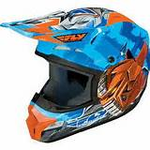
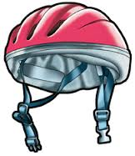
Examine the real helmets and think about the following questions:
What characteristics contribute to a good helmet?
Should it be large or small?
Heavy or light?
Soft or hard on the inside?
Soft or hard on the outside?

Slide 5

Engineers Working Together
Biomedical engineers make sure helmet is comfortable and effectively protects head during the specific activity.
Materials engineers design and select the best materials
Mechanical engineers design how it all fits together and functions effectively

Slide 6
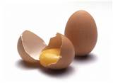
Design Challenge
Design a helmet that will protect an egg “head” from injury when dropped from the top of the ladder.
Helmet Requirements:
Must measure 6 in or less on any side
Cannot use a parachute
May cover whole egg “head”

Slide 7
Plan
As the teacher holds up the materials.
Decide what materials you want to use and draw a design for your helmet.
You have 2 minutes for this process

Slide 8
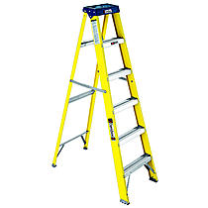
Design
You have 15 minutes to build your helmet.
When you’re ready, test it.
At 7:35 clean up and discuss successes and failures

Slide 9
Hope you enjoyed this challenge!

